Slide 1
MIND CONTROLLED ROBOT BY ADITHYA KUMAR EIGHTH GRADE

Slide 2
ENGINEERING GOAL
The goal of my “Mind Controlled Robot” project is to design a Robot which can be controlled by using brain waves. I developed the robot prototype using Mindwave EEG headset and the Arduino Uno motherboard kit.

Slide 3
EXPERIMENTAL DESIGN
INTRODUCTION
The main goal of my mind controlled Robot is to allow the user to control a simple robot using brain waves. I designed the mind controlled robot using Mindwave Headset, Arduino and a basic robot.

Slide 4
MATERIALS USED
Neurosky Mindwave | Arduino Uno Mother Board
RF Dongle | Two 3-6 volts DC servo motors
Small solderless breadboard | Two-state Power Switch
1 Castor wheel | Two 3D printed wheels
Motor Controller | Chasis
Assorted wires in different colors | Double sided mounting tapes
4 L shaped brackets | Piezo Speaker
Battery pack | 4 AA batteries
4 pin connector | Laptop with Arduino IDE
Screws | Washers
Soldering Iron | Lead free soldering material
Volt meter | Arduino IDE
Hammer, Pliers, Wrench & Knife | Philips screwdriver
Marker

Slide 5
Procedure – Robot Design
Attach the servos onto the servo mounts using 4 nuts and 4 bolts.
Attach the servo mounts onto the chassis with the L-brackets and screws.
Attach the wheels to the mounted servo motors.
Attach the Castor wheel onto the Chassis using 2 washers, 2 nuts and 2 bolts.
Attach the solderless breadboard onto the top of the chassis using the double sided foam tape.
Attach the Arduino uno to the Chassis using 4 nuts. Feed the nuts through the four threaded holes in the Arduino.
Attach the battery pack which powers the servos onto the Chassis and wire them up accordingly.
Attach the motor controller into the bread board as shown in the schematic diagram below.
Wire up both the motors, motor controller and Arduino as shown in the schematic diagram.
Program the Arduino to move the robot front and back using the Arduino IDE. Load the program into the Arduino and test the robot

Slide 6
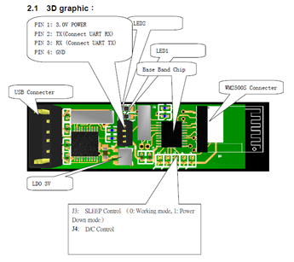
Procedure – Connecting the RF Dongle to Arduino
Connecting the dongle to the Arduino Board requires removing the plastic covering from the dongle and soldering wires to 4 of the pins.
Remove the plastic covering from the USB dongle.
Once the cover is off, the RF dongle board will be as shown in the picture below:

Slide 7
Find the 4 pins, located in the center of the board.
Starting at the end with the ‘ + ‘ sign the pin assignments are:
Pin 1 (starting at +): 3.0 V Power
Pin 2 : TX
Pin 3 : RX
Pin 4 : Ground
Connect a 4 pin connector into these pins.
Connect wires to these 4 pins, leaving enough wire to connect to the Arduino.
Use a Knife to destroy the connections from these PINs to the Chip inside the RF dongle. This is to ensure that the brain wave signals received from the Mindwave is sent to the Arduino and no the internal chip in the RF dongle.
The Mindwave RF dongle uses a 3.3 V power. Connect the +ve of the RF dongle to Arduino’s 3.3 V Output pin.
Connect the dongle’s Tx directly to the Arduino’s Rx(Pin 0). Connect the dongle’s Rx to the Arduino’s Tx (pin 1). You can add a voltage divider to reduce the voltage going to the dongle’s Rx pin because Arduino sends 5V whereas Dongle uses only 3.3 V. It is not absolutely necessary to add a voltage divider but it is good to avoid any harm caused using the excess voltage.
Connect the dongle’s GND to Arduino’s GND

Slide 8
Procedure – Pairing the Mindwave with Arduino (using the RF Dongle)
Turn both the Mindwave headset and Arudino.
The LEDs in the Mindwave and the RF dongle will be red initially.
Pair the RF dongle and the Mindwave headset by sending the instruction 0XC2 to the RF dongle from Arduino.
Once they are paired the LED in both the Mindwave and the Arduino turns blue. The Arduino is ready to received instruction from the Mindwave now.

Slide 9
Procedure – Mind Controlled Robot
Load the Arduino Program into Arudino.
Read the attention level received from the Mindwave through the RF dongle.
If the attention level is greater than 50 (when the user is focusing), move the motors of both the servos forward.
If the attention level is less than 50, move the motors back

Slide 10
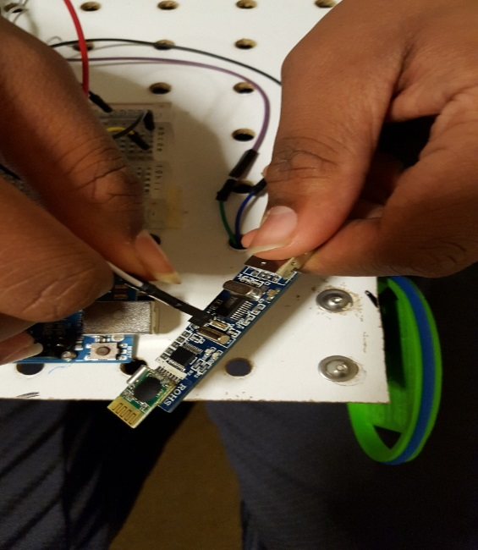
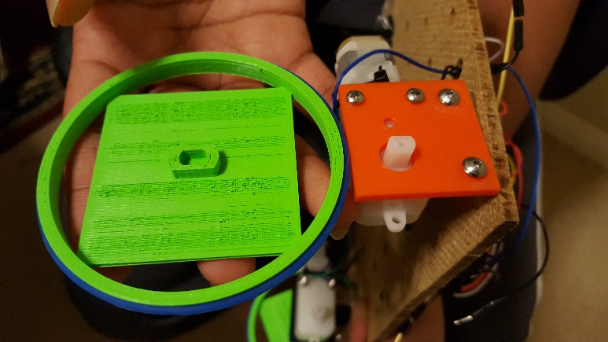
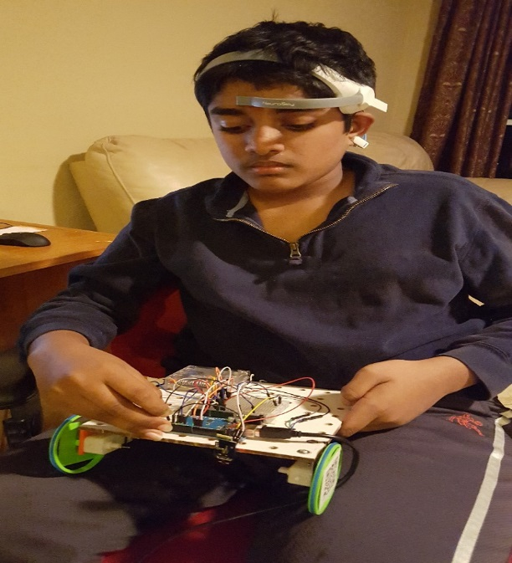
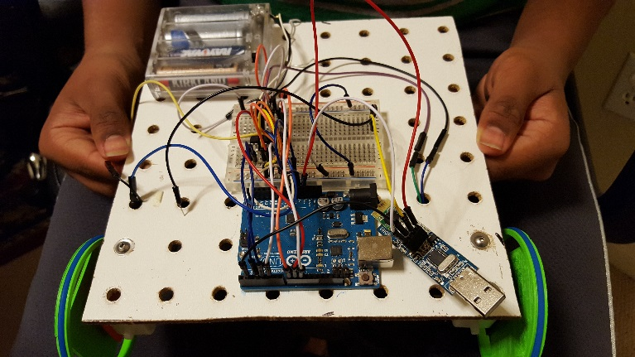
3D Printed Wheels of the Robot
Connecting the RF Dongle with the Arduino
Fully Completed Robot
Mind Controlled Robot In Action

Slide 11
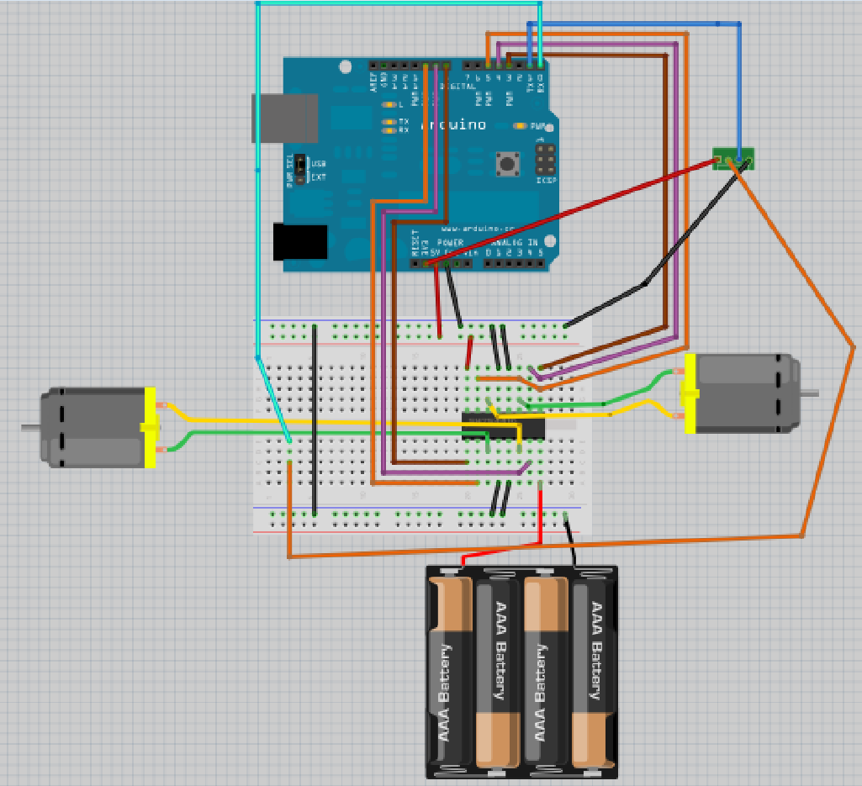
SCHEMATIC DIAGRAM

