Slide 1
AmAN: The Wearable stress monitoring sock
Naveen.K.T.S

Slide 2
Problem
Sharp increase in cardiac patients in recent years
Low doctor to patient ratio even in urban cities
Current healthcare model is shortsighted in nature
Most modern systems are not exactly wearable (Scanadu)
Long term stress monitoring is really uncomfortable
Lack of context while sampling data

Slide 3
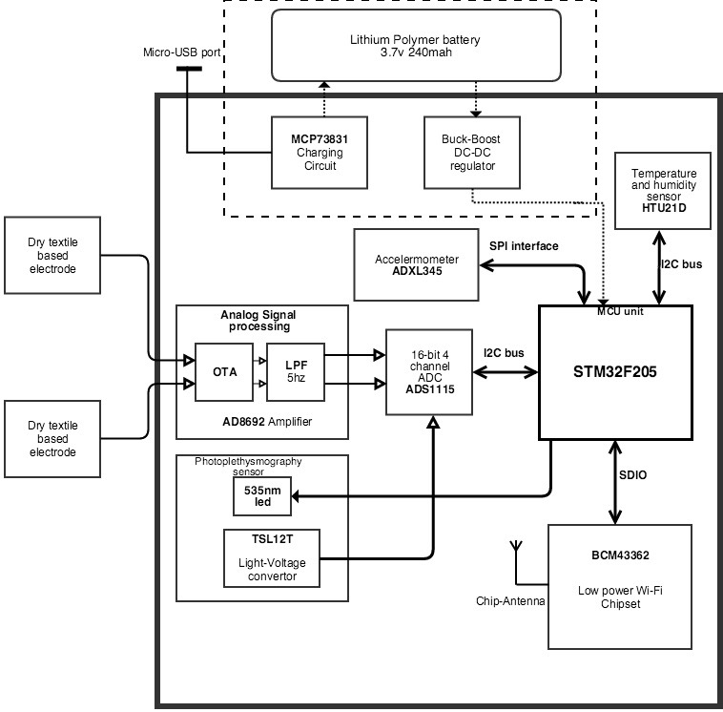
Solution - Aman
Monitor stress comfortably and reliably C1F4B355mj

Slide 4
Solution- Glimpse into the quantified self
Quantify stress (Electrodermal Activity)
Measure ambient environmental parameters like (Temp,Humidity)
Correlation with motion data from IMU
Non obtrusively find heart rate (Using PPG)

Slide 5
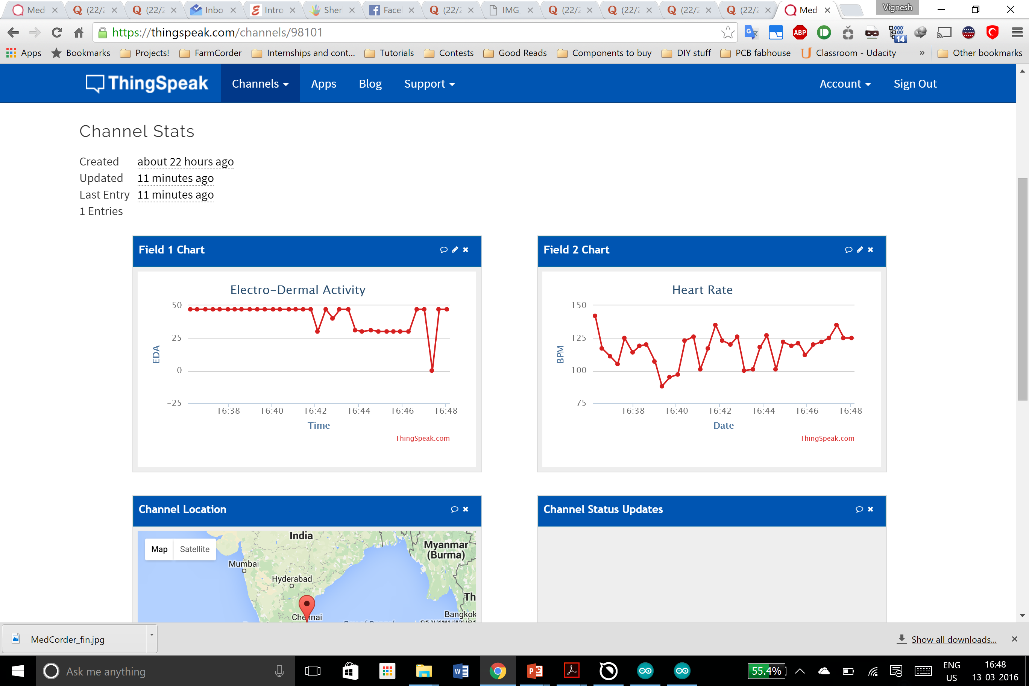
Solution - Aman
A comfortable multiparameter monitoring sock

Slide 6
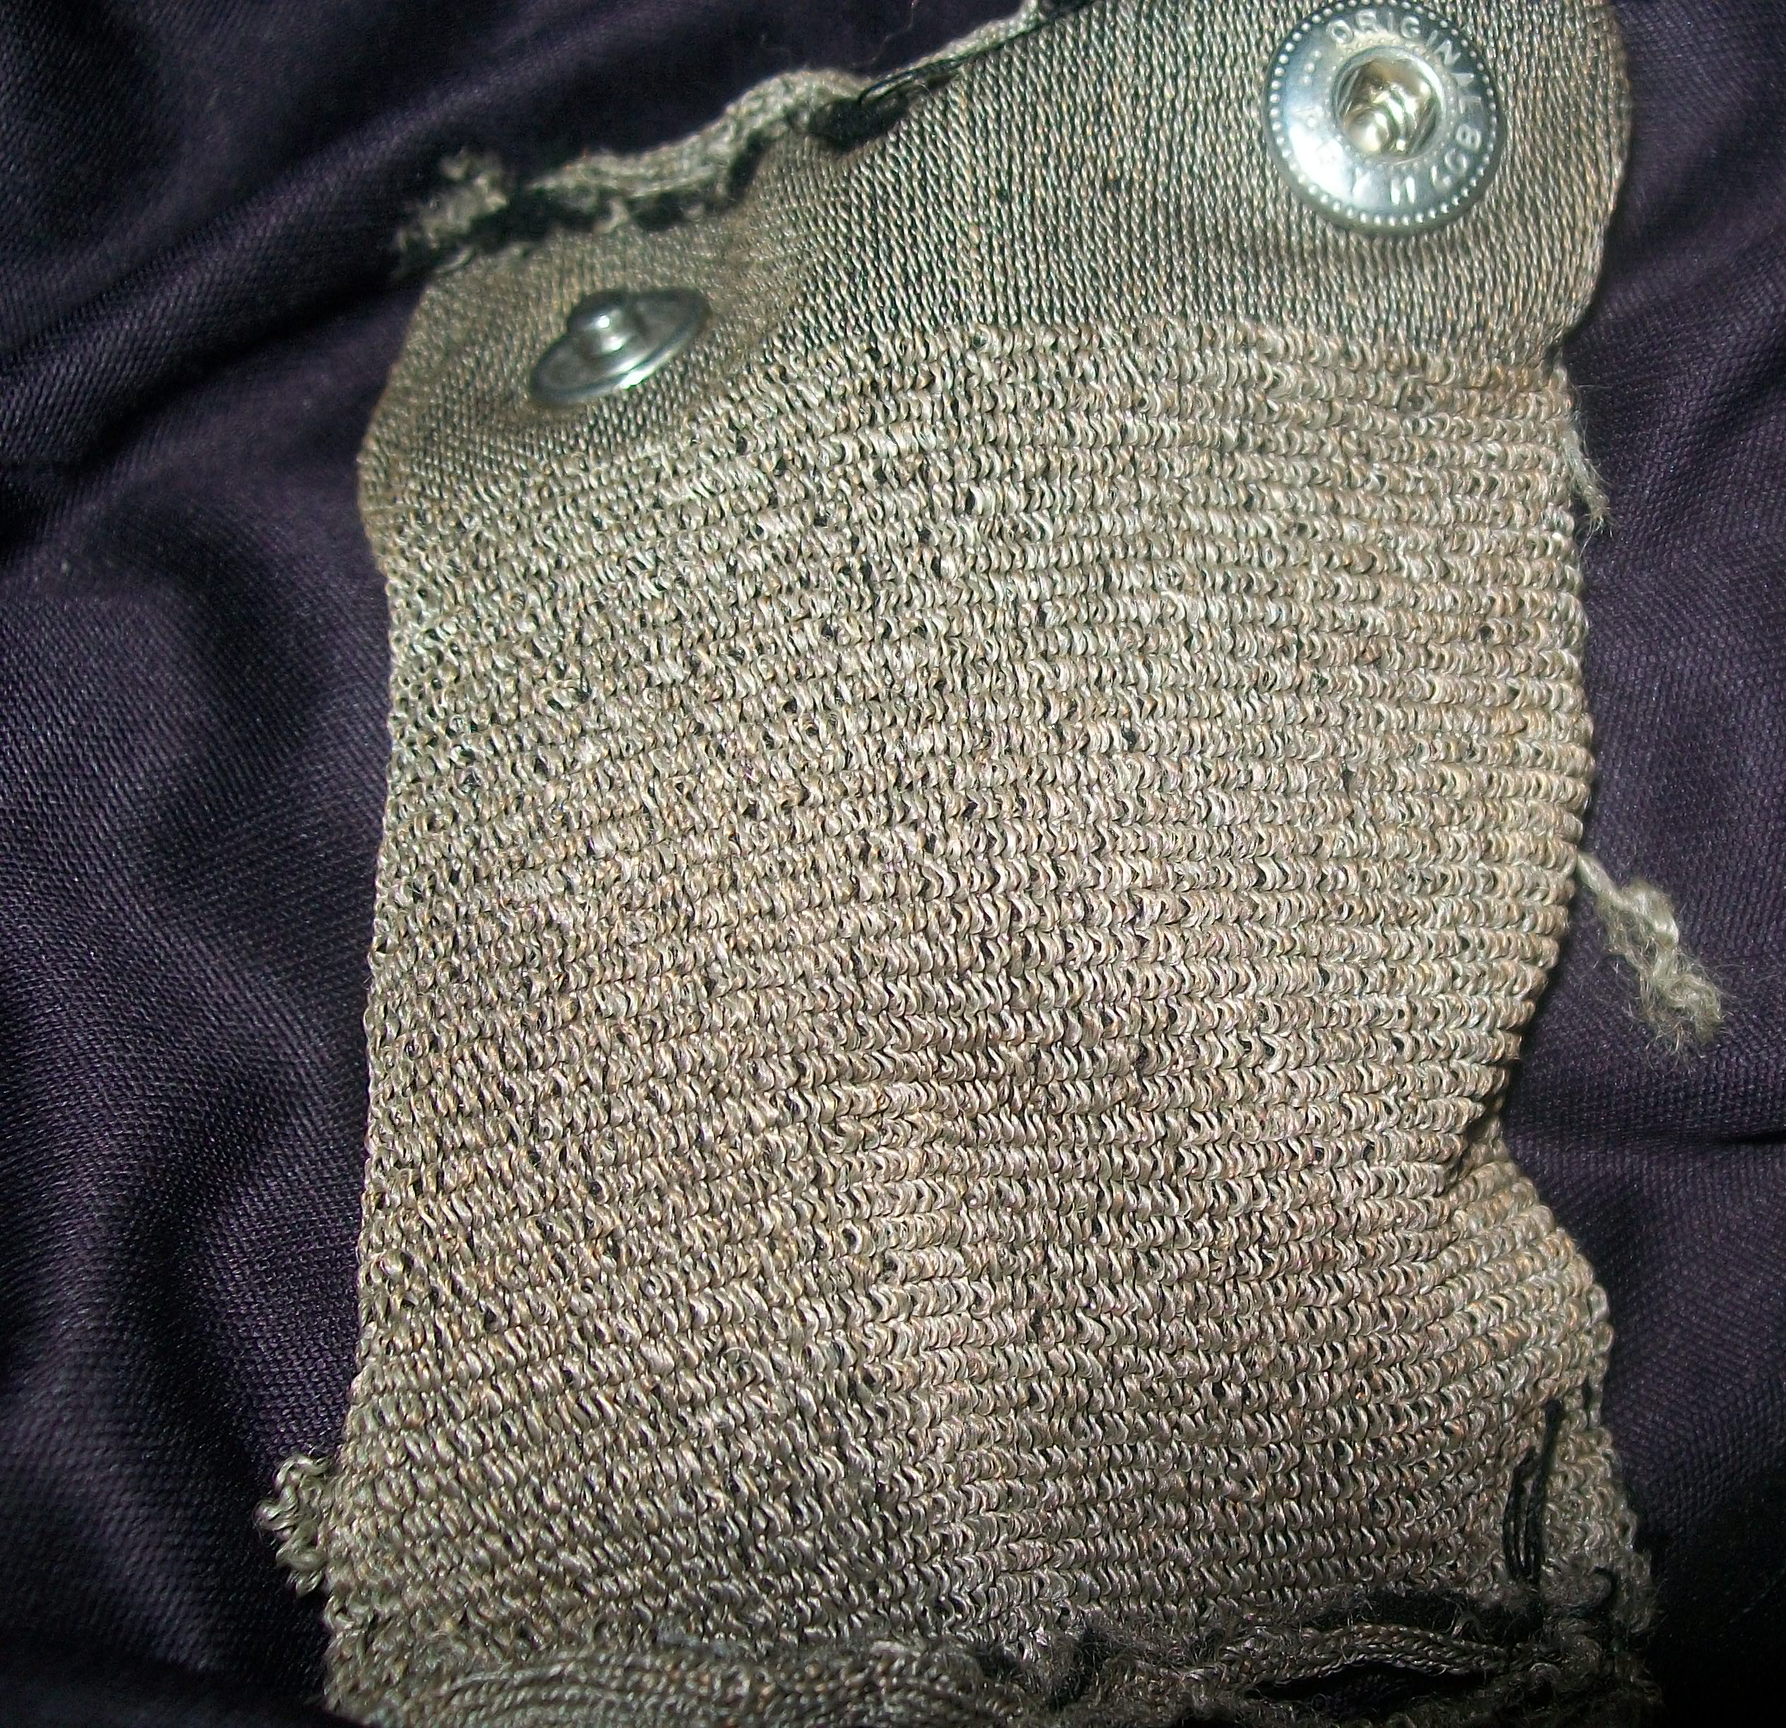
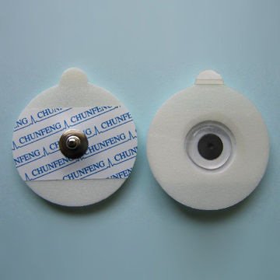
The electrodes
vs
http://image.ec21.com/image/zxmedical/oimg_GC01949681_CA04260667/Disposable_ECG_Electrodes.jpg
Custom Fabric electrodes (Used in Google’s project jacquard)
AgCl “sticky” electrodes

Slide 7
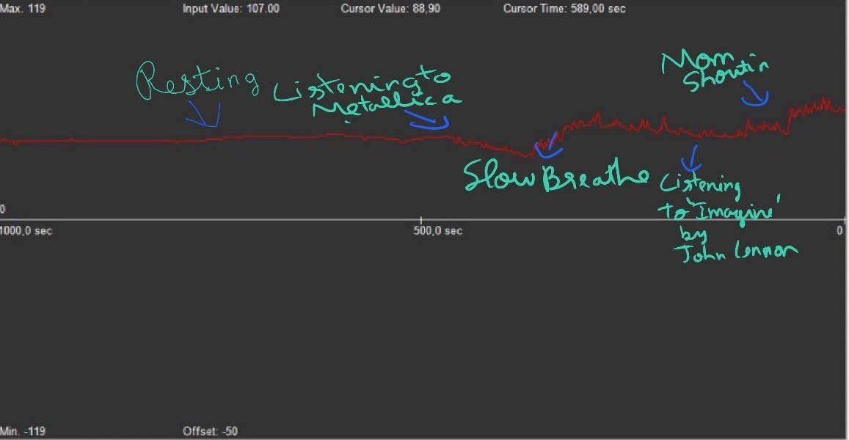
EDA
Accurate Electrodermal Activity
Our end goal is to get clinical quality electrodermal measurements using fabric electrodes. While there is no consensus on the site to measure EDA, We have chosen to measure in the arch of heel. For the prototype we have used a wheatstone bridge arrangement to measure conductivity.

Slide 8
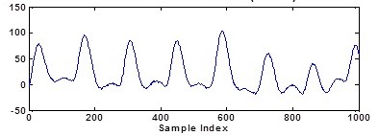
Photoplethysmogram (PPG)
PPG in wrist
Heart rate monitoring from wrist-type photoplethysmographic (PPG) signals during intensive physical exercise
We aim to measure PPG of the toe by integrating it to the sock. Works by measuring absorption of 535nm light by blood. Future versions would also measure SPO2(Pulse Ox).

Slide 9
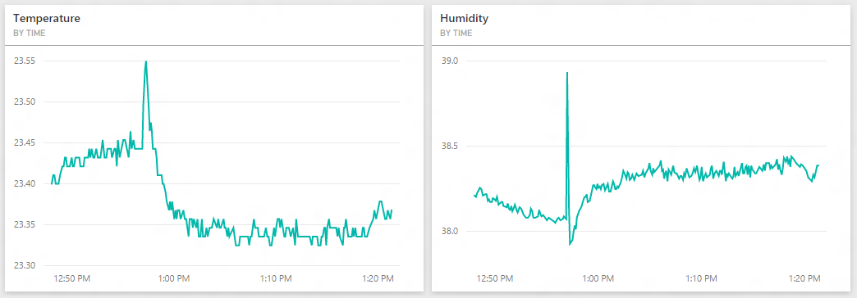
Humidity & Temperature: Give context to measurement
HTU21 I2C humidity sensor is used to measure temp & humidity. Measurement is done to give context to the EDA & HR measurements.

Slide 10
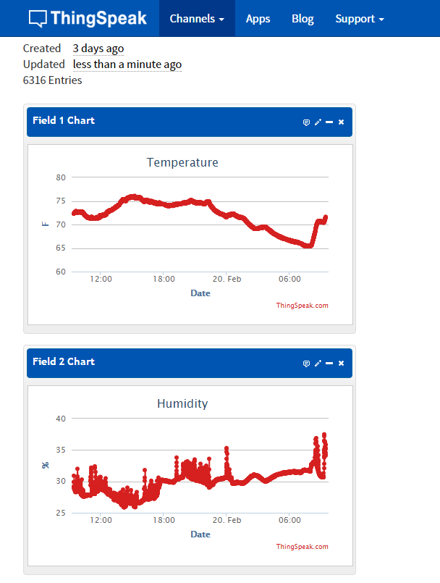
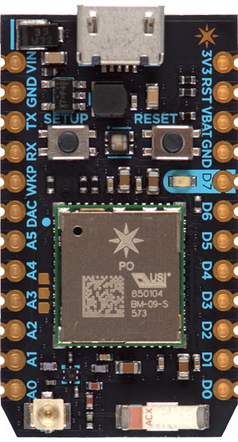
IoT powered analytics: Manage stress better
Using WiFi/BLE to push data to cloud to enable monitoring of vitals.

Slide 11
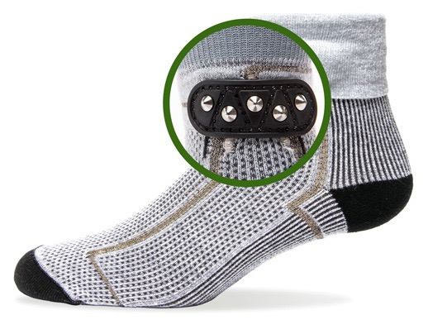
Conclusion:
Final goal is to build a clinical grade, multi-parameter wearable sock to leverage machine learning based diagnostics and help manage stress. In other words to build the “Sherlock” for the IBM Watson
http://cdn.uconnectlabs.com/wp-content/uploads/sites/8/2016/01/ibm_watson-1.png

