Slide 1
FoodBeacon
6$ BLE mesh sensor for food supply chain management

Slide 2
What and why FoodBeacon?
It is a Low cost scalable BLE Temperature & Humidity sensor to prevent food spoilage and enable asset tracking of food.

Slide 3
Causes for Food SpoiIage
Physical damage
Various Fungal and other Microbial bodies
Molds and Yeasts
Browning and Staling
Oxidation

Slide 4
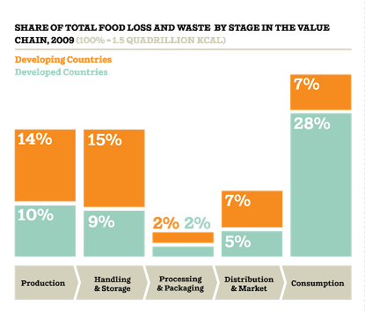
Problems faced due to Food Spoilage
Approximately 1.3 billion tons of food Is wasted every year. This represents around one third of all food generated for human consumption.
Inadequate food for the people

Slide 5
Components Used
HARDWARE
3D Printed Enclosure
LIGHTBLUE BEAN – BLE Sensor NODE
HDC1000 - Relative Humidity & Temperature Sensor
Chip – 9$ Linux Gateway Device
MiCS5524 - VOC & Ethanol Sensor to detect and quantify rot
ADXL345 – Accelerometer to detect & impact vibration during transport
SOFTWARE
NODE-RED
IBM Blumix

Slide 6
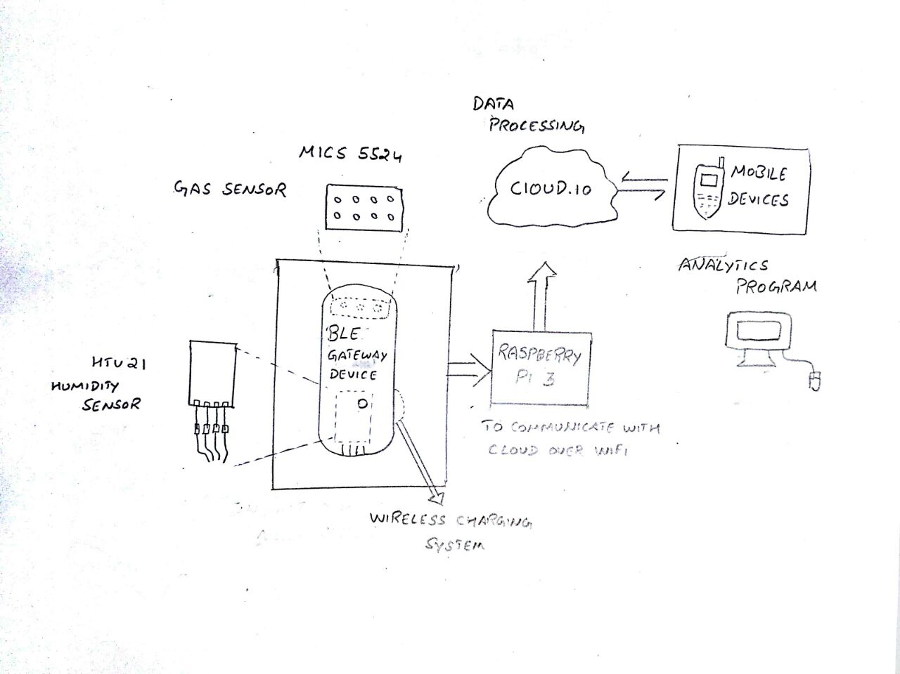
Solution through FoodBeacon

Slide 7
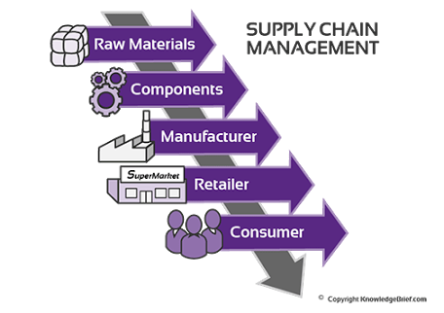
Target customers

