Slide 1
Soil Moisture Sensor Project Two Presentation Two
Colin McAllister & Daeyoo Kim

Slide 2
Project Review
Building wireless soil moisture probe
Controlled by esp32 microcontroller
Powered by single-cell lithium ion battery and solar panel
External temperature compensated RTC manages ESP32’s sleep mode and ensures consistent measurements
Obtains soil moisture by measuring dielectric permittivity of soil with capacitive probe

Slide 3
Probe Schematic
Three core elements to circuit
ESP32
Power management
Real-time clock
Connectors
Programmer board
Solar cell
Battery
Battery thermistor

Slide 4
Power management
MCP73871
Manages single cell lithium battery
Temperature dependent charging using 10kΩ thermistor
Prioritizes load over battery when input voltage is applied
LM3724
Open drain output pin disables ESP32 when lithium cell drops below 2.5v
TPS63021
Buck-boost converter to regulate battery output to 3.3 volts

Slide 5
Programmer board
Wanted a detachable way to program the soil probe
Small board converts USB to Serial
Uses CP2102N USB Bridge
Common design used with most ESP32 breakout boards
Features two BJT transistors that toggle EN and IO0 pins on ESP32 to trigger device to enter bootloader mode
CP2102N independently powered by own 5 volt to 3.3 volt fixed linear regulator
Interfaces with soil probe using 8-pin header

Slide 6
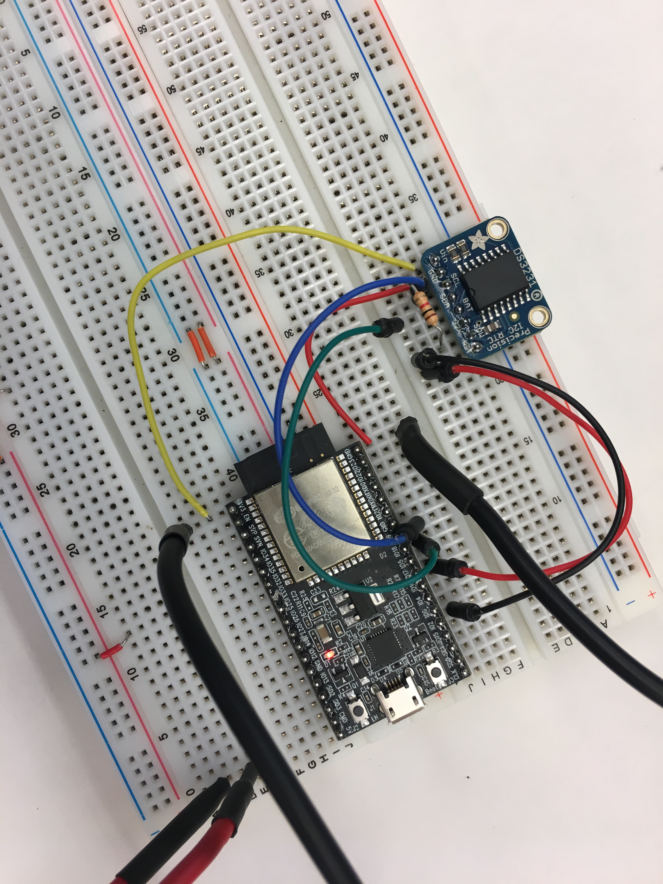
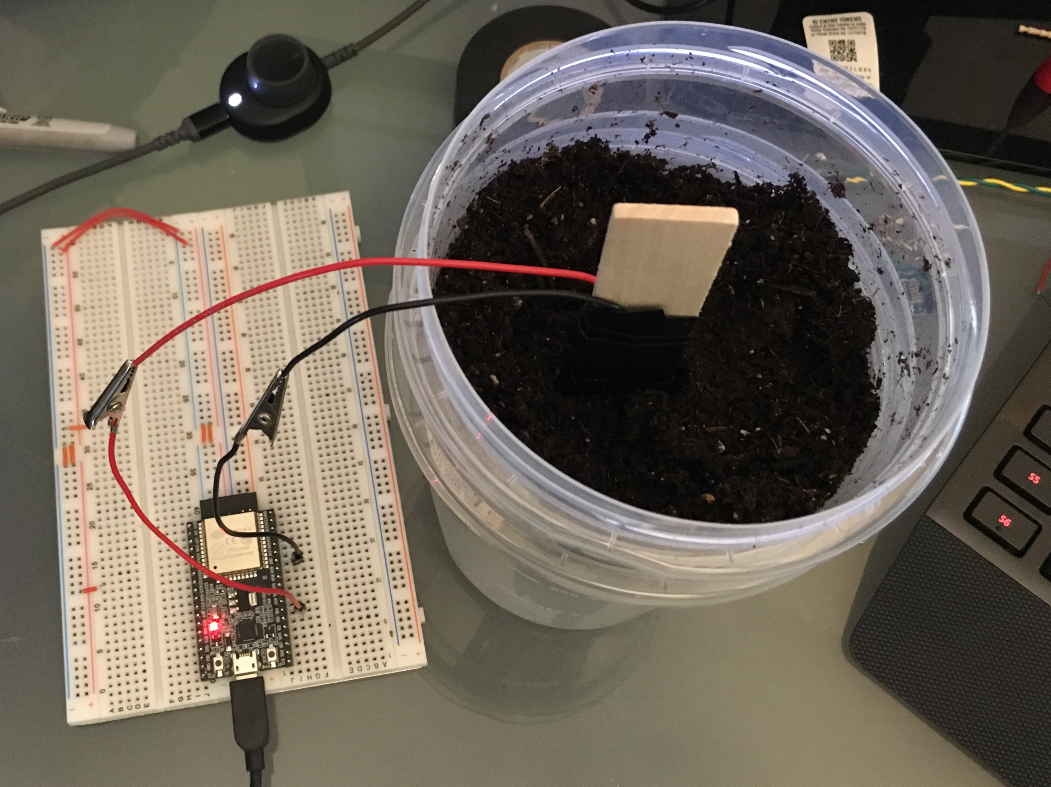
Prototyping
Tested integrating the RTC with the ESP32
Communicates over I2C bus
Programming current time
Setting alarm interrupt and using alarm to wake from deep sleep
Tested capacitive touch pin with measuring soil moisture
Saw slight change in capacitor sensor’s output voltage when placed in different soil moistures

Slide 7
Power testing
Time to conduct and transmit measurement (seconds) | Estimated daily current consumption (mAh)
1 | 58.74
5 | 59.83
10 | 61.19
15 | 62.55
30 | 66.64
45 | 70.72
60 | 74.81
120 | 91.16
Current Consumption at 3.3 volts
In deep sleep: 2.436 mA
Active: 43.3 mA
Assuming 1 measurement per hour

Slide 8
Battery selection
Want to select a battery that will last about a week without solar power
Battery Size (mAh) | Minimum Lifetime (days) | Maximum Lifetime (days)
350 | 3.8 | 6.0
400 | 4.4 | 6.8
500 | 5.5 | 8.5
1200 | 13.2 | 20.4
2000 | 21.9 | 34.1

Slide 9
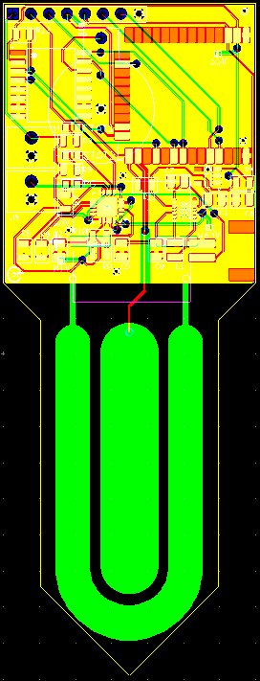
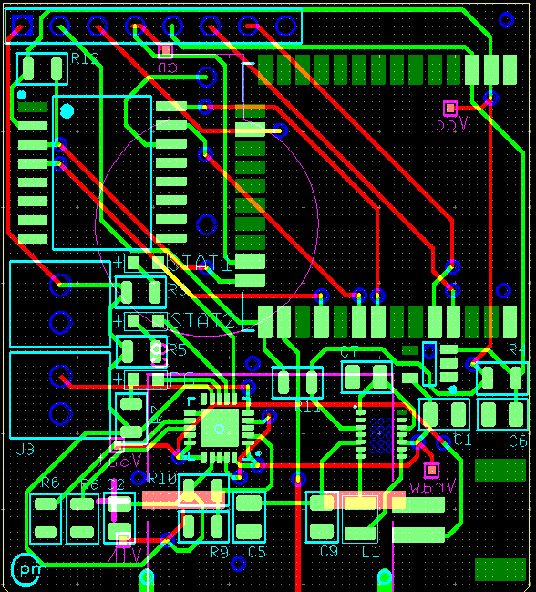
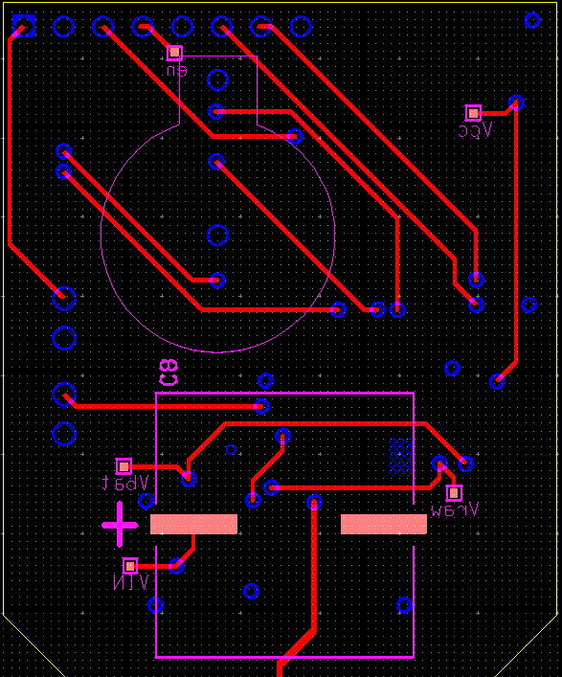
Moisture sensor board layout
Board size:
1.4” x 3.7”

Slide 10
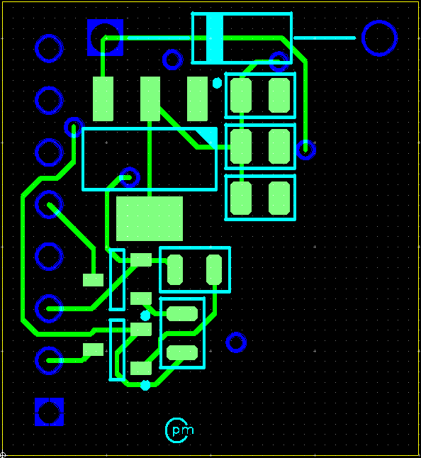
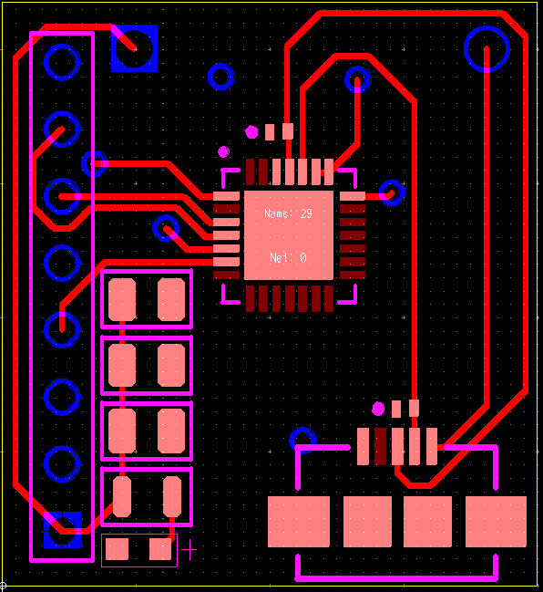
Programmer board layout
Board size:
0.8” x 0.87”

Slide 11
Software
Code written in C and compiled with Espressif’s ESP-IDF SDK
Structure: one main file plus two libraries
Main file
Measures soil, establishes wireless connection, and uploads to static IP over TLS/SSL
Nonvolatile memory helper library
Stores and retrieves variables saved in nonvolatile memory
RTC helper library
Configures and reads/writes to RTC over I2C
Code available on Github
https://github.com/colin-pm/soil_moisture_meter

Slide 12
Questions?

