Slide 1

Novasaur TTL Retrocomputer
Building a Computer
From Scratch
VCF East 2023

Slide 2

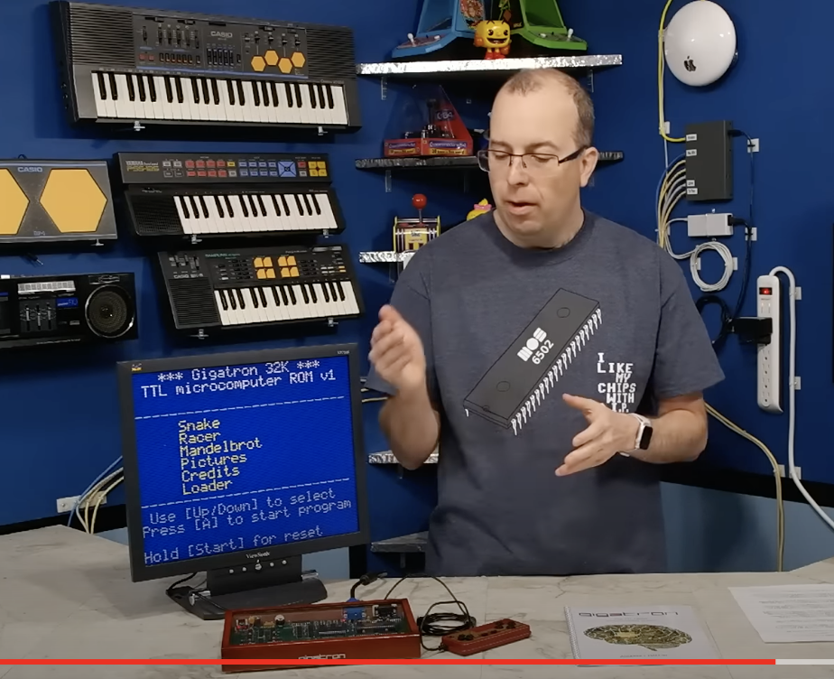
40 Years in the Making
1979 - First logic circuit (half adder)
1983/4 - Original CPU design
1986 - Digital Systems Engineering
1991 - Production Engineering
2018 - Gigatron release
2019 - Novasaur begins

Slide 3
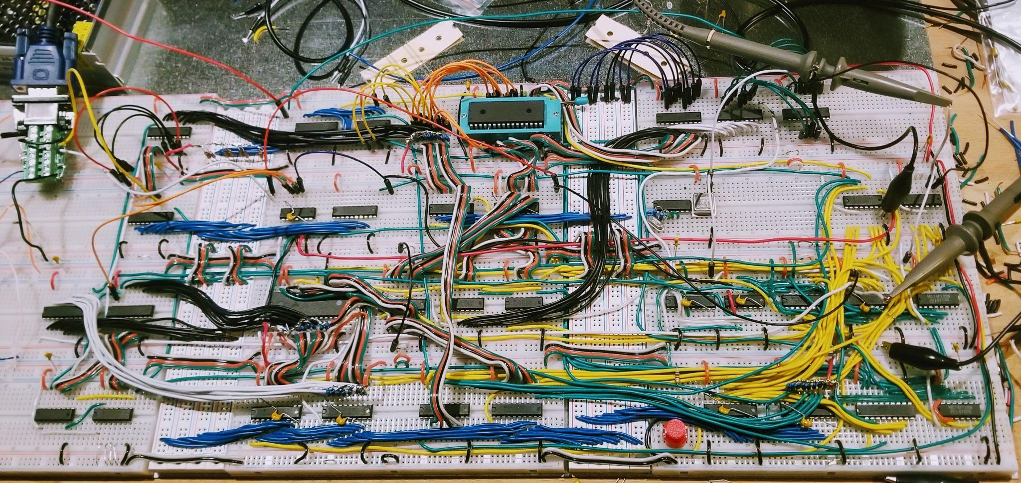
Novasaur Rev ‘0’

Slide 4
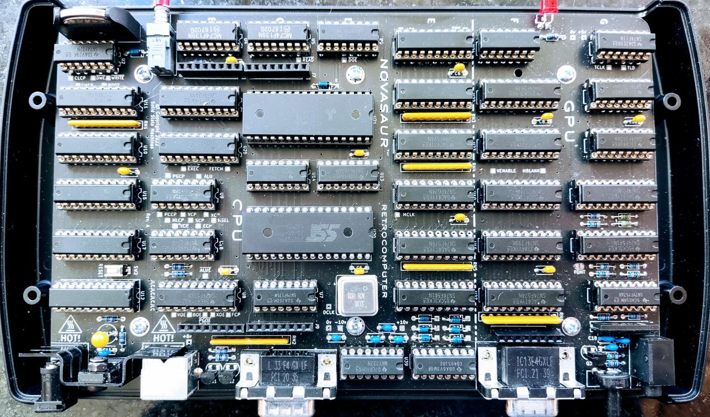
Novasaur Rev ‘A’

Slide 5
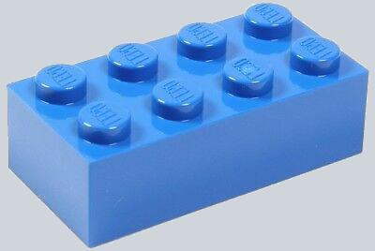
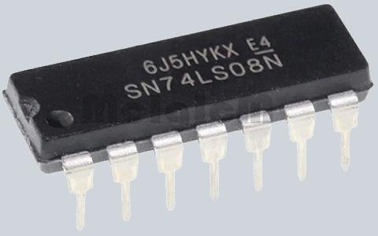
Hardware Requirements
Simple building blocks
1970’s technology - exists EOY 1979
Readily available - 50+ years later?
74-series TTL chips - not CMOS
Scorched-earth minimalism
Fast enough to be useful

Slide 6
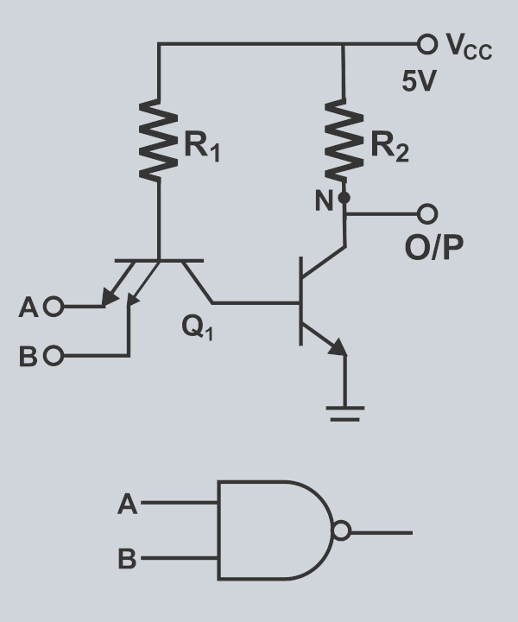
Technology
TRANSISTOR-TRANSISTOR LOGIC
POWER
mW
S
H
20
ADVANCED SCHOTTKY
SCHOTTKY
10
AS
F
ALS
LS
L
0
1
3
10
30
SPEED
ns

Slide 7
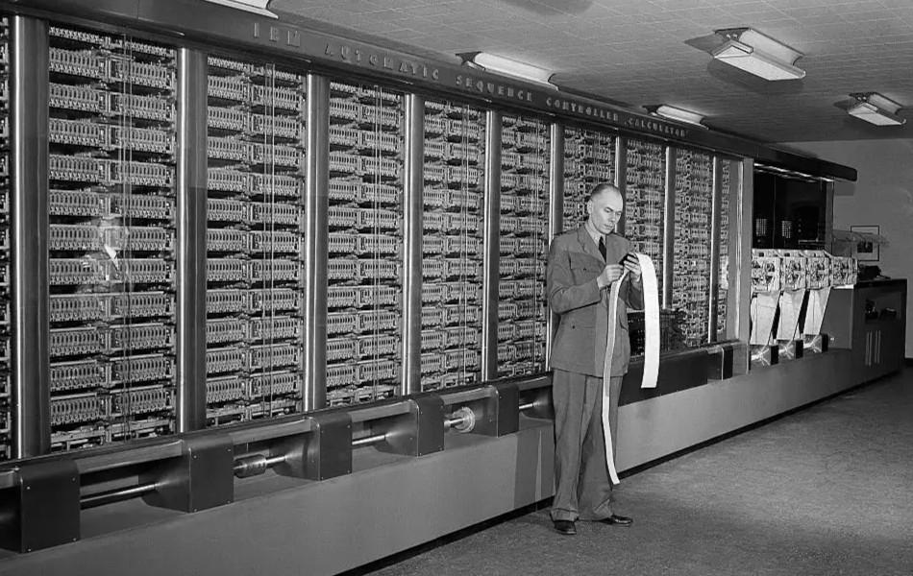
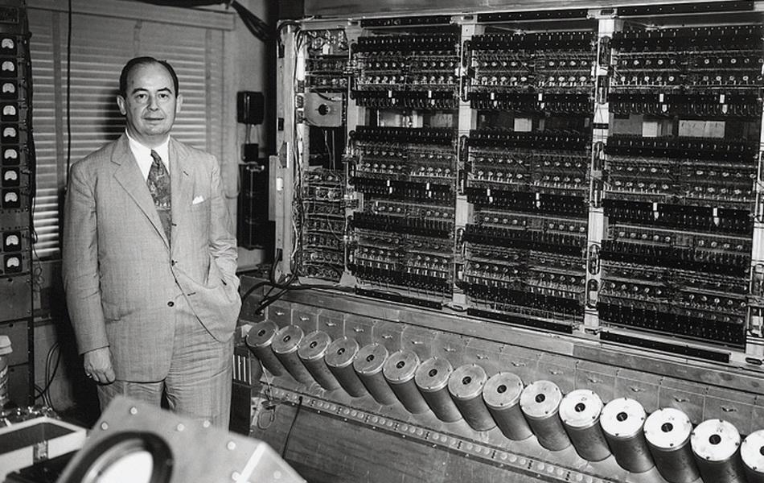
Computer Architectures
Harvard
von Neumann
Harvard Mark 1
Punch tape is the program memory
EDVAC
Stored program (loaded from tape)

Slide 8
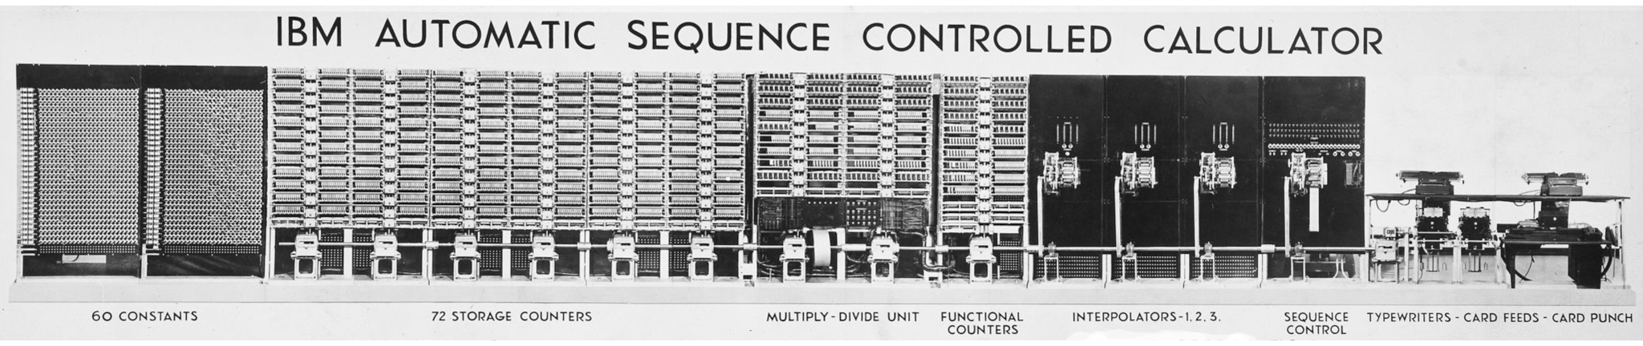
Harvard Mark 1
Data Memory
Program Memory
Storage Counters
(23 decimal digits)
Paper Tape
(24 bit instructions)

Slide 9
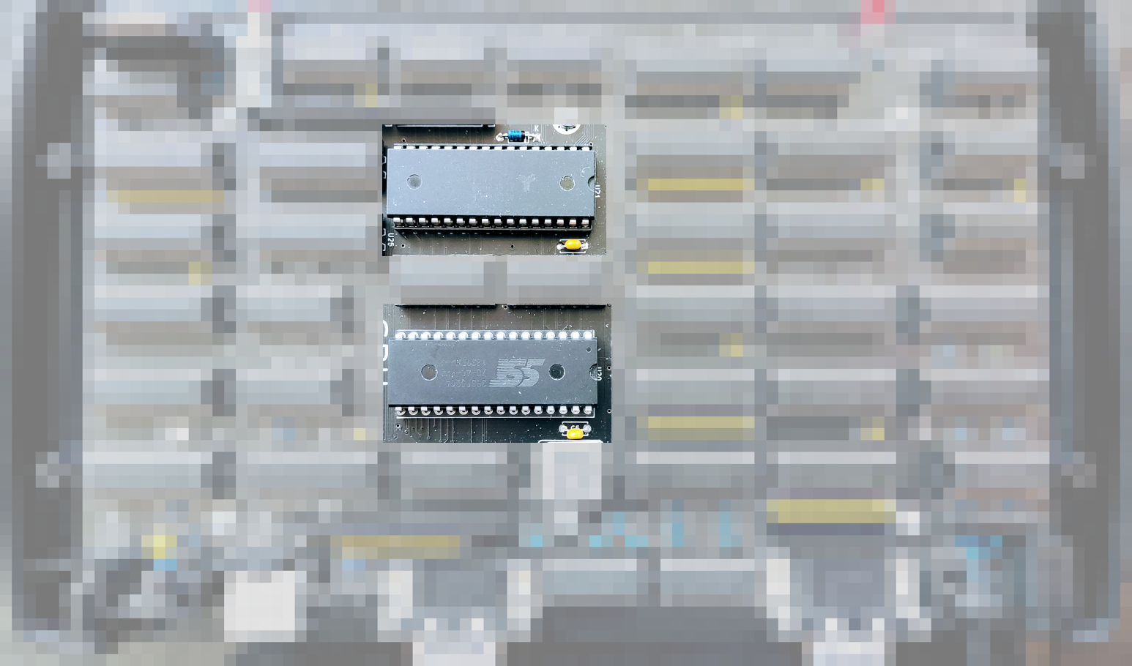
Harvard Architecture
Data Memory
Program Memory

Slide 10
Harvard Architecture
ALU
Control
Unit
I/O
Program Memory
Data Memory

Slide 11
Simple Addressing
Page
PC
ALU
X
Y
Control
Unit
-8 bit
-8 bit
Program Memory
|
8
bit
Data Memory
8-bit page register
Single 8-bit counter
No address bus needed
*one index per memory
8-bit X register
8-bit Y register

Slide 12
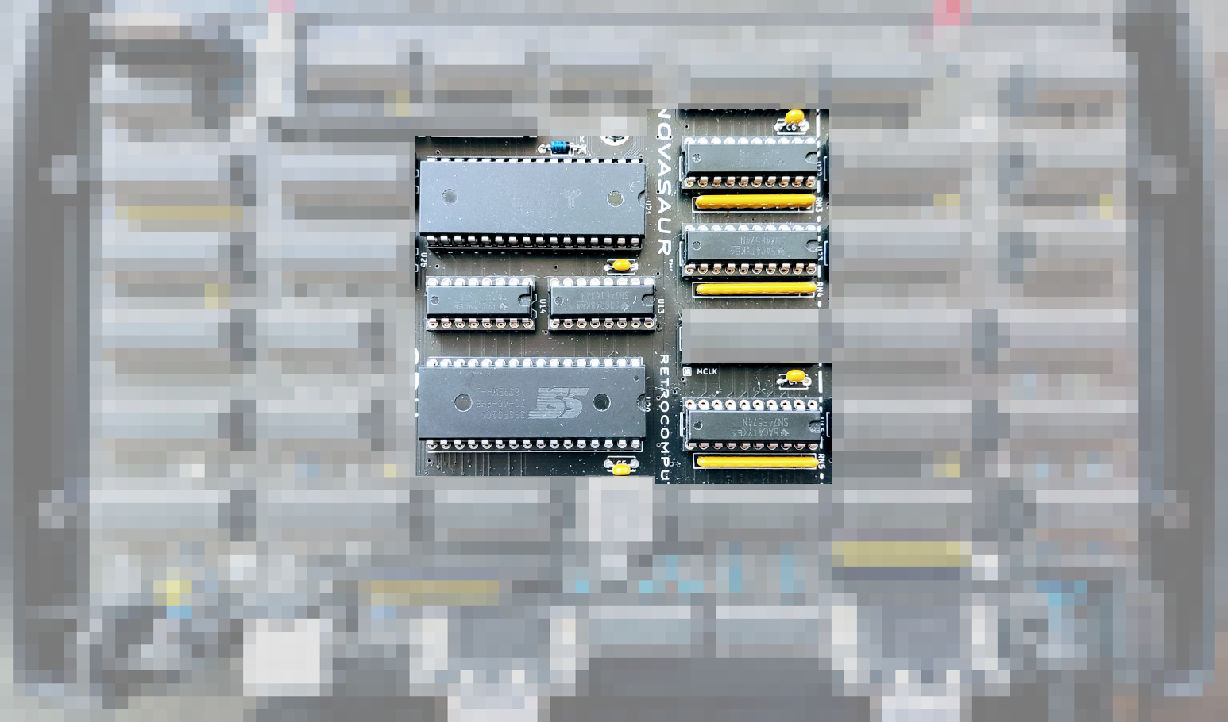
CPU Addressing
X Register Y Register
Program Counter
Page Register

Slide 13
Minimal ‘Toy’ Computer
Instructions are represented as a Control Word
The Control Word defines:
  A data Source - program or data memory
  An ALU operation to perform - add A or 0
  A Destination - any register and/or data memory
Every instruction is an ALU operation
Every register takes its input from the ALU

Slide 14
Does it Work?
Page
PC
ALU
X
Y
CW
A
Program Memory
Data Memory

Slide 15
Can it Increment the X Register?
Assume the value is saved in memory address [33, 55]
X = 55 + 0 # set X index of stored value
Y = 33 + 0 # set Y index of stored value
A = 1 + 0 # set up an increment function
A = [Y, X] + A # increment stored value
A → [Y, X] # update stored value
X = 0 + A # set X with incremented value

Slide 16
Can it be Improved?
Assume the value is saved in memory address [33, FF]
X = 55 + 0 # use a “zero page”
Y = 33 + 0 # set Y index of stored value
A = 1 + 0 # set up an increment function
A = [Y, X] + A
A → [Y, X] # combine as [Y, FF],X = [Y, FF]+A
X = 0 + A

Slide 17
Can it get Smaller?
Page
PC
ALU
X
Y
CW
A
Program Memory
Data Memory
Lookup Table

Slide 18
Lookup Table Options
Fn
Fn
Fn
4x4-bit addr
Pro - small
Con - complex
2 cycles, carry, intermediate result register
8x4-bit addr
Trade off
2 cycles, no carry, A is intermediate,
8k per function
8x8-bit addr
Pro - simple
Con - large
64k per function

Slide 19
Example 8x4 Table Addition
2
9
5
8
8
3
1
5
8
1
A =
HL =
+L
Lookup 1 :
A = A + L
+H<<4
Lookup 2 :
A = A + H<<4

Slide 20
ALU Addressing
HL
B
X
Y
CW
A
-4 bit
-8 bit
Program Memory
as
ALU
|
4
bit
Data Memory

Slide 21
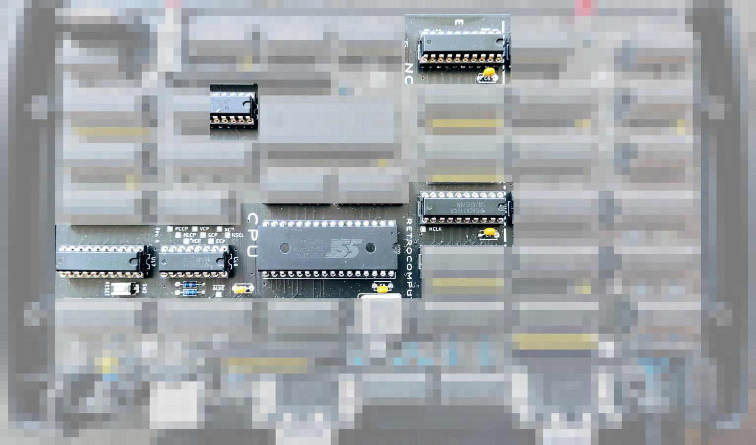
ALU Addressing
A Register
ALU Func
B Register
HL Reg
HL Sel

Slide 22
ALU Functions
40
MV - move HL to dest
ADD - addition (no carry)
AF - arithmetic flags
AND - logical AND
OR - logical OR
XOR - logical XOR
WAV - wave table
DIS - dispatch page
MUL - multiply (8=4*4 bits)
DIV - divide (4=8/4 bits)
COM - comms state
VID - video timing
FNC - unary functions
FND - unary (8080)
FNE - unary (VM)
FNF - unary (default)

Slide 23
Default Unary Functions
IDEN A = A
INC A = A + 1
INC2 A = A + 2
DEC A = A - 1
1COM A = !A
2COM A = -A
LSR A = A >> 1
LSL A = A << 1
ZERO? A==0?
KERN? bank==1?
INCLINE inc VM line
INCBLK inc VM block
NSR A>>1 | 0x80
SWAP AB = BA
REVERSE reverse bits
AUDIO flip sign

Slide 24
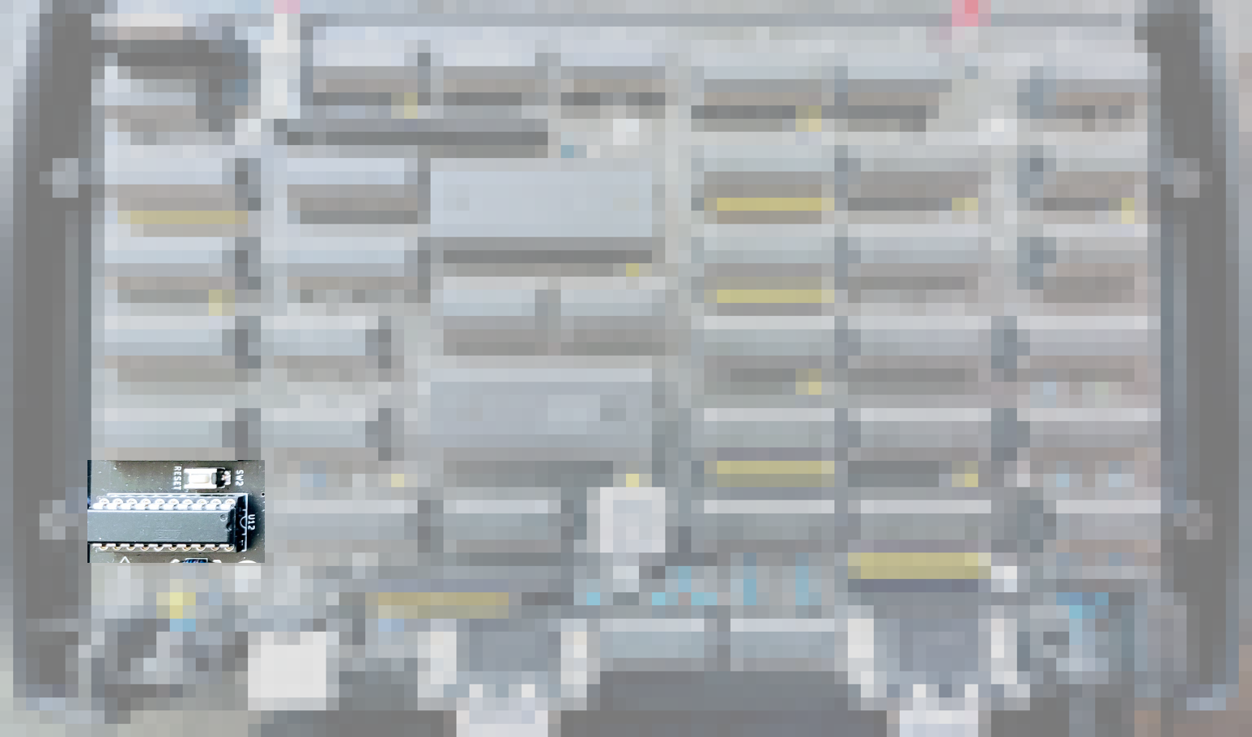
Execution State Machine
Generic Array Logic
(16R4 circa 1978)

Slide 25
Execution Sequence
FETCH
READ
EXECUTE
WRITE
Read control word from Program Memory
Decode
and
Read data from
Data Memory
Read ALU or immediate value from Program Memory
Write result to register and/or Data Memory
Single CPU cycle
x2

Slide 26
Memory Concurrency
FETCH
READ
EXECUTE
WRITE
ROM
RAM
ROM
RAM
READ
LOOKUP
READ
N/A
RAM
ROM
RAM
ROM

Slide 27
Introducing the ‘’ GPU ’’
Transparent DMA - read RAM while CPU reads ROM
Add Horizontal counter and Vertical index register
Graphics Mode - one byte per pixel (256 colors)
Text Mode - two bytes per char (ASCII, 8 colors)
  Read character code point from RAM
  Lookup glyph data in ROM → shift register
  Read FG/BG/Font value from RAM

Slide 28
GPU Addressing
S
B
H
V
G
F
-5 bit
-8 bit
Program Memory
as
FONT
|
2 bit
BANK 0 as
Video Memory

Slide 29
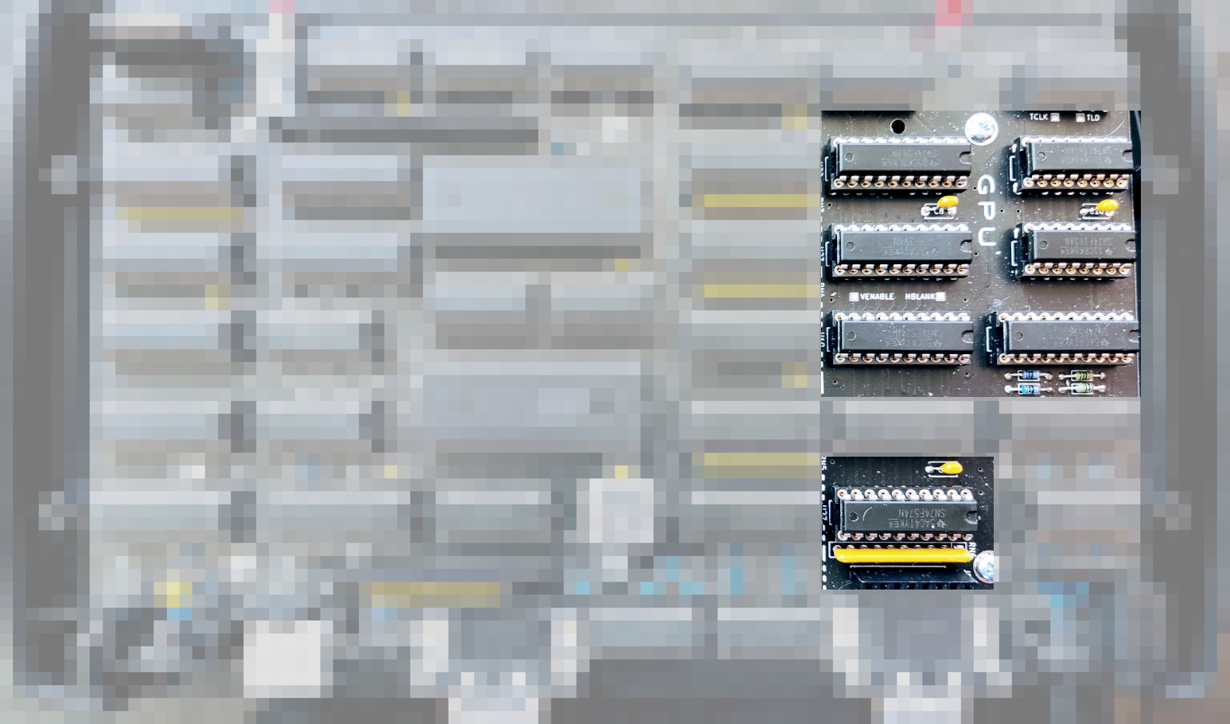
GPU Addressing
H Counter
V Register
S/F Register
G Register

Slide 30
256k ROM Memory Map
BANK 0
BANK 1
BANK 2
BANK 3
Program
64k
Storage
64k
ALU
high
ALU
low
Font

Slide 31
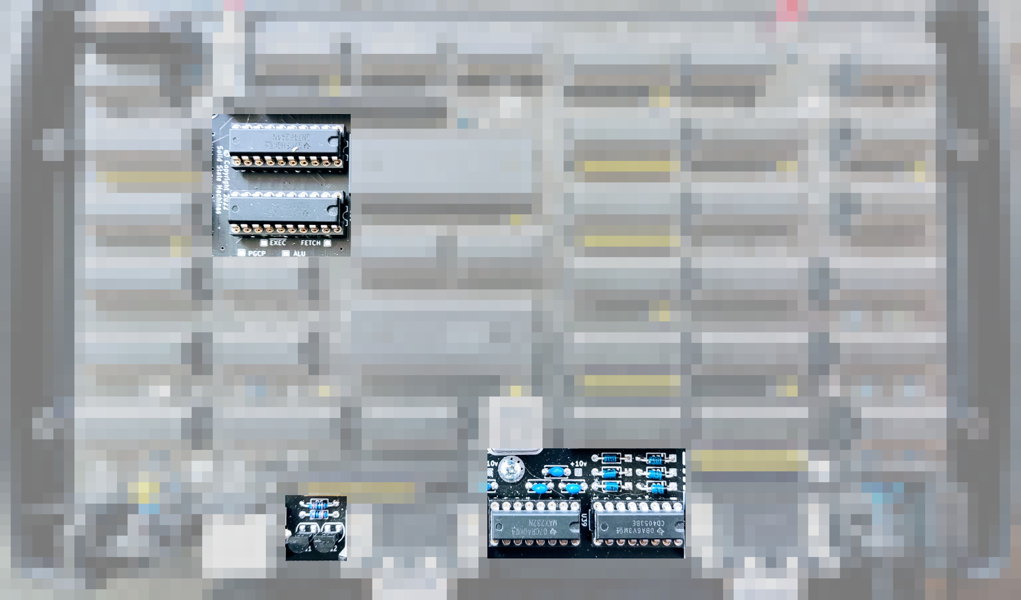
Input/Output
Ei Buffer
Eo Register
Line Driver
Analog Switch

Slide 32
Ei/Eo Register
KB CLK
KB
RX
CTS
RX
expansion
VID MODE
KB
EN
RTS
TX
RAM BANK
30
7 6 5 4 3 2 1 0
INPUT
7 6 5 4 3 2 1 0
OUTPUT

Slide 33
512k RAM Memory Map
BANK 0
BANK 1
BANK 2
BANK 3
Video
60k
64k
64k
64k
64k
64k
64k
64k
System
BANK 4
BANK 5
BANK 6
BANK 7

Slide 34
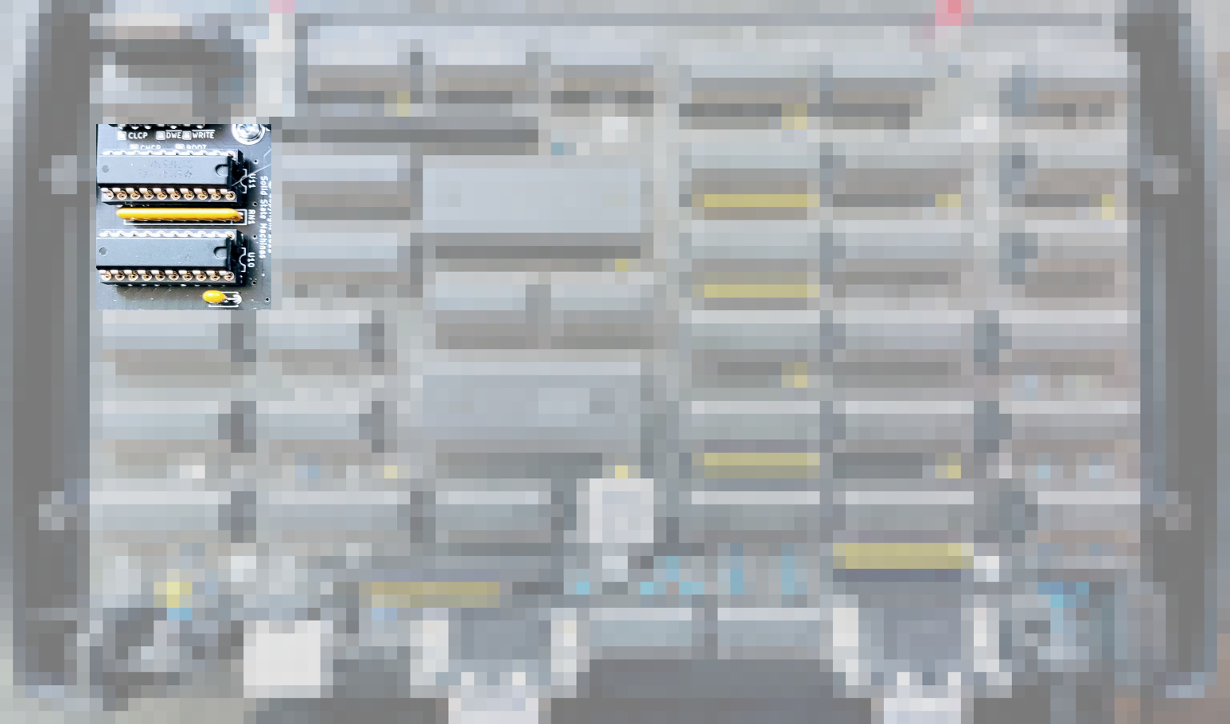
Control Word
Control Word

Slide 35
Control Word
EXEC MODE
SRC
ZP
WR
DEST REG
ALU FUNCTION
SRC
ZB
1
MODE
SRC
ZP
WR
DEST
7 6 5 4 3 2 1 0
2-CYCLE FETCH
7 6 5 4 3 2 1 0
1-CYCLE FETCH

Slide 36
Execution Modes
0 | 4-cycles | ALU | HL→A
1 | 3-cycles | ALU | L
2 | 3-cycles | ALU | H → A
3 | 3-cycles | ROM | H
4,5* | 1 or 2-cycles | LOAD | * conditional on A sign
6,7 | 2-cycles | FNF | H → A, H

Slide 37
Increment the X Register
Code | Assembler | Description | Cycles
9433 | LD Y, 0x33 | Immediate load Y | 2
9510 | LD HL, 0x10 | Immediate load HL | 2
58FE | FNFH DZ, XD | [Y,FF] , X = FNF ( H , [Y, FF] ) | 3
6 Bytes |  | ~850ns @ 121ns/cycle | 7 Cycles

Slide 38
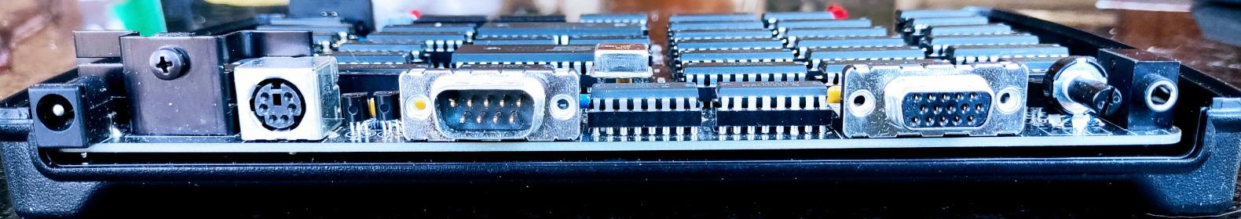
How does it actually work?
Keyboard
Serial
Video
Audio
PS/2
US/English
RS232
CTS/RTS
VGA, SVGA, XGA
60,75Hz Refresh
3 Voice, 1 Noise
ADSR

Slide 39
Software Requirements
Concurrent protocols - lots of state
Critical timing - lots of control
No Interrupts - protocols too fast to restart
Cannot Yield - no user program on hardware
Stored Program - user program → data memory
Interpreter - virtual CPU with existing ISA

Slide 40
Software Stack
Application
User Program
CP/M
BIOS
Micro Kernel
Disk
Timers
TTY
Console
Hardware Abstraction Layer
v8080 CPU
Hardware
Keyboard
Serial
Video
Audio

Slide 41
Video
Blanking
V-sync driven by SW
Blanking
Active Video
H-sync
driven by HW

Slide 42
Video Modes
Mode | Resolution | Text Columns | Lines
VGA | 640 × 480 | 104 | 525
VGA @ 75 | 640 × 480 | 80 | 500
SVGA | 800 × 600 | 80 | 628
XGA | 1024 × 768 | 64 | 806

Slide 43
Video Control
VID function
20
Update indexes - S + V - reset H
Count lines - 500-806 - reset V
Line count > 9-bits
Use ALU lookup
  Block count - 8 bits
  Line count - 4 bits

Slide 44
Blocks of Lines
BLOCK0
VID
COM
Reset Count
0
VID
COM
1
LINE
VID
COM
2
VID
COM
3
BLOCK1
VID
COM
Count
0
VID
COM
1
LINE
VID
COM
2
VID
COM
3

Slide 45
Virtual Machine Cycle
Break line into columns
  VGA (31.5 kHz) ~ 192 kHz / 6
  SVGA (37.9 kHz) ~ 192 kHz / 5
  XGA (48.4 kHz) ~ 192 kHz / 4
Speed limit - 55ns memory = 18 MHz
Use 16.5 MHz - process cycle = 8.25 MHz
43-cycle VMC - 191.86 kHz

Slide 46
VGA
S
B
1
2
3
4
S
5
6
7
8
9
S
10
11
12
13
14
18 VMCs/block, 10659 blocks/second, 175 blocks/frame

Slide 47
SVGA
S
B
1
2
3
S
4
5
6
7
S
8
9
10
11
S
12
13
14
15
20 VMCs/block, 9593 blocks/second, 160 blocks/frame

Slide 48
XGA
S
B
1
2
S
3
4
5
S
6
7
8
S
9
10
11
S
12
13
14
20 VMCs/block 9593 blocks/second
161 blocks/frame

Slide 49
Virtual Machine State
MODE LINE
EXT
CYCLE
VMS BYTE
Line count Column Count
0,1,2 0,1,2,3,4,5
3,4,5,6 0,1,2,3,4
7,8,9,10 0,1,2,3,4
11,12,13,14,15 0,1,2,3

Slide 50
VM Dispatch
~30 CYCLES
OF CODE
VMS+1
DISPATCH
~72 CYCLES
OF CODE
VMS+2
DISPATCH
Each page is VM operation
84 pages for 8080
Page = DIS ( VMS, INST )

Slide 51
vCPU Execution Sequence
S
B
F
E
F
S
E
F
I
S
E+F
E
S
F
E+F
I
1 VMC FETCH +1,2,3 VMC EXECUTE (~2.3 VMCs per 8080 instruction)

Slide 52
Threads
S
B
F
K
C
S
A
A
A
S
T
1
2
3
S
R
4
5
6
reset Frame (60/75 Hz), start Keyboard scan (15 Hz), update Clock
6 secs
12 mins
24 hrs
BLOCK
AUDIO
TRANSMIT
RECEIVE

Slide 53
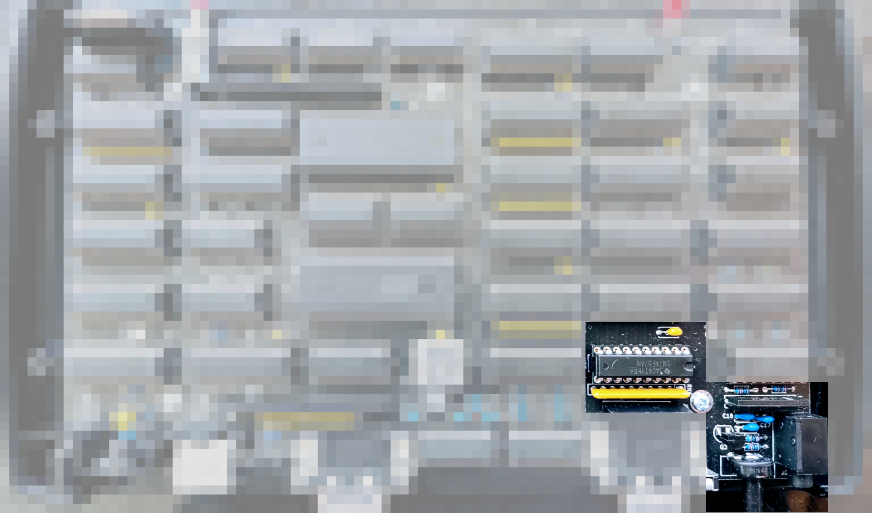
Audio
BLANKING
G Register
R2R DAC
Filter/Amp

Slide 54
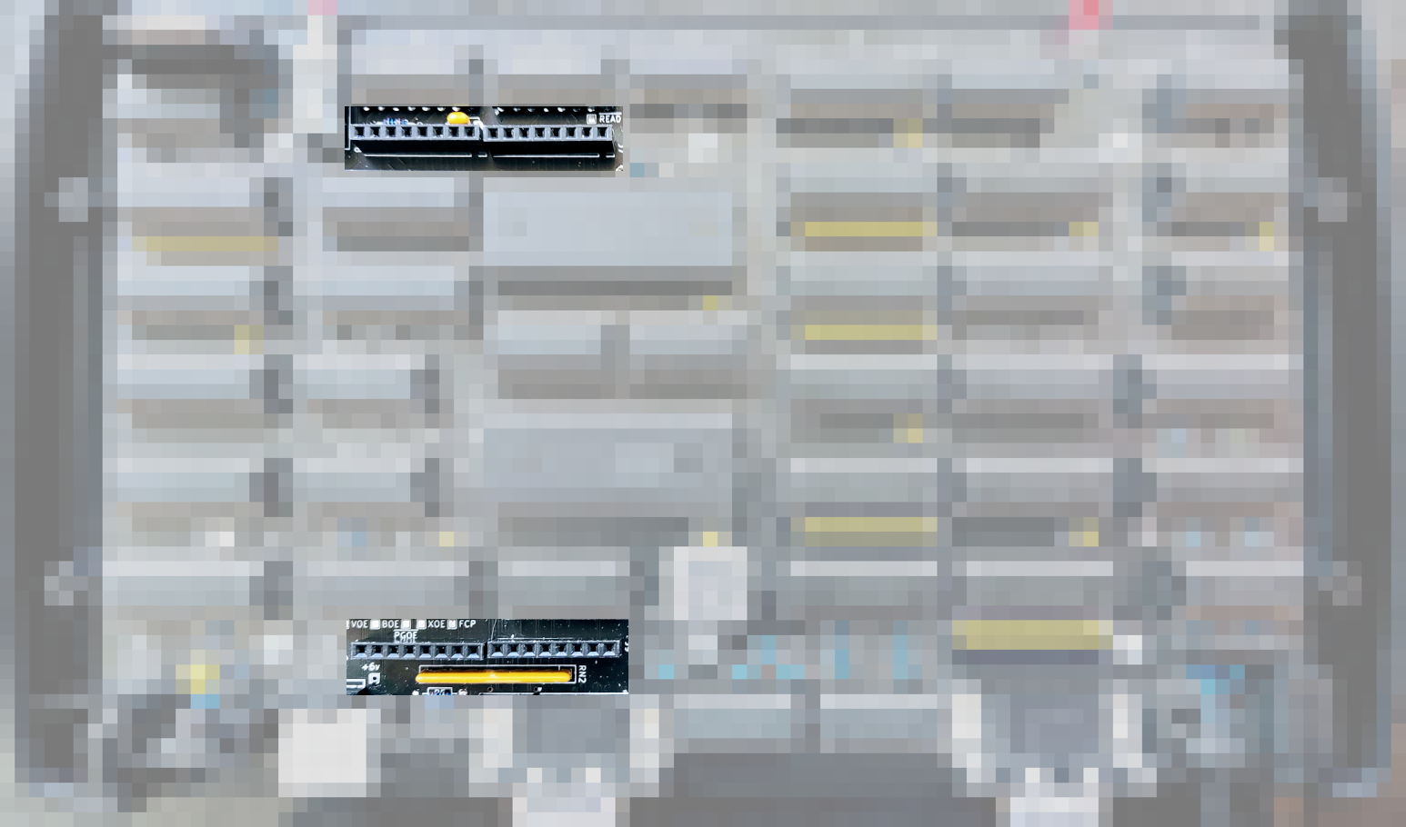
Expansion
IN port 1-7
OUT port 1-7

Slide 55
Hardware Abstraction
10
Port# | Input | Output | Notes
8 | Serial Rx (TTY) | Serial Rx (TTY)
9 | Console (KBD) | Console (CRT) | Text mode
10 | KBD Scan Code | Set Audio Mode | Resource control
11 | Character @ cursor pos | Enable/Disable Serial | Resource control
12-55 | Zero Page Read | Zero Page Write | Audio, console params
56-63 | Zero Page Read | N/A | Read only params (RTC)

Slide 56
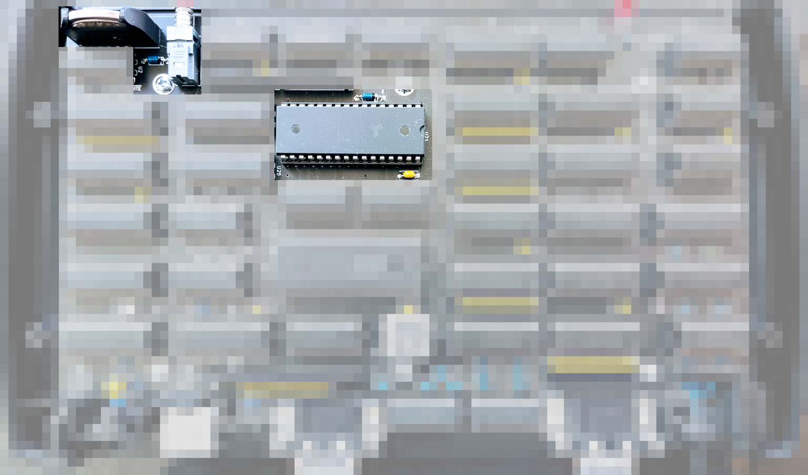
RAM Disk
CR2032 @ 4uA

Slide 57
A: Drive RAM Disk
BANK x 4
TRACK
8 secs/
track,
254 tracks, 2032 records

Slide 58
Memory Management
CPU 0
CPU 1
CPU 2
CPU 3
Video
60k
MICRO KERNEL
CP/M
TTY
CP/M
CRT
SYS
RAM DISK
CPU 4
CPU 5
CPU 6
CPU 7

Slide 59
System Memory (Bank 0)
SHM 1 … SHM 7
SERIAL & KEYBOARD
BUFFERS
TBD
SHM 0
CONTEXT SEQUENCE
ZERO PAGE
CPU 1 … CPU 7
CPU 0
F0 F1 F2 F3 F4 F5 F6 F7 F8 F9 FA FB FC FD FE FF
00
vCPU
FF
Context Switch

Slide 60
A: Drive Read
RECORD
RECORD
CP/M
KERNEL
DISK
Kernel Copy
GET ?
GET 5
RTN 2
RTN ?
2 1 5

Slide 61
A: Drive Write
RECORD
RECORD
CP/M
KERNEL
DISK
Kernel Copy
PUT ?
PUT 5
2 1 5

Slide 62
B: Drive
ASM
BASIC - IMSAI 8k BASIC
CPM22 - CCP/BDOS/BIOS
DDT
DUMP
ED
LOAD
PIP
STAT
SUBMIT
UTIL - format, file transfer
XSUB
Boot - bootstrap
Disk - disk client
Kernel - 2k Kernel
Monitor - 2k 8080 Monitor

Slide 63
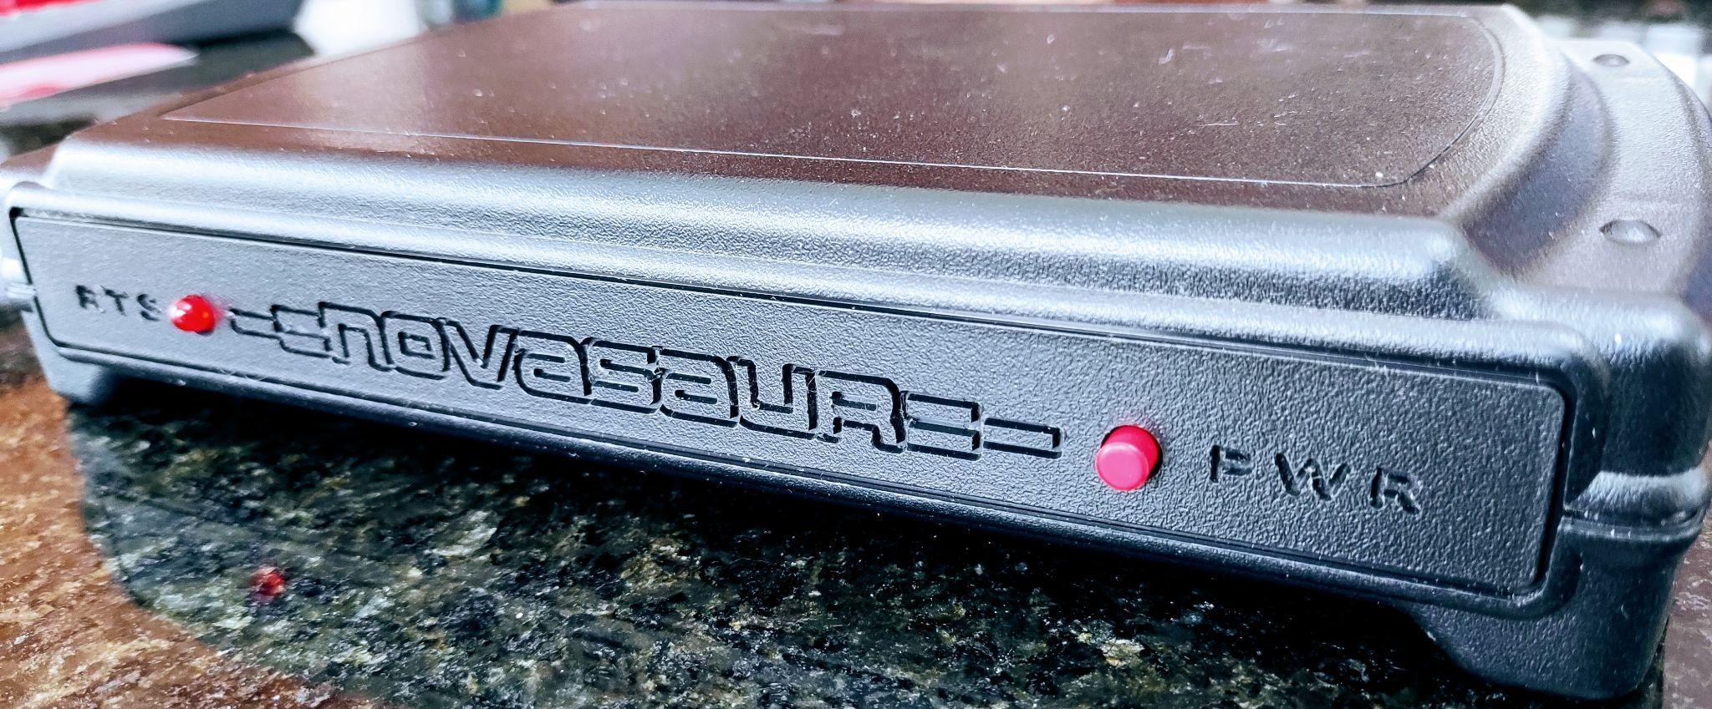
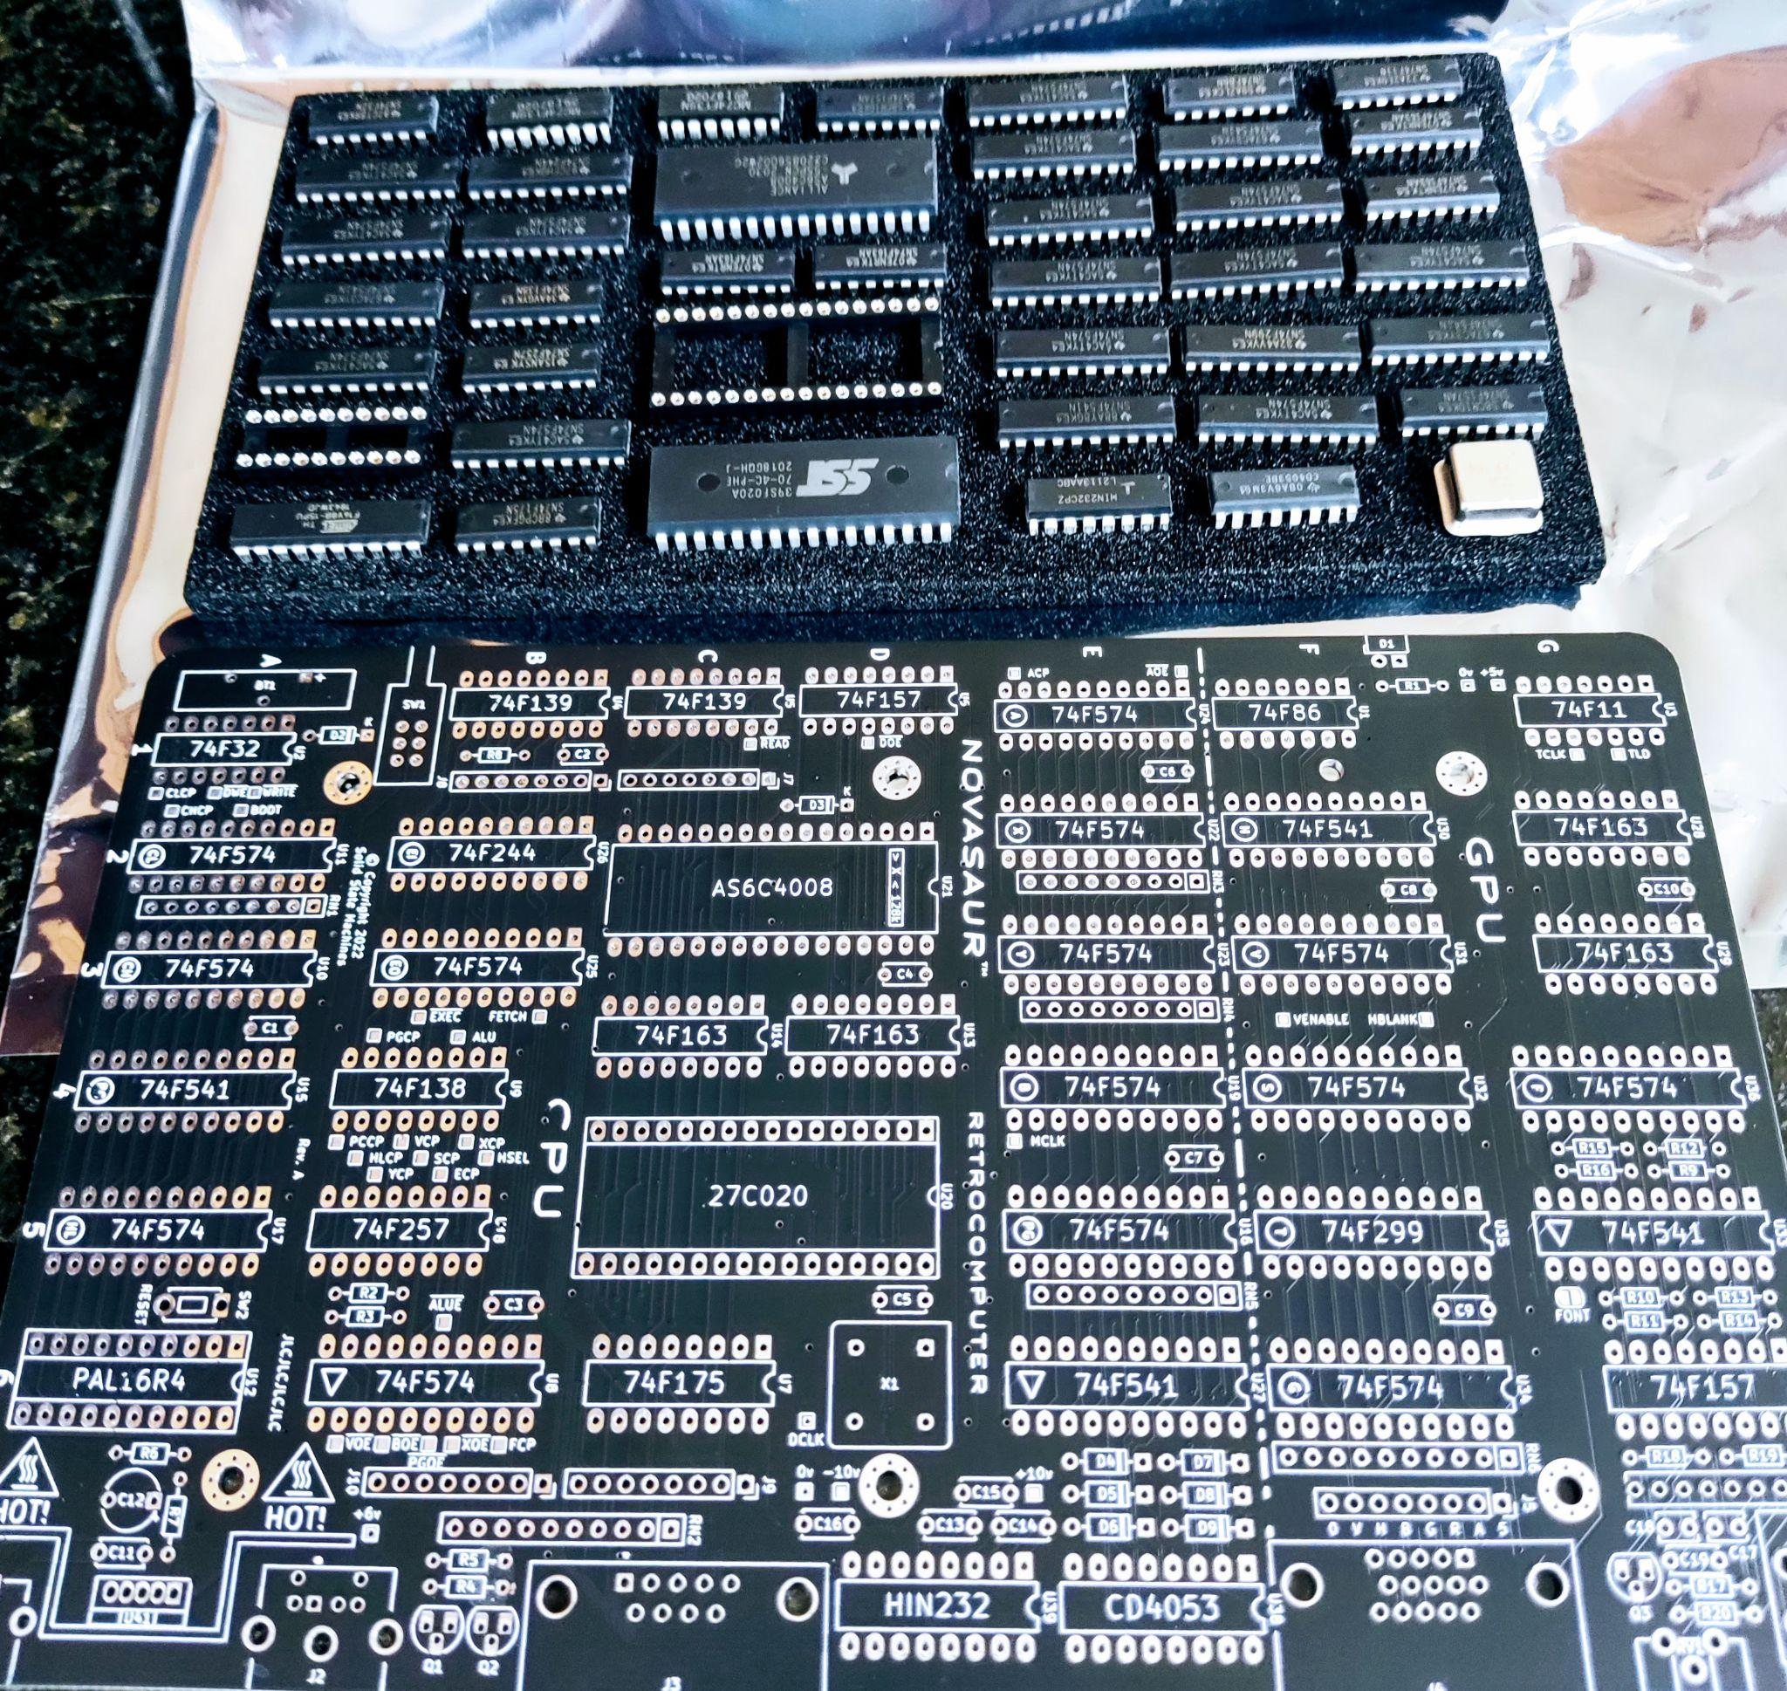
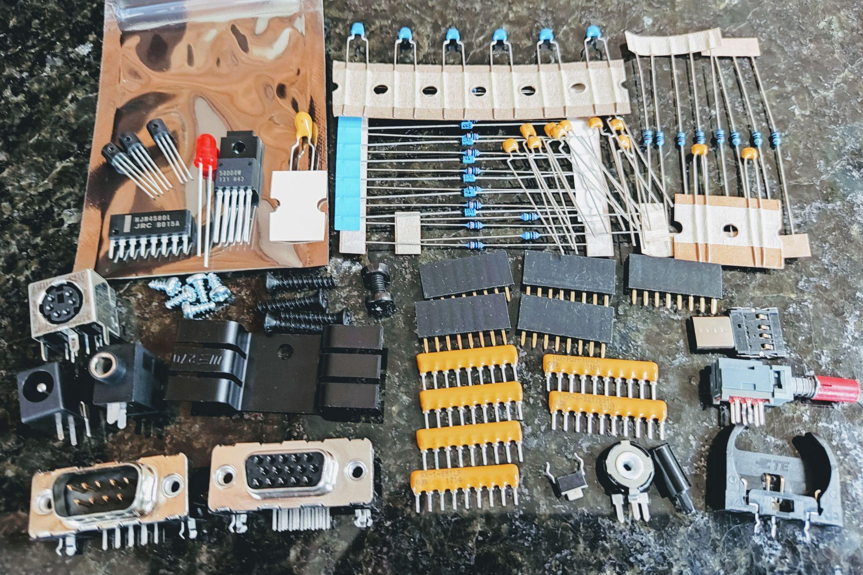
Novasaur Kit
COMING SOON

Slide 64
Thank You!
VCF East
https://www.solidstatemachines.com
https://hackaday.io/project/164212-
novasaur-cpm-ttl-retrocomputer
https://github.com/ajhewitt/novasaur
VCF East 2023

