Slide 1
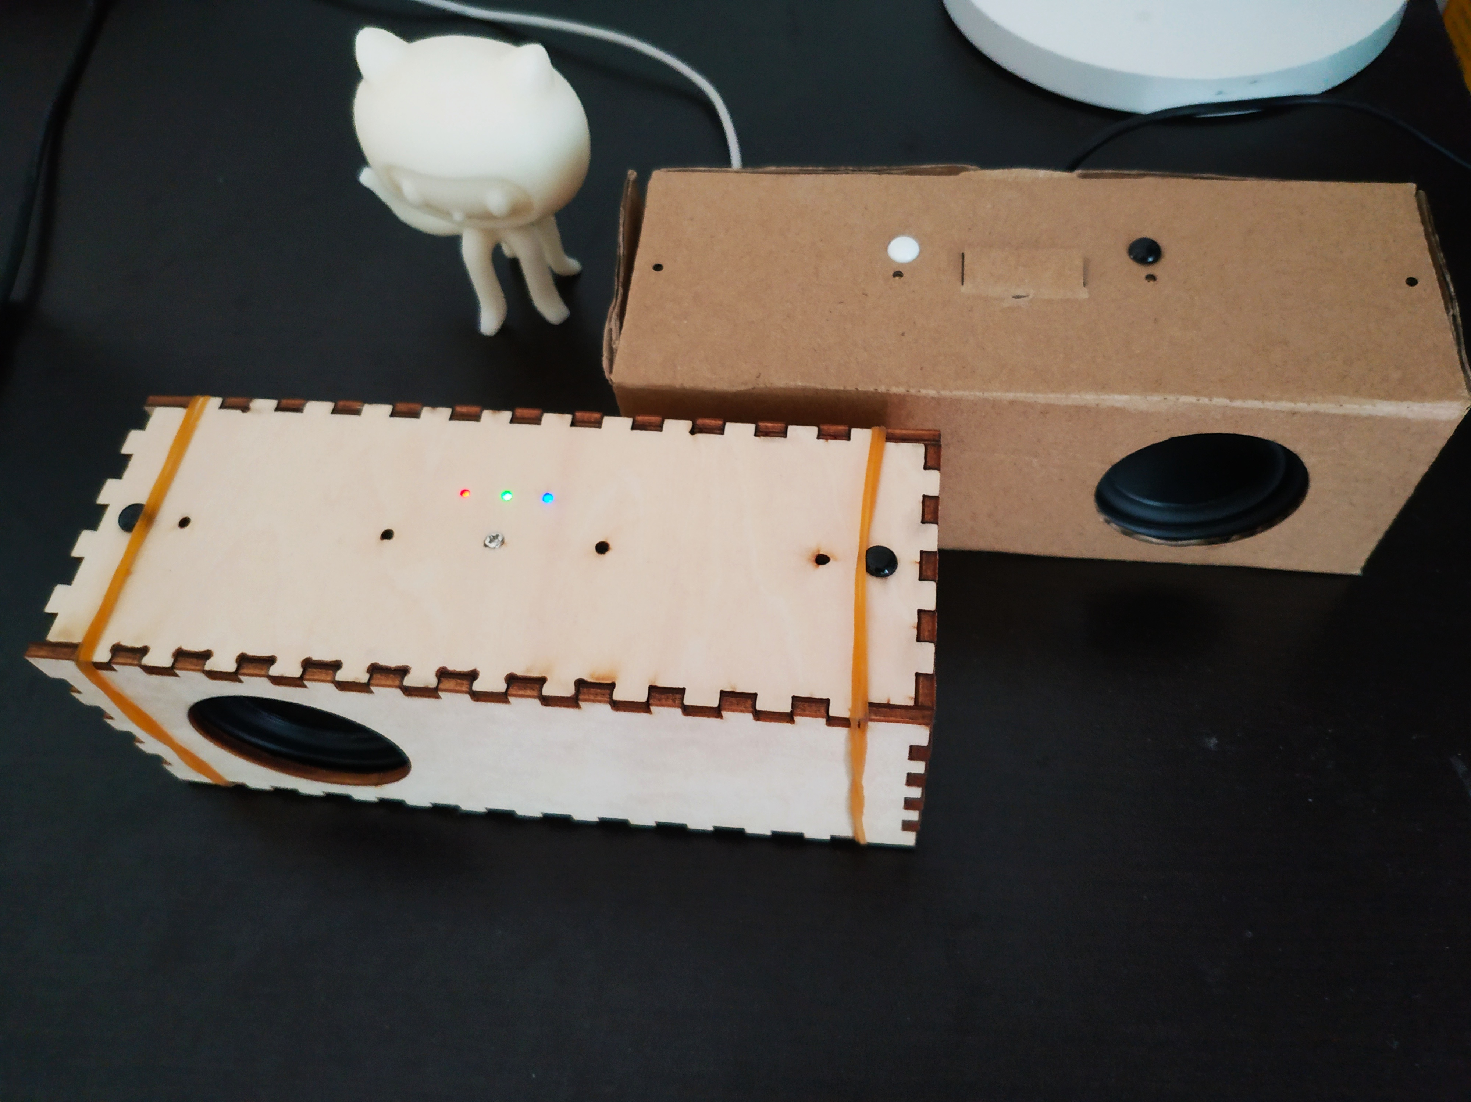
Smart Speaker from Scratch
To make an open source smart speaker for daily use
Yihui Xiong

Slide 2
Content
Why an open source smart speaker
What to do
How to

Slide 3
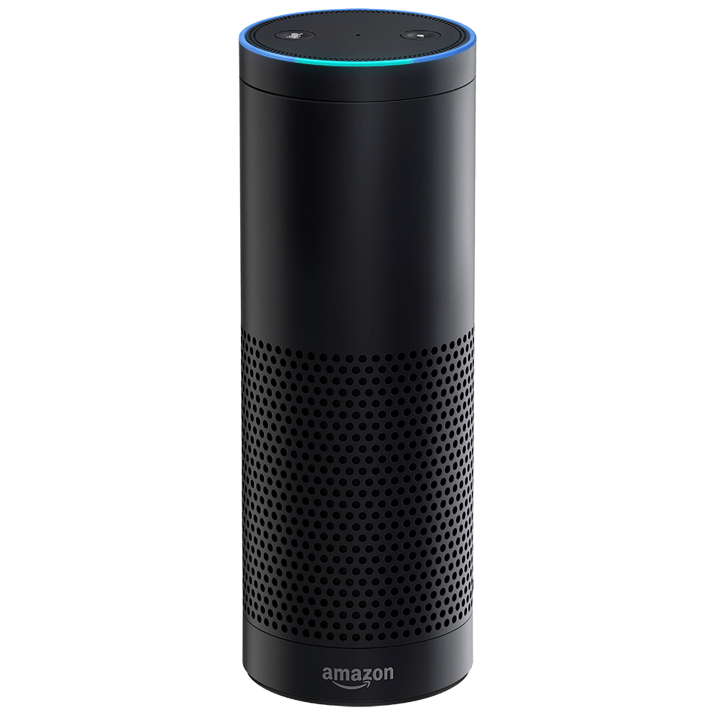
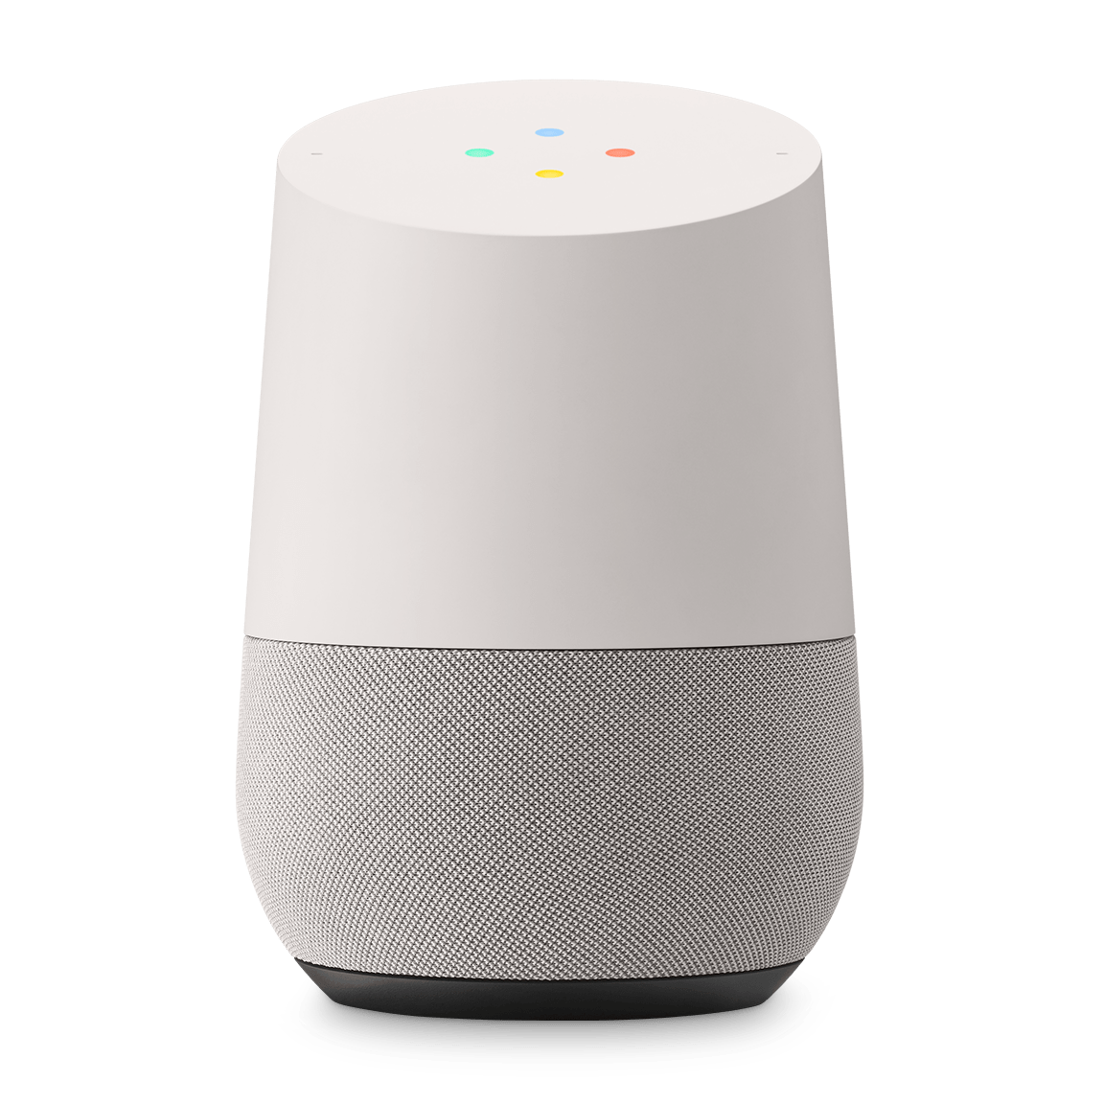
Why an open source smart speaker
Smart speakers, such as Echo & Google Home, are well-designed products, but they also are always-listening black boxes
Privacy Concern
Limited Functions, No Apps

Slide 4
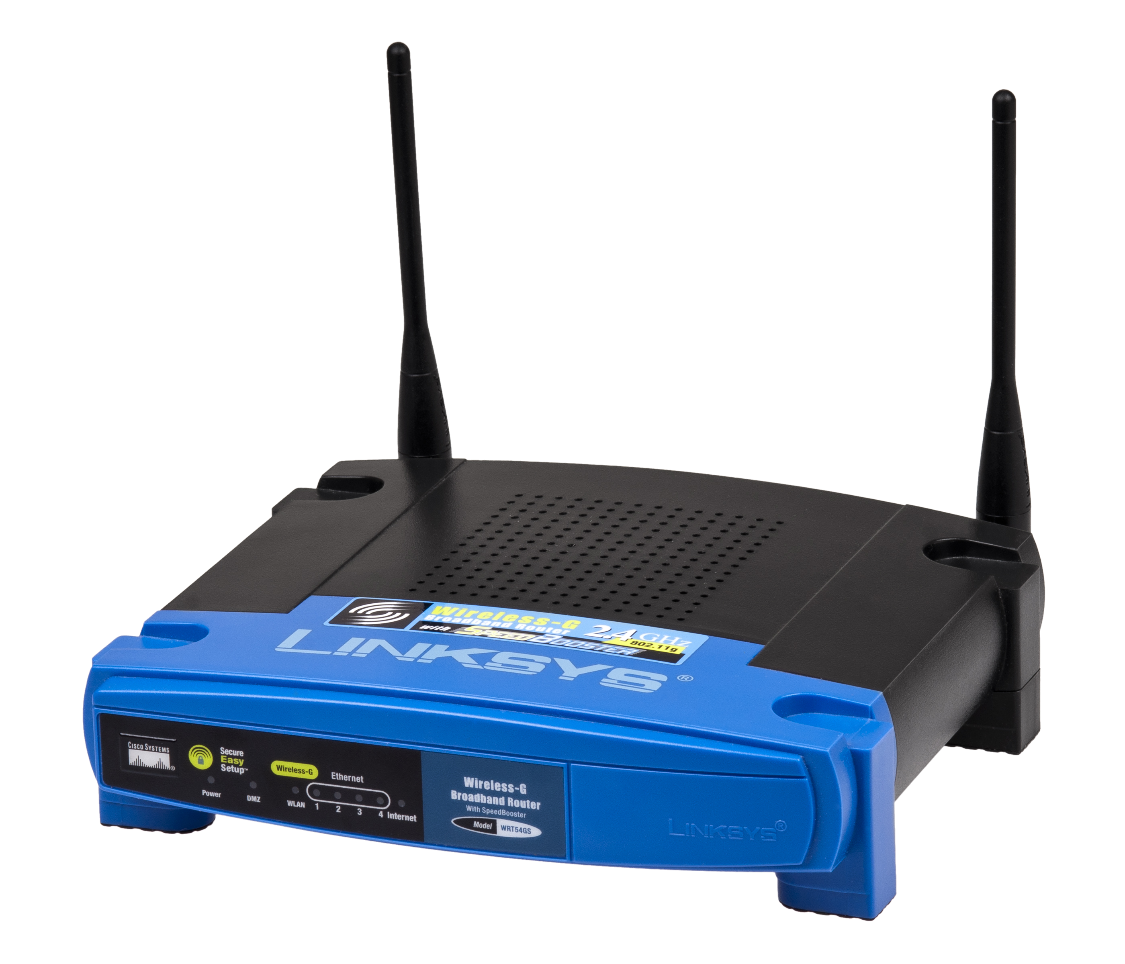
Idea from Routers & OpenWrt
Routers were black boxes until we have OpenWrt
Linksys used Linux in their WRT54G series of routers. Under the terms of the GPL, Linksys was required to make its source code available.
Then the OpenWrt project was started.
We can replace many routers' firmwares with OpenWrt and install all kinds of apps.
WRT54G
Notes:
Linksys used Linux in their WRT54G series of routers. Under the terms of the GPL, Linksys was required to make its source code available.

Slide 5
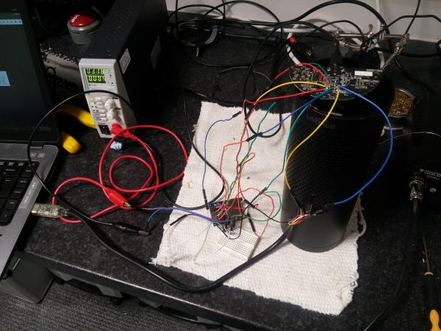
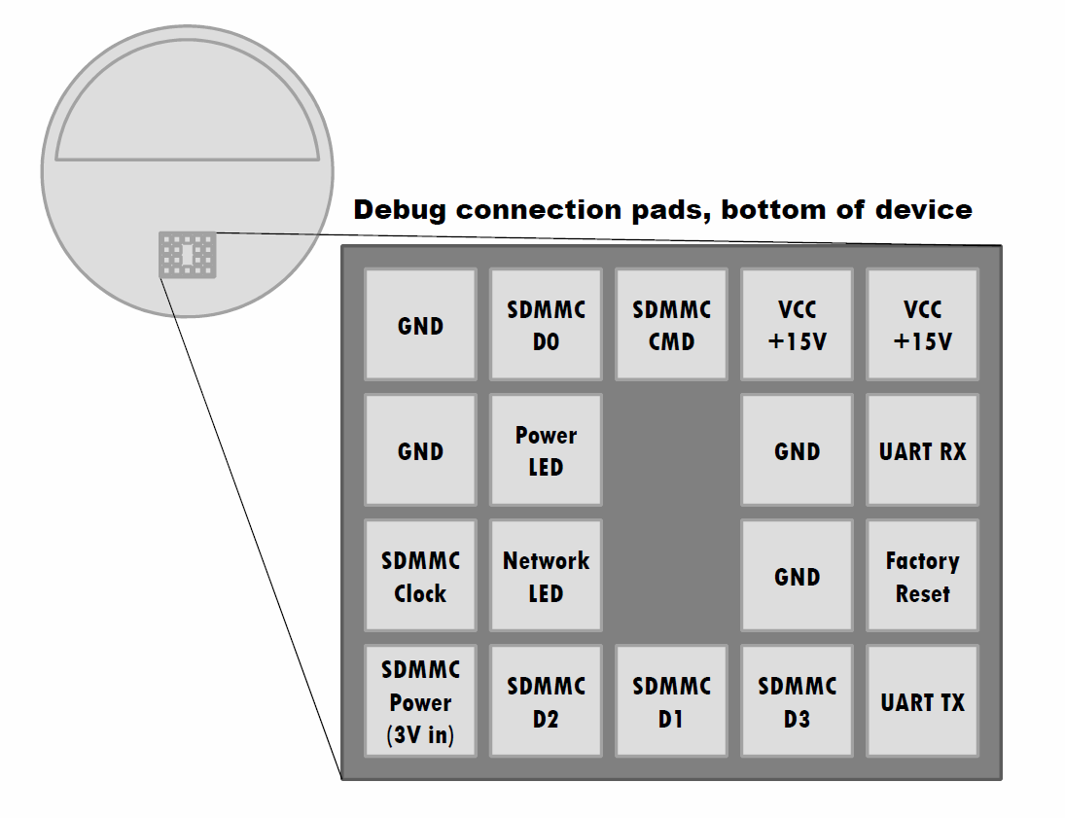
A little bit different
Amazon released Echo's source code, but it's quite hard to hack it and install software on it
Notes:
image from https://labs.mwrinfosecurity.com/blog/alexa-are-you-listening/
https://github.com/echohacking/wiki/wiki/Echo

Slide 6
Hacking vs Making
Making an open source smart speaker is easier than hacking the existing smart speakers

Slide 7
Content
Why an open source smart speaker
What to do
How to

Slide 8
How a smart speaker works
AEC
NS
DOA
Beamforming
VAD
KWS
ASR
NLU
Skills
Wiki
＋－
×÷
...
TTS

Slide 9
What to do
Hardware
SBC like Raspberry PI, NanoPi Air
Mic Array
Software
Audio processing algorithms (AEC, Beamforming)
Voice Assistant (KWS, ASR, NLU, STT)
Document
Doc like Linux From Scratch

Slide 10
Content
Why an open source smart speaker
What to do
How to

Slide 11
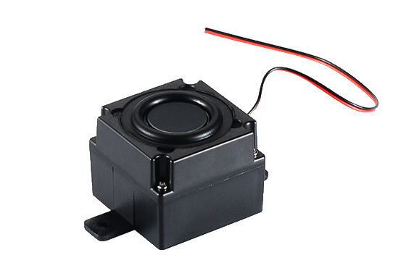
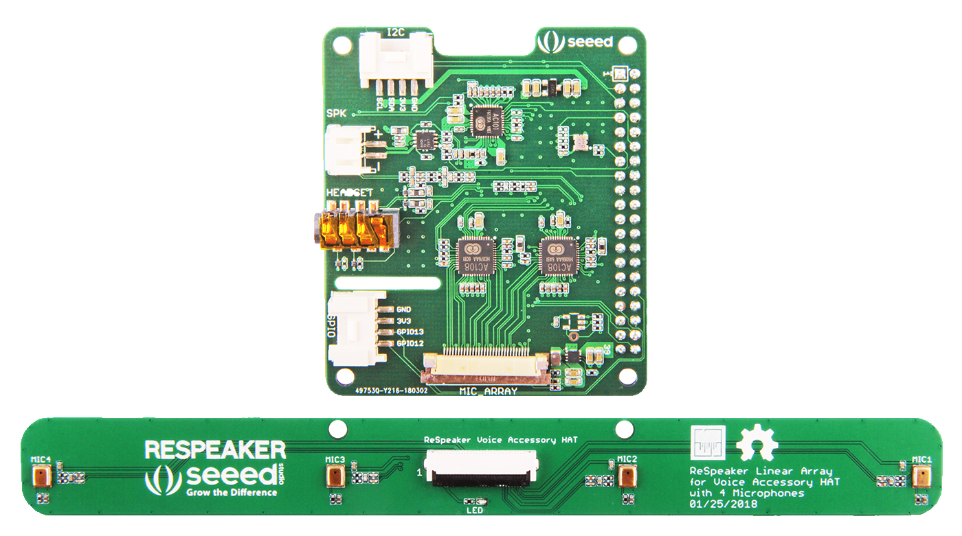
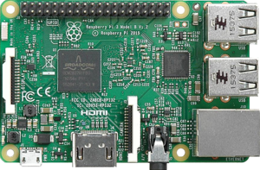
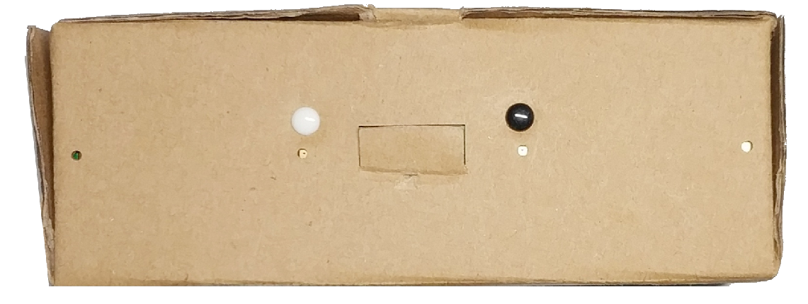
Prototype #1
+
+
ReSpeaker 4 Mic Linear Array
Raspberry Pi 3B
45mm Speaker
Paper Case Smart Speaker

Slide 12
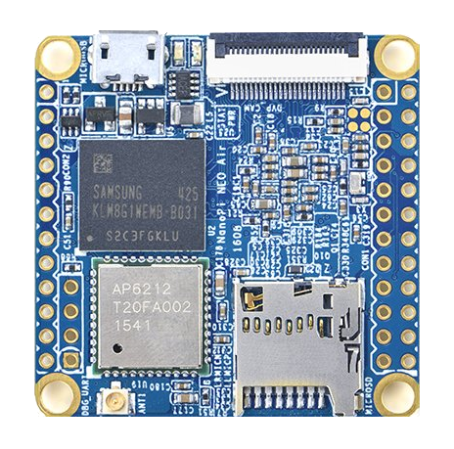
Next step
Use NanoPi Air + New Mic Array
Cheaper
More compact
Lower power comsumption
+
+

Slide 13
Follow the project on Hackady & Github
search “Smart Speaker from Scratch” on hackaday.io
https://github.com/voice-engine

Slide 14
Thanks
search “Smart Speaker from Scratch on hackaday.io
https://github.com/voice-engine

