Slide 1
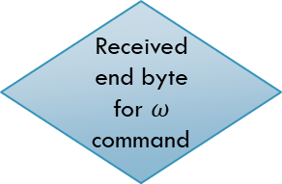
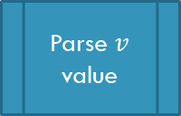
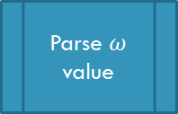


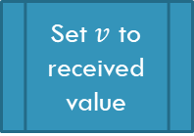
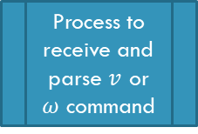
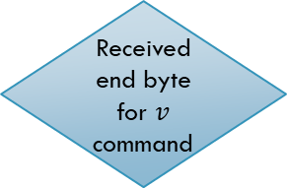
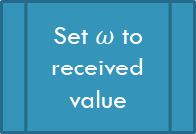
Start
Get control source of the robot
Source == USB
Source == Phone
Received start byte for $ω$command
Received start byte for $v$command
Parse $ω$ value
Parse $v$ value
Print “Undefined State Error”
Process to receive and parse $v$ or $ω$ command
Received end byte for $ω$ command
Received end byte for $v$ command
Set $ω$ to received value
Set $v$ to received value

Slide 2
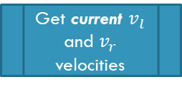
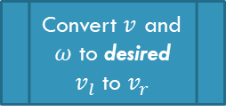
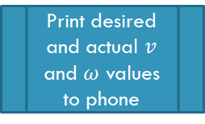
Source = (Phone|| USB)
Convert $v$ and $ω$ to desired $v_{l}$ to $v_{r}$
Get current $v_{l}$ and $v_{r}$ velocities
Calculate PID control signal
Apply PID control signal to motors
Print desired and actual $v$ and $ω$ values to phone
Delay, 20 ms

