Slide 1
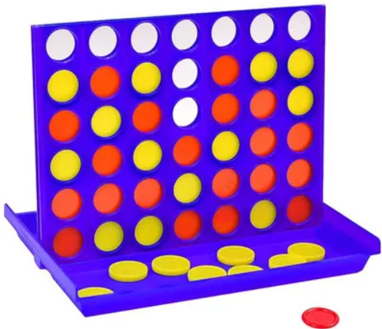
Voice controlled CONNECT 4
Packaged by jason sor developped by guillaume bouton wired by florian andro

Slide 2
SUMMARY
Introduction : 1) Introduction
2) Box 2) Arduino UNO 3) Neopixels ADA 4356 4) HC-06 Bluetooth Module 5) LCD printer 128*64
6) Code

Slide 3
INTRODUCTION
Basics of the project : 1) LED Matrix Connect 4 2) Blow Control
Improvments to be made : 1) Voice Control 2) Score Printing

Slide 4
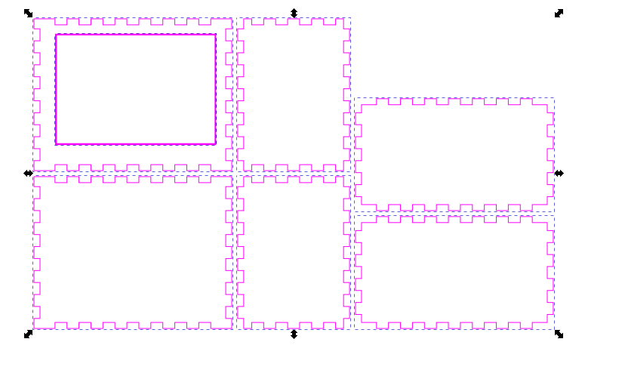
BOX

Slide 5
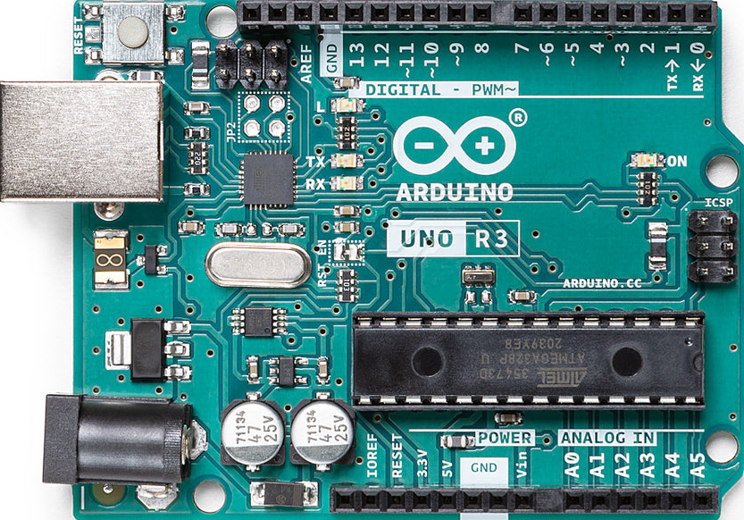
COMPONENTS USED
ARDUINO UNO
LCD PRINTER 128*64
HC-06 BLUETOOTH
NEOPIXEL ADA 4356

Slide 6
ARDUINO UNO
SUPPLY : 5V & 3,3V
13 PIN + 6 Analogic PIN
Memory : 32 KB

Slide 7
HC-06 BLUETOOTH
Supply : 5V TXD + RXD GND
Purpose : connect bluetooth devices (here : phones for voice control)

Slide 8
NEOPIXELS ADA 4356
Supply : 5V Max Current : 60 mA Serial Connection (42 Leds)

Slide 9
LCD PRINTER 128*64
DATA IN SERIAL CONNECTION Supply : 5V Current : 65 mA Resolution : 128*64

Slide 10
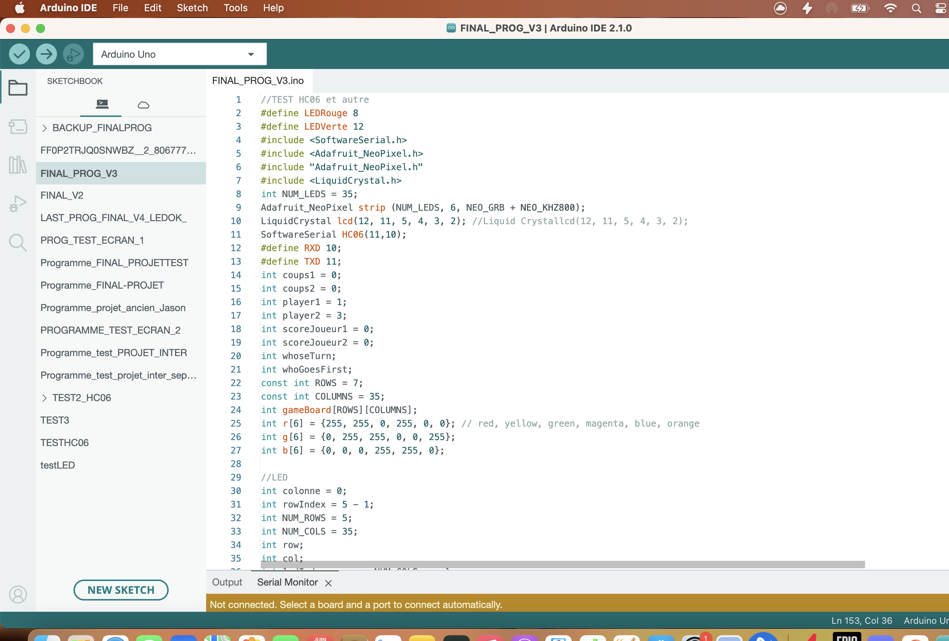
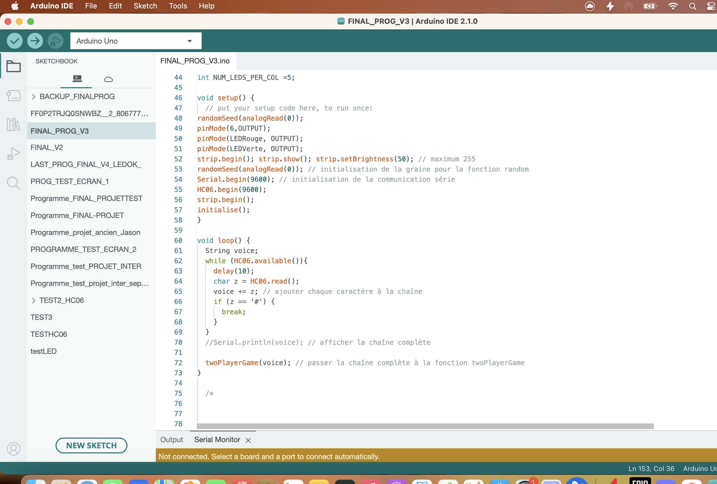
About the code : (initialisation)

Slide 11
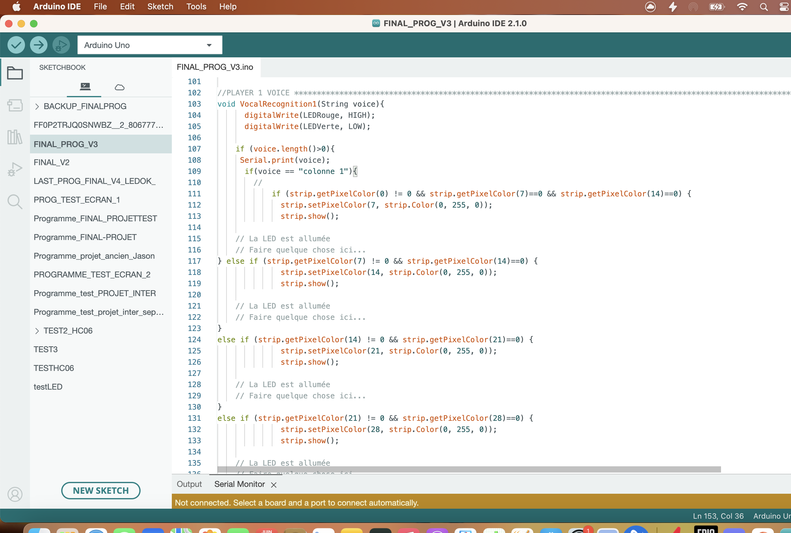
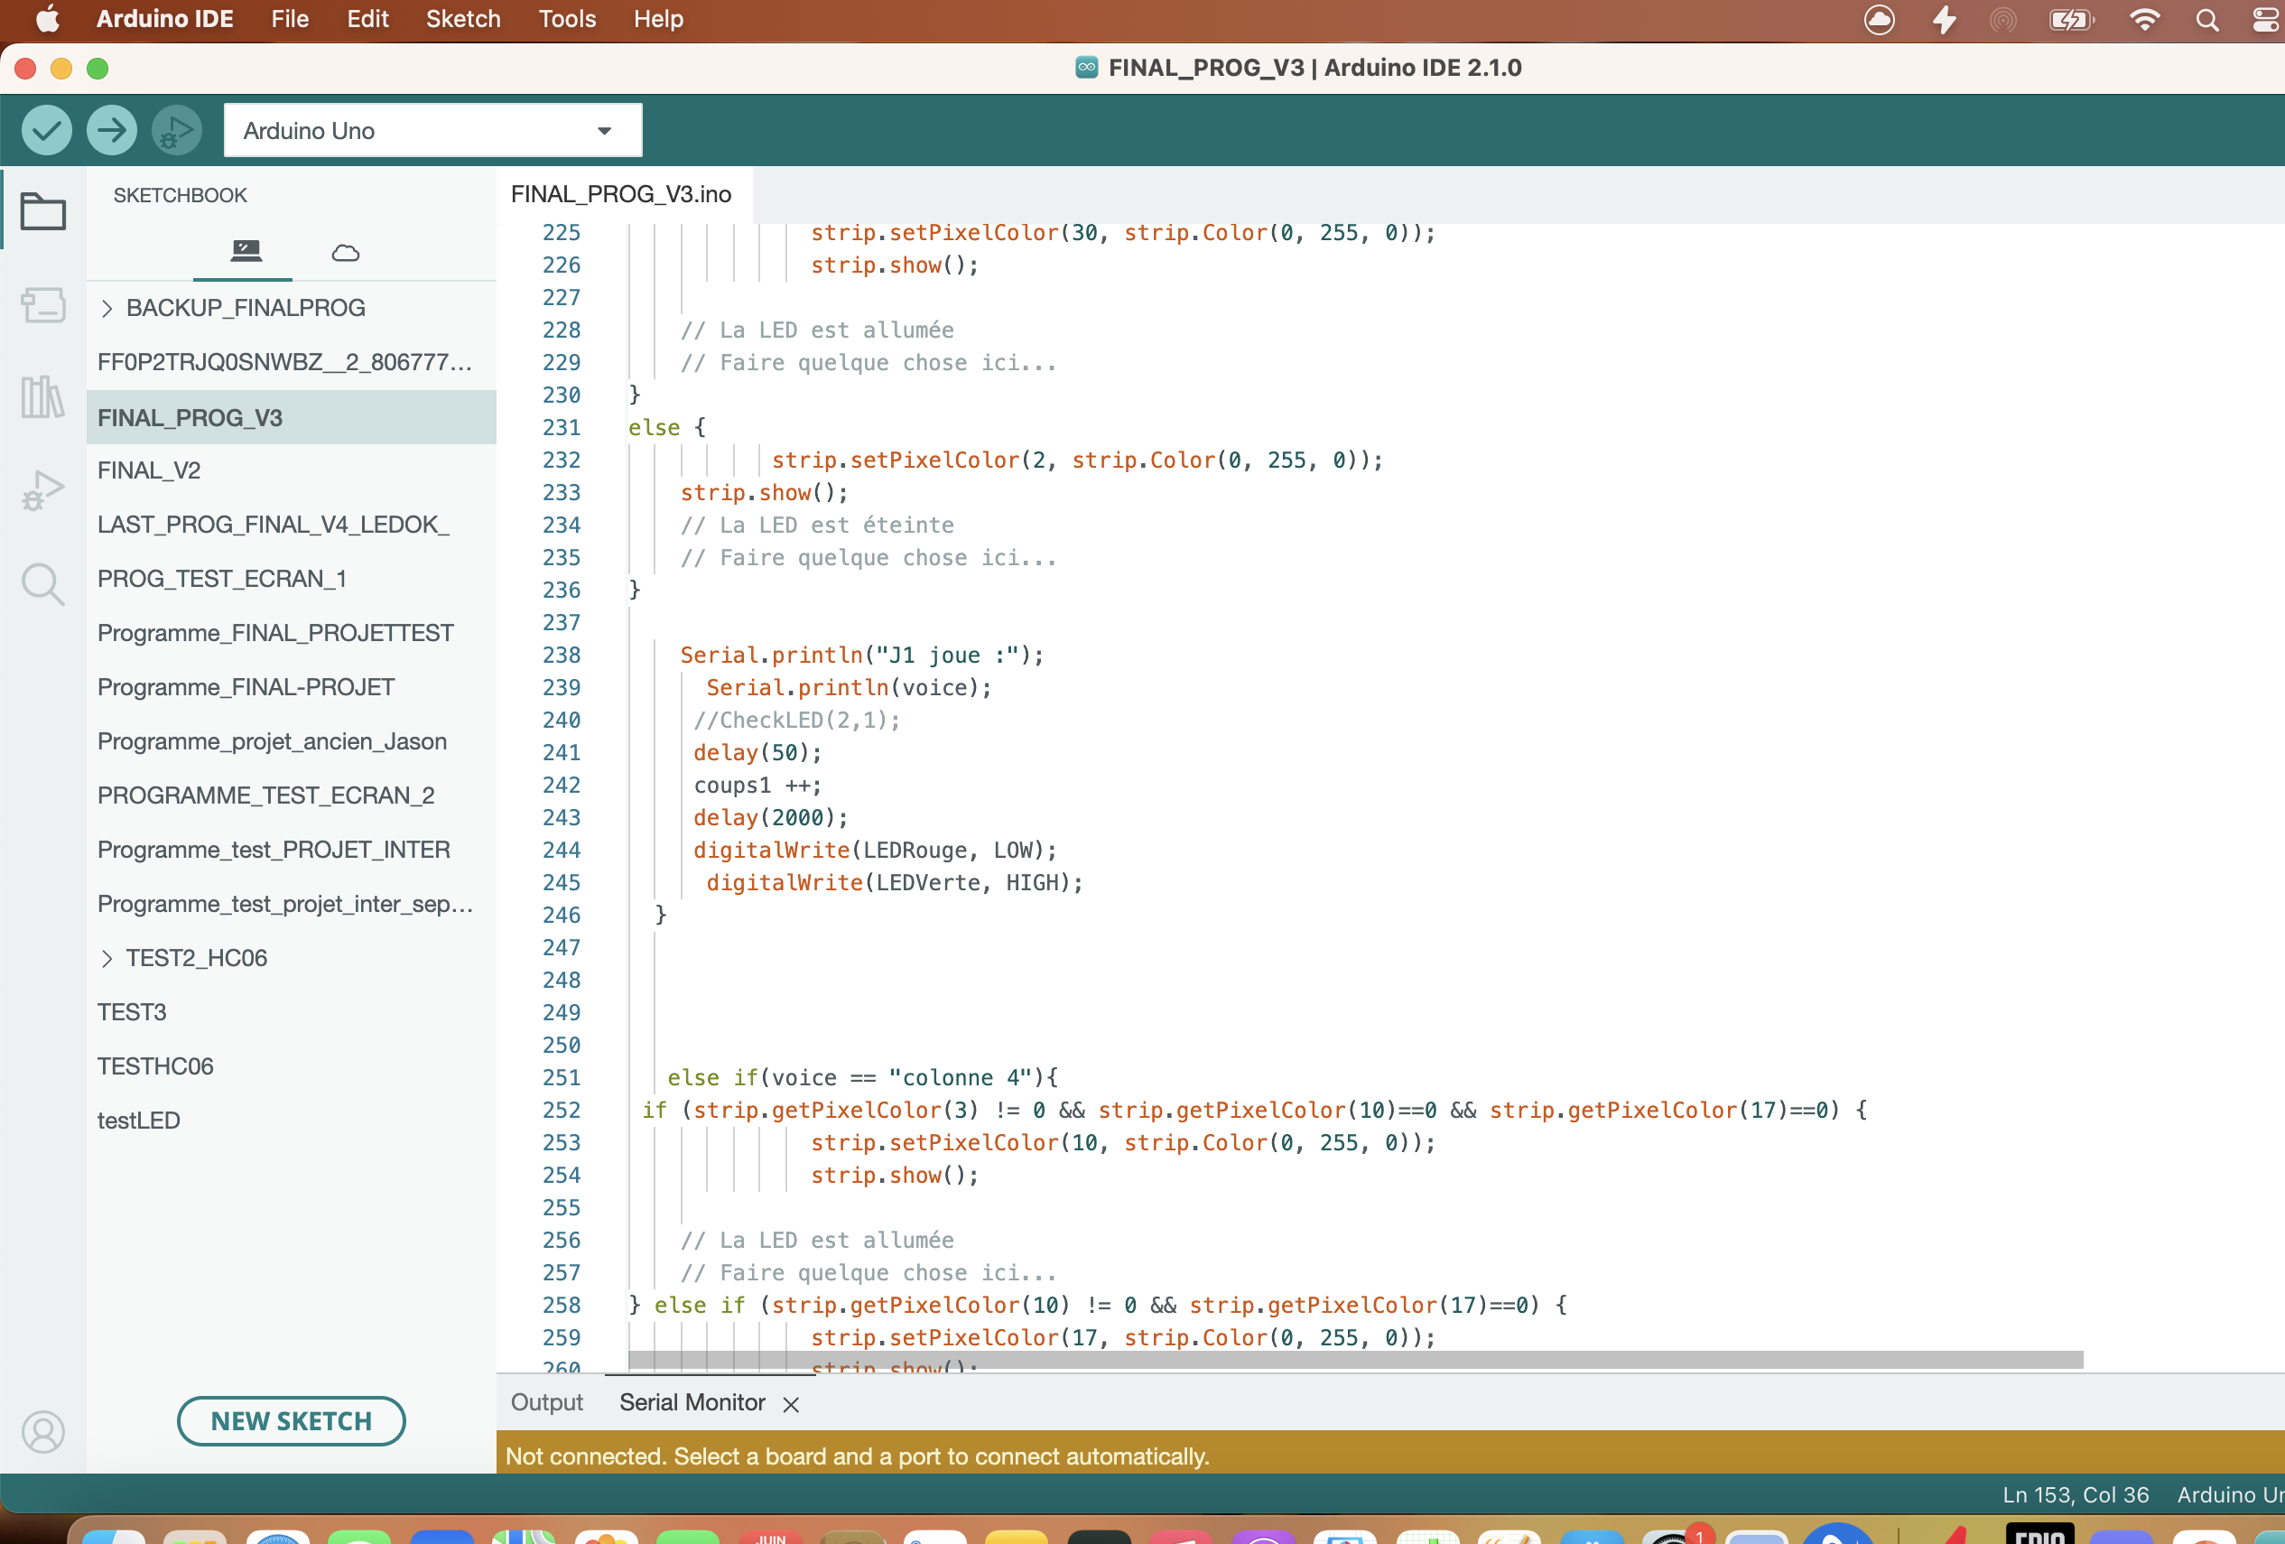
About the code : (Voice control/Bluetooth)

Slide 12
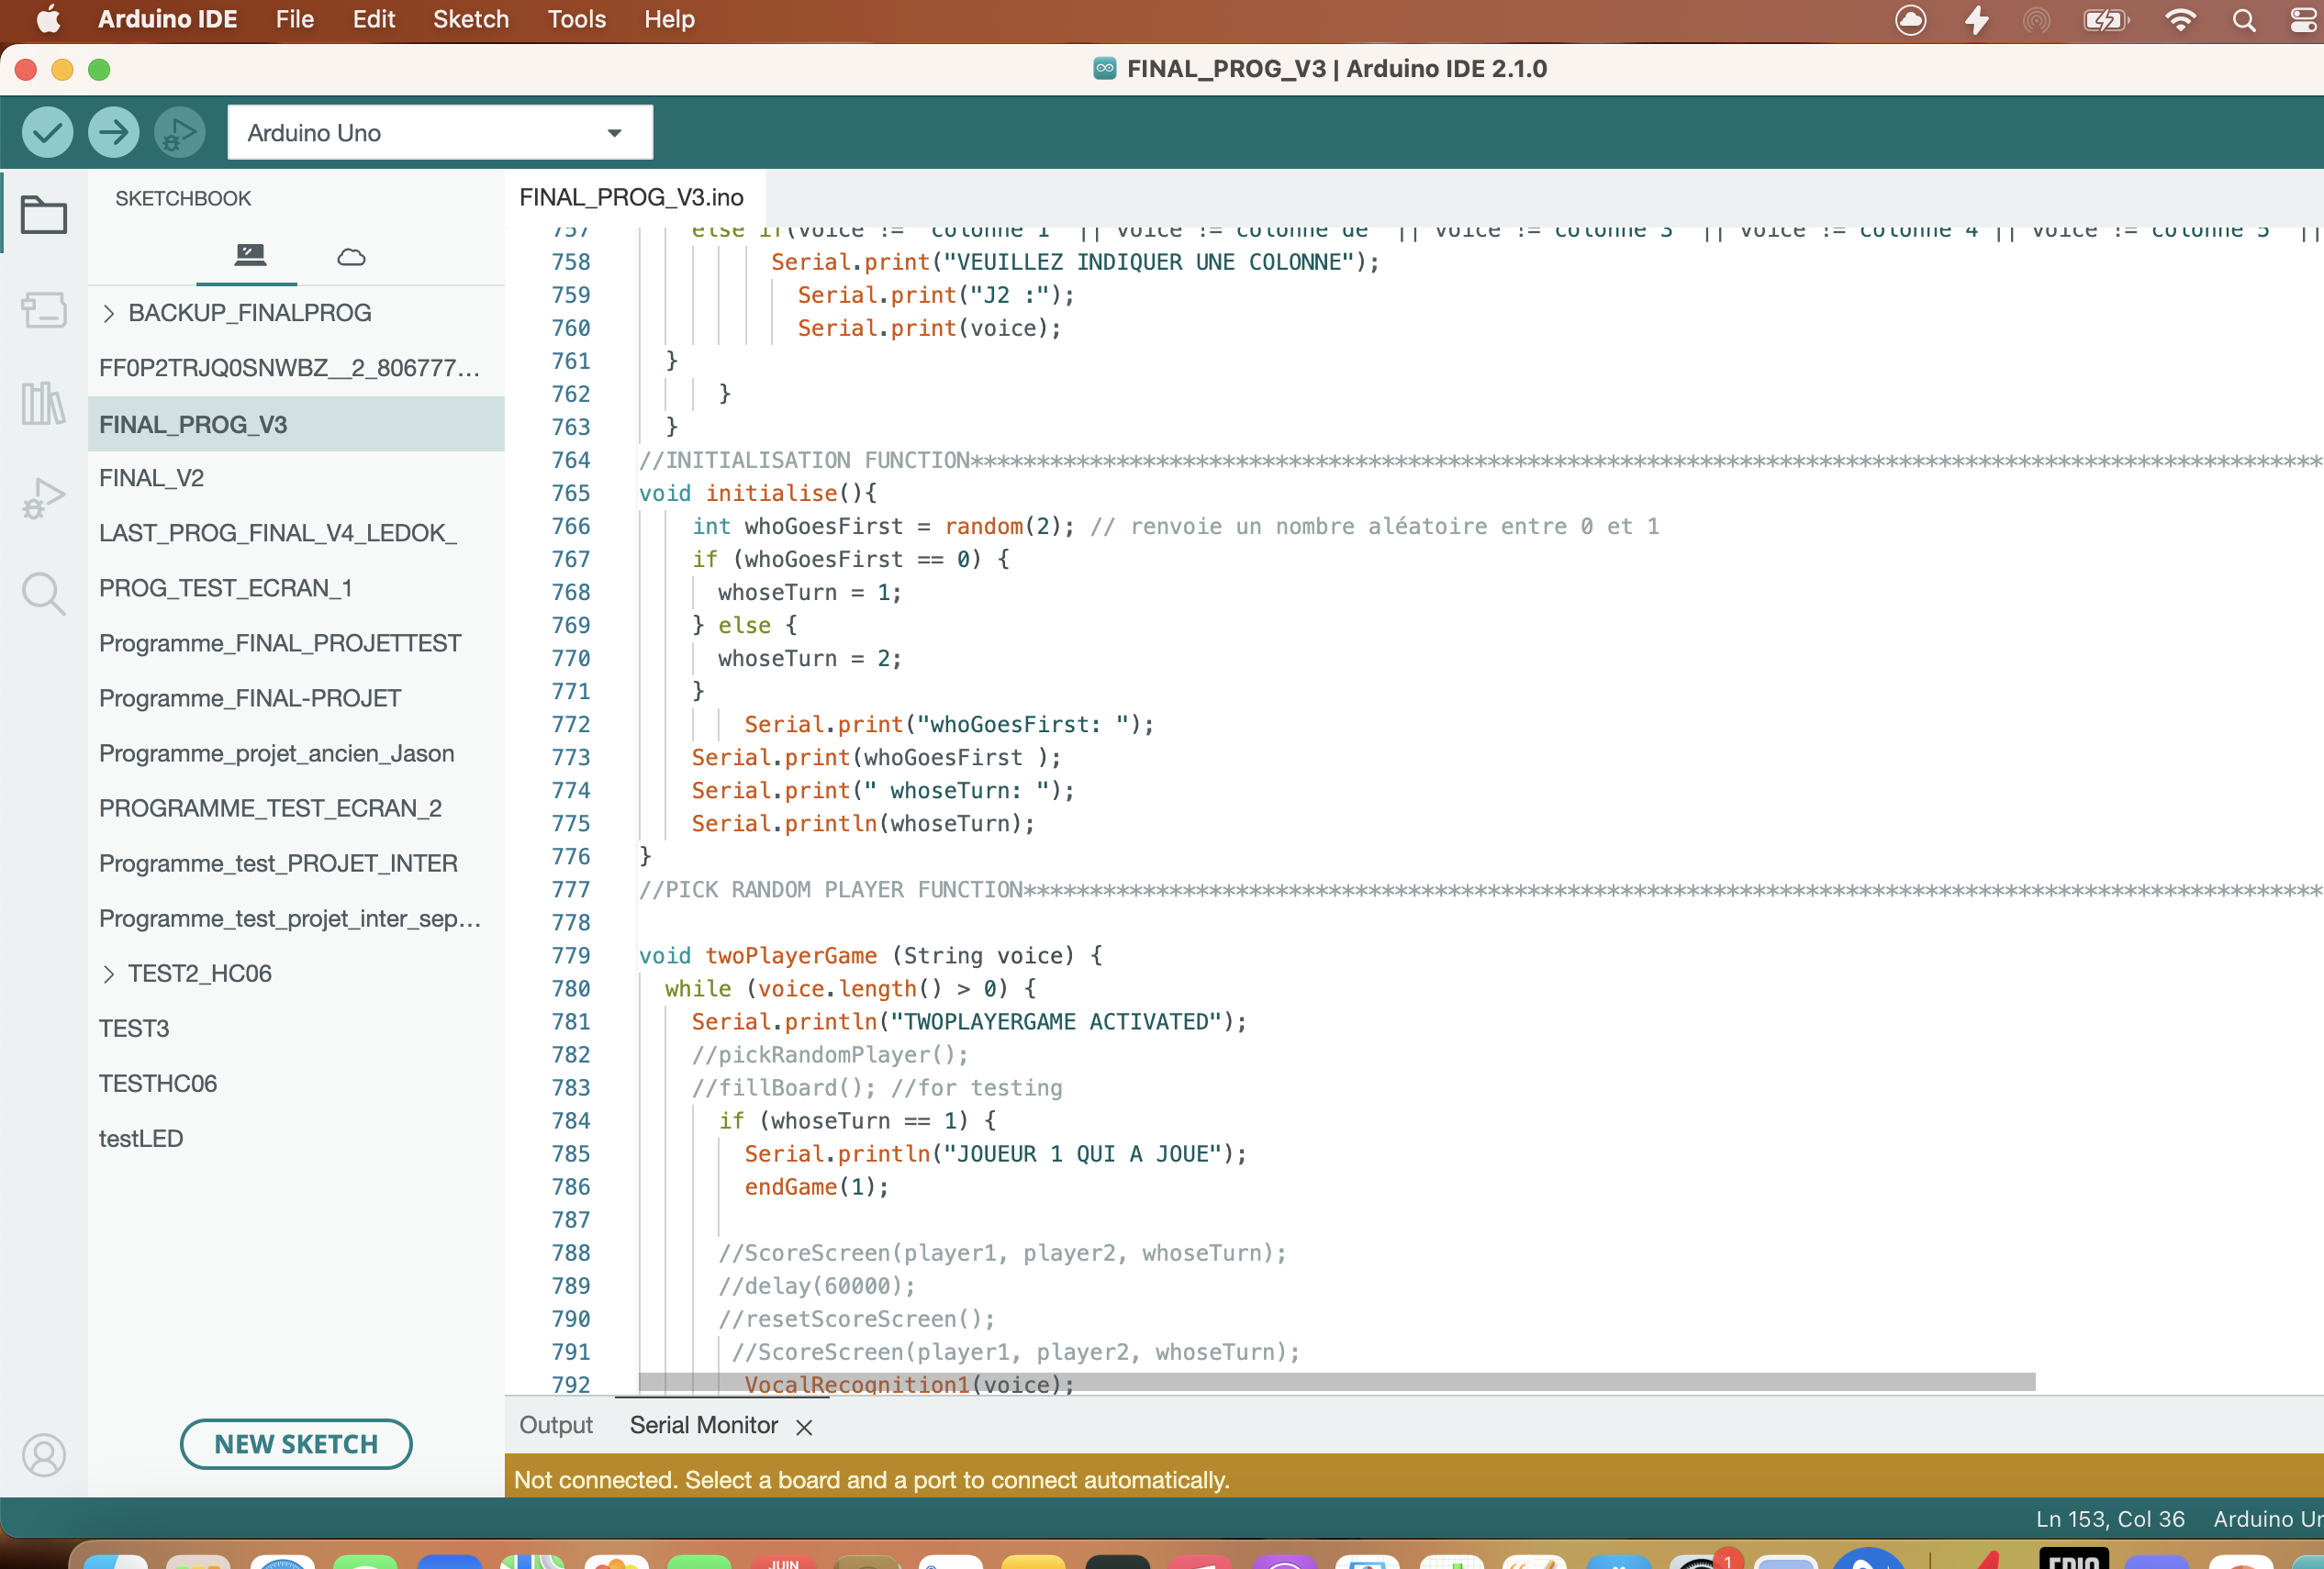
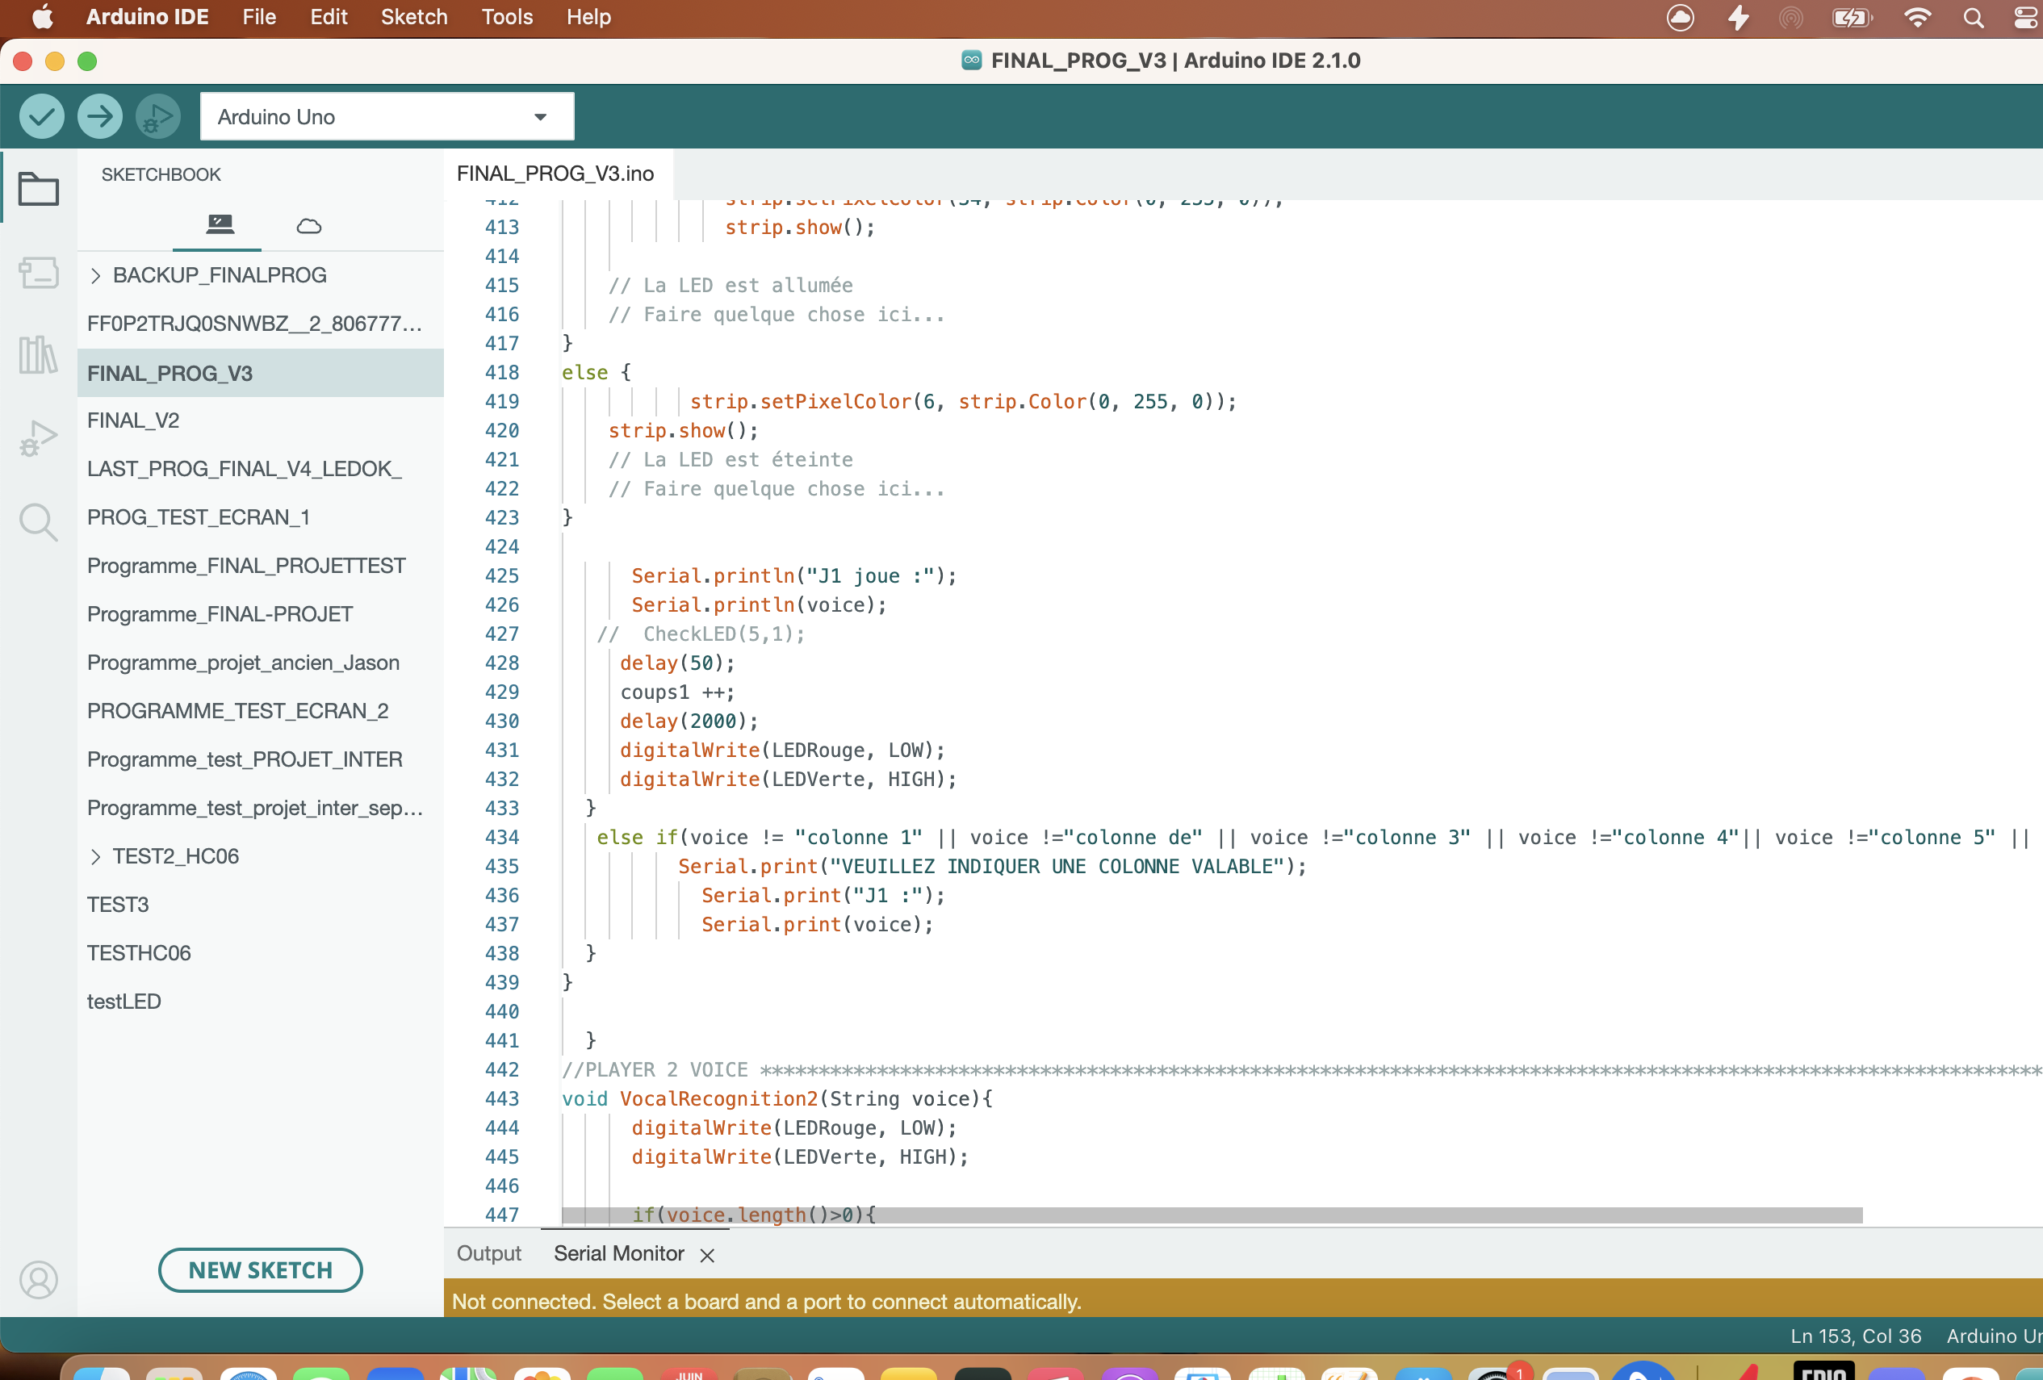
About the code : (initialize/verif)

Slide 13
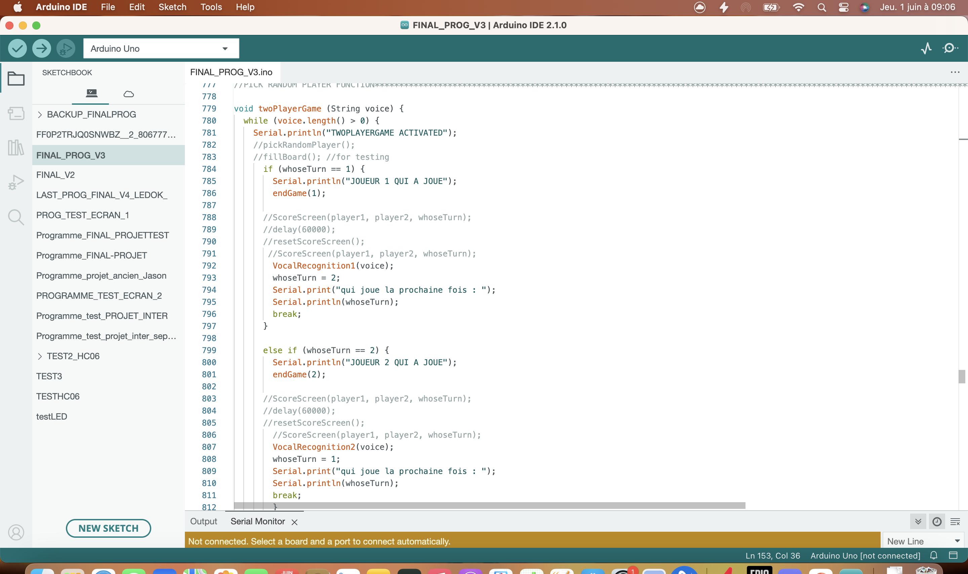
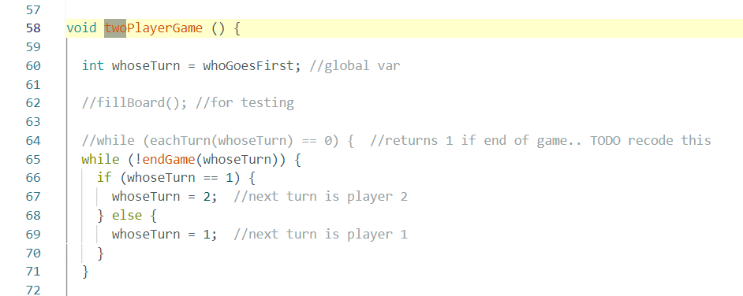
About the code : (differences between twoplayergames / old /new)

Slide 14
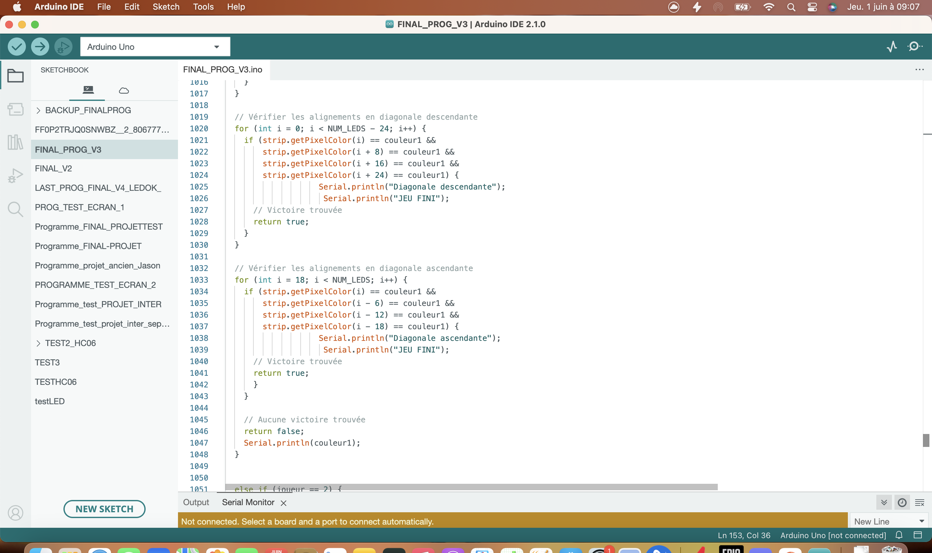
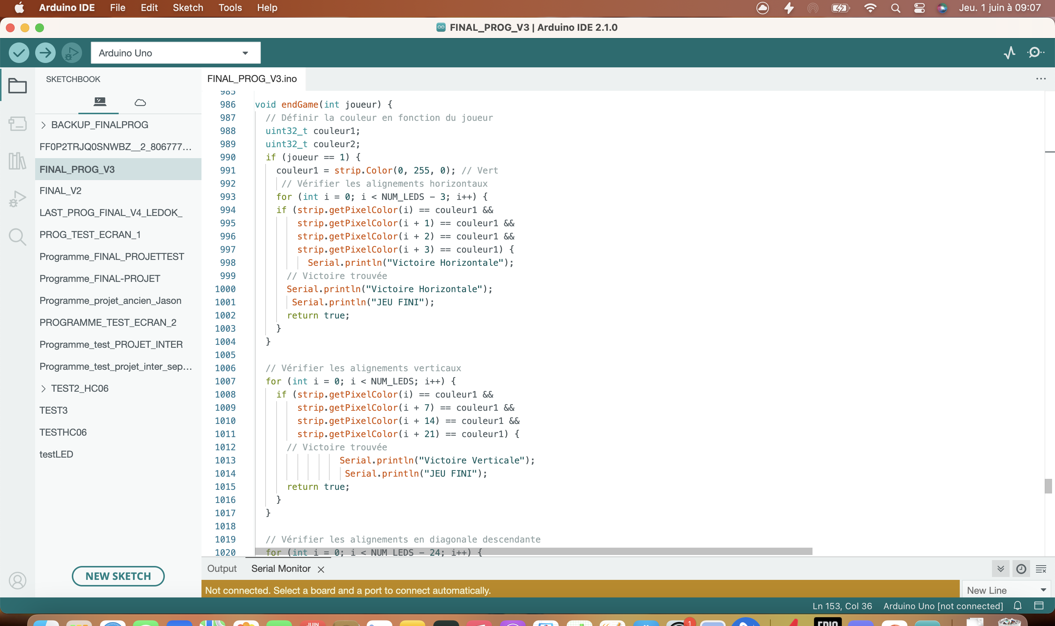
About the code : (endgame → didn’t work)

Slide 15
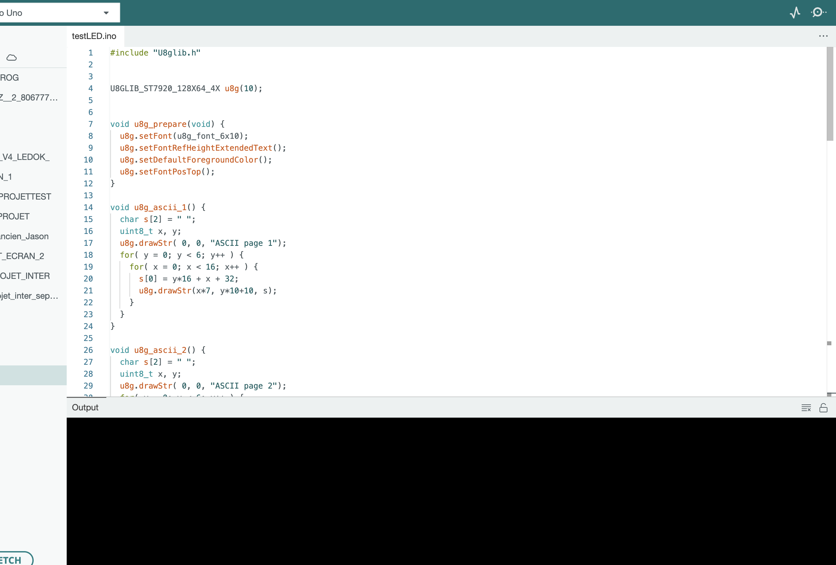
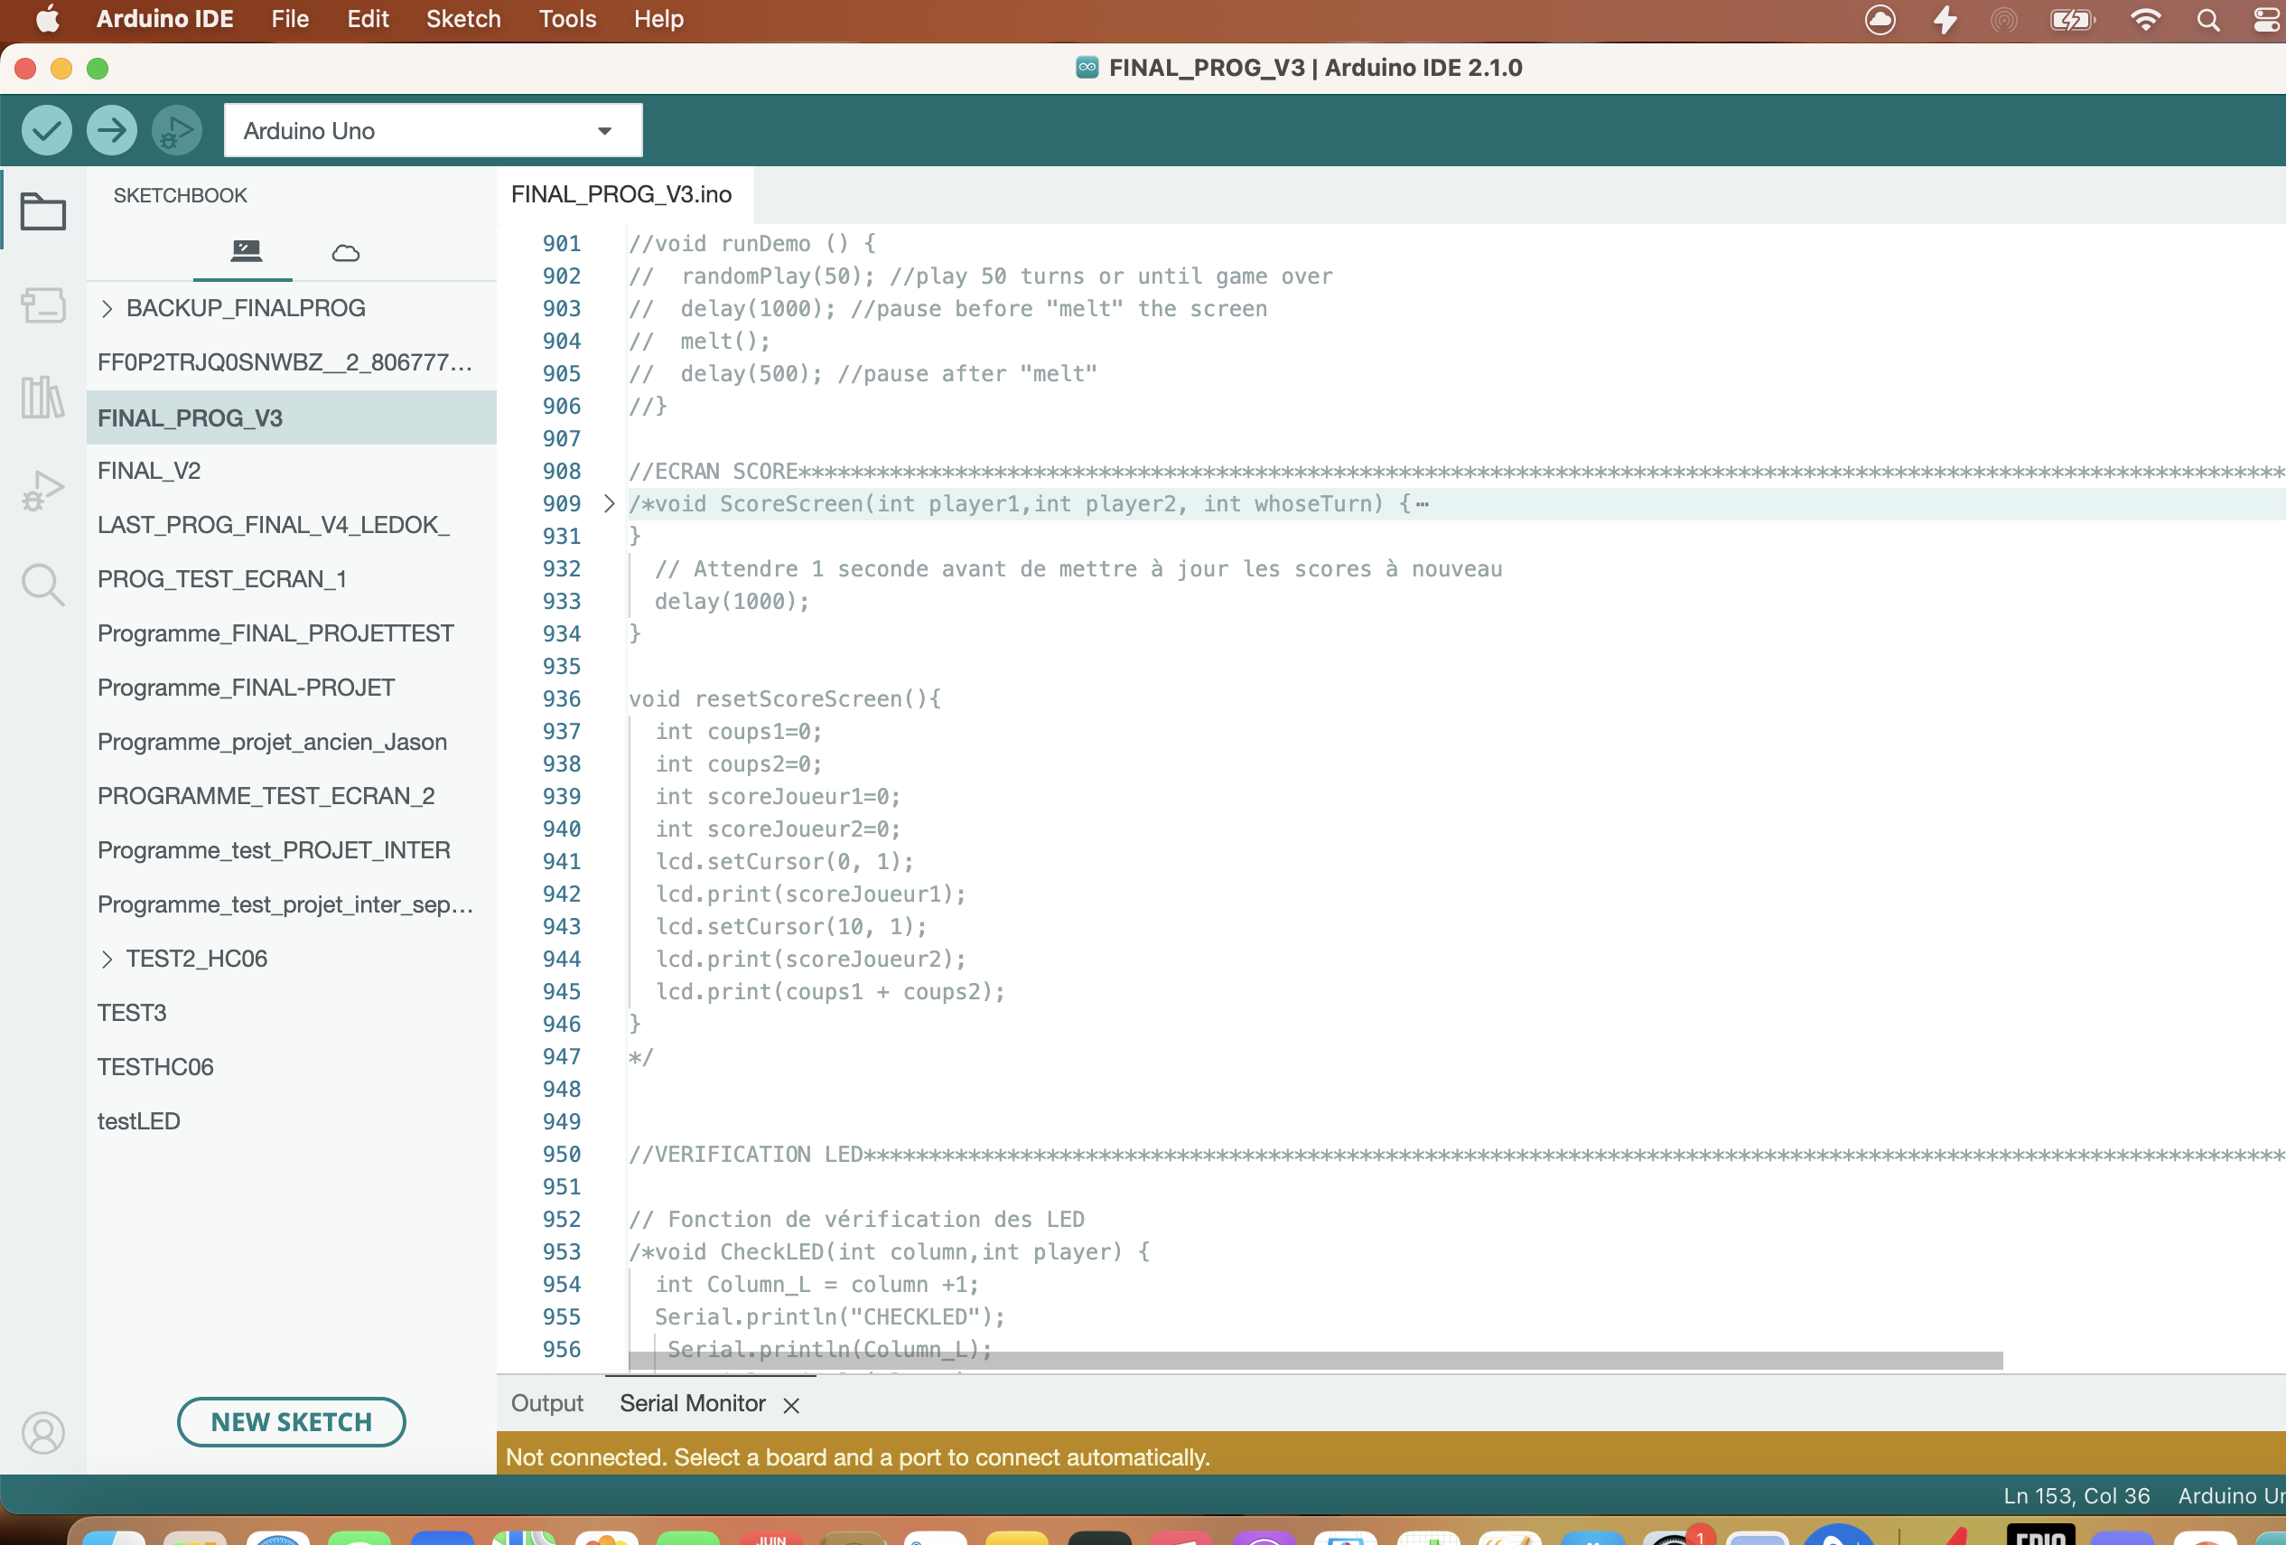
About the code : (the screen→ didn’t work→ in the main code)

Slide 16
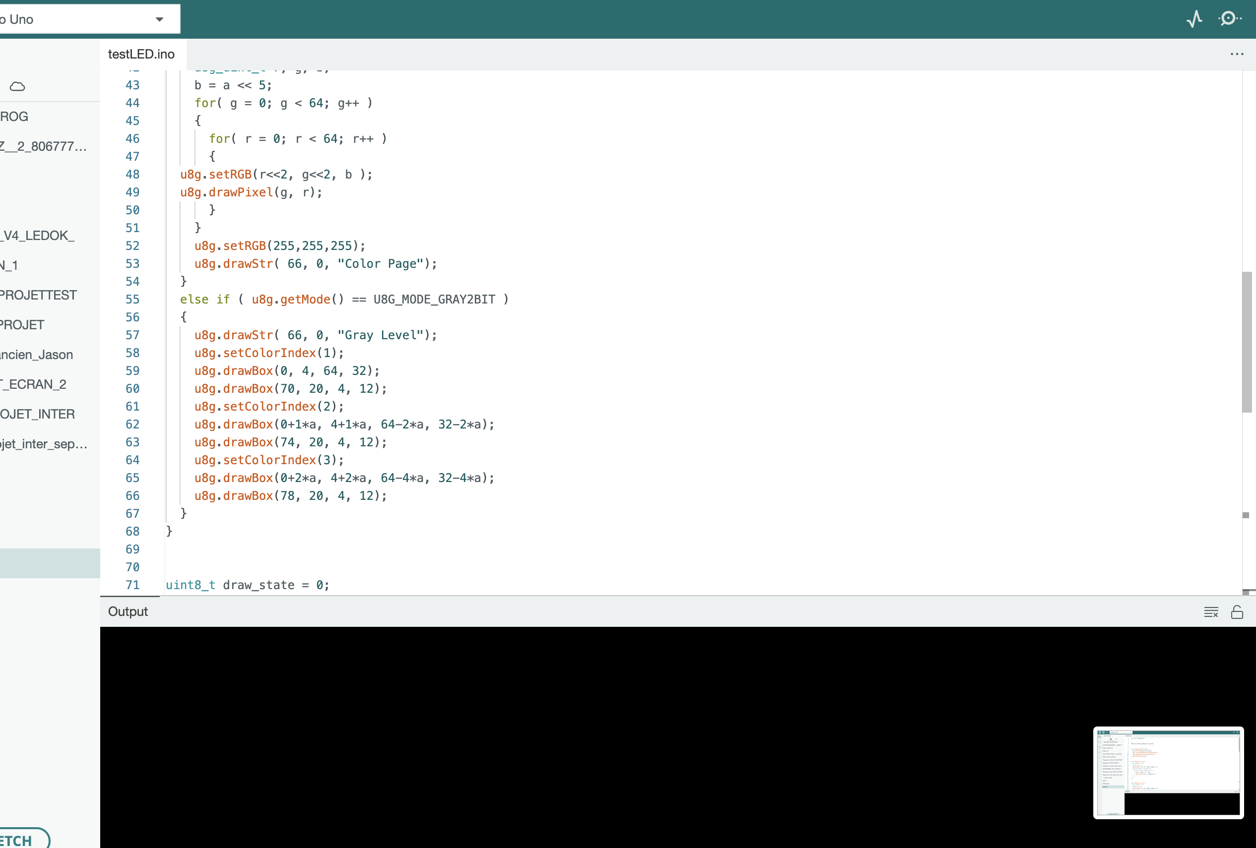
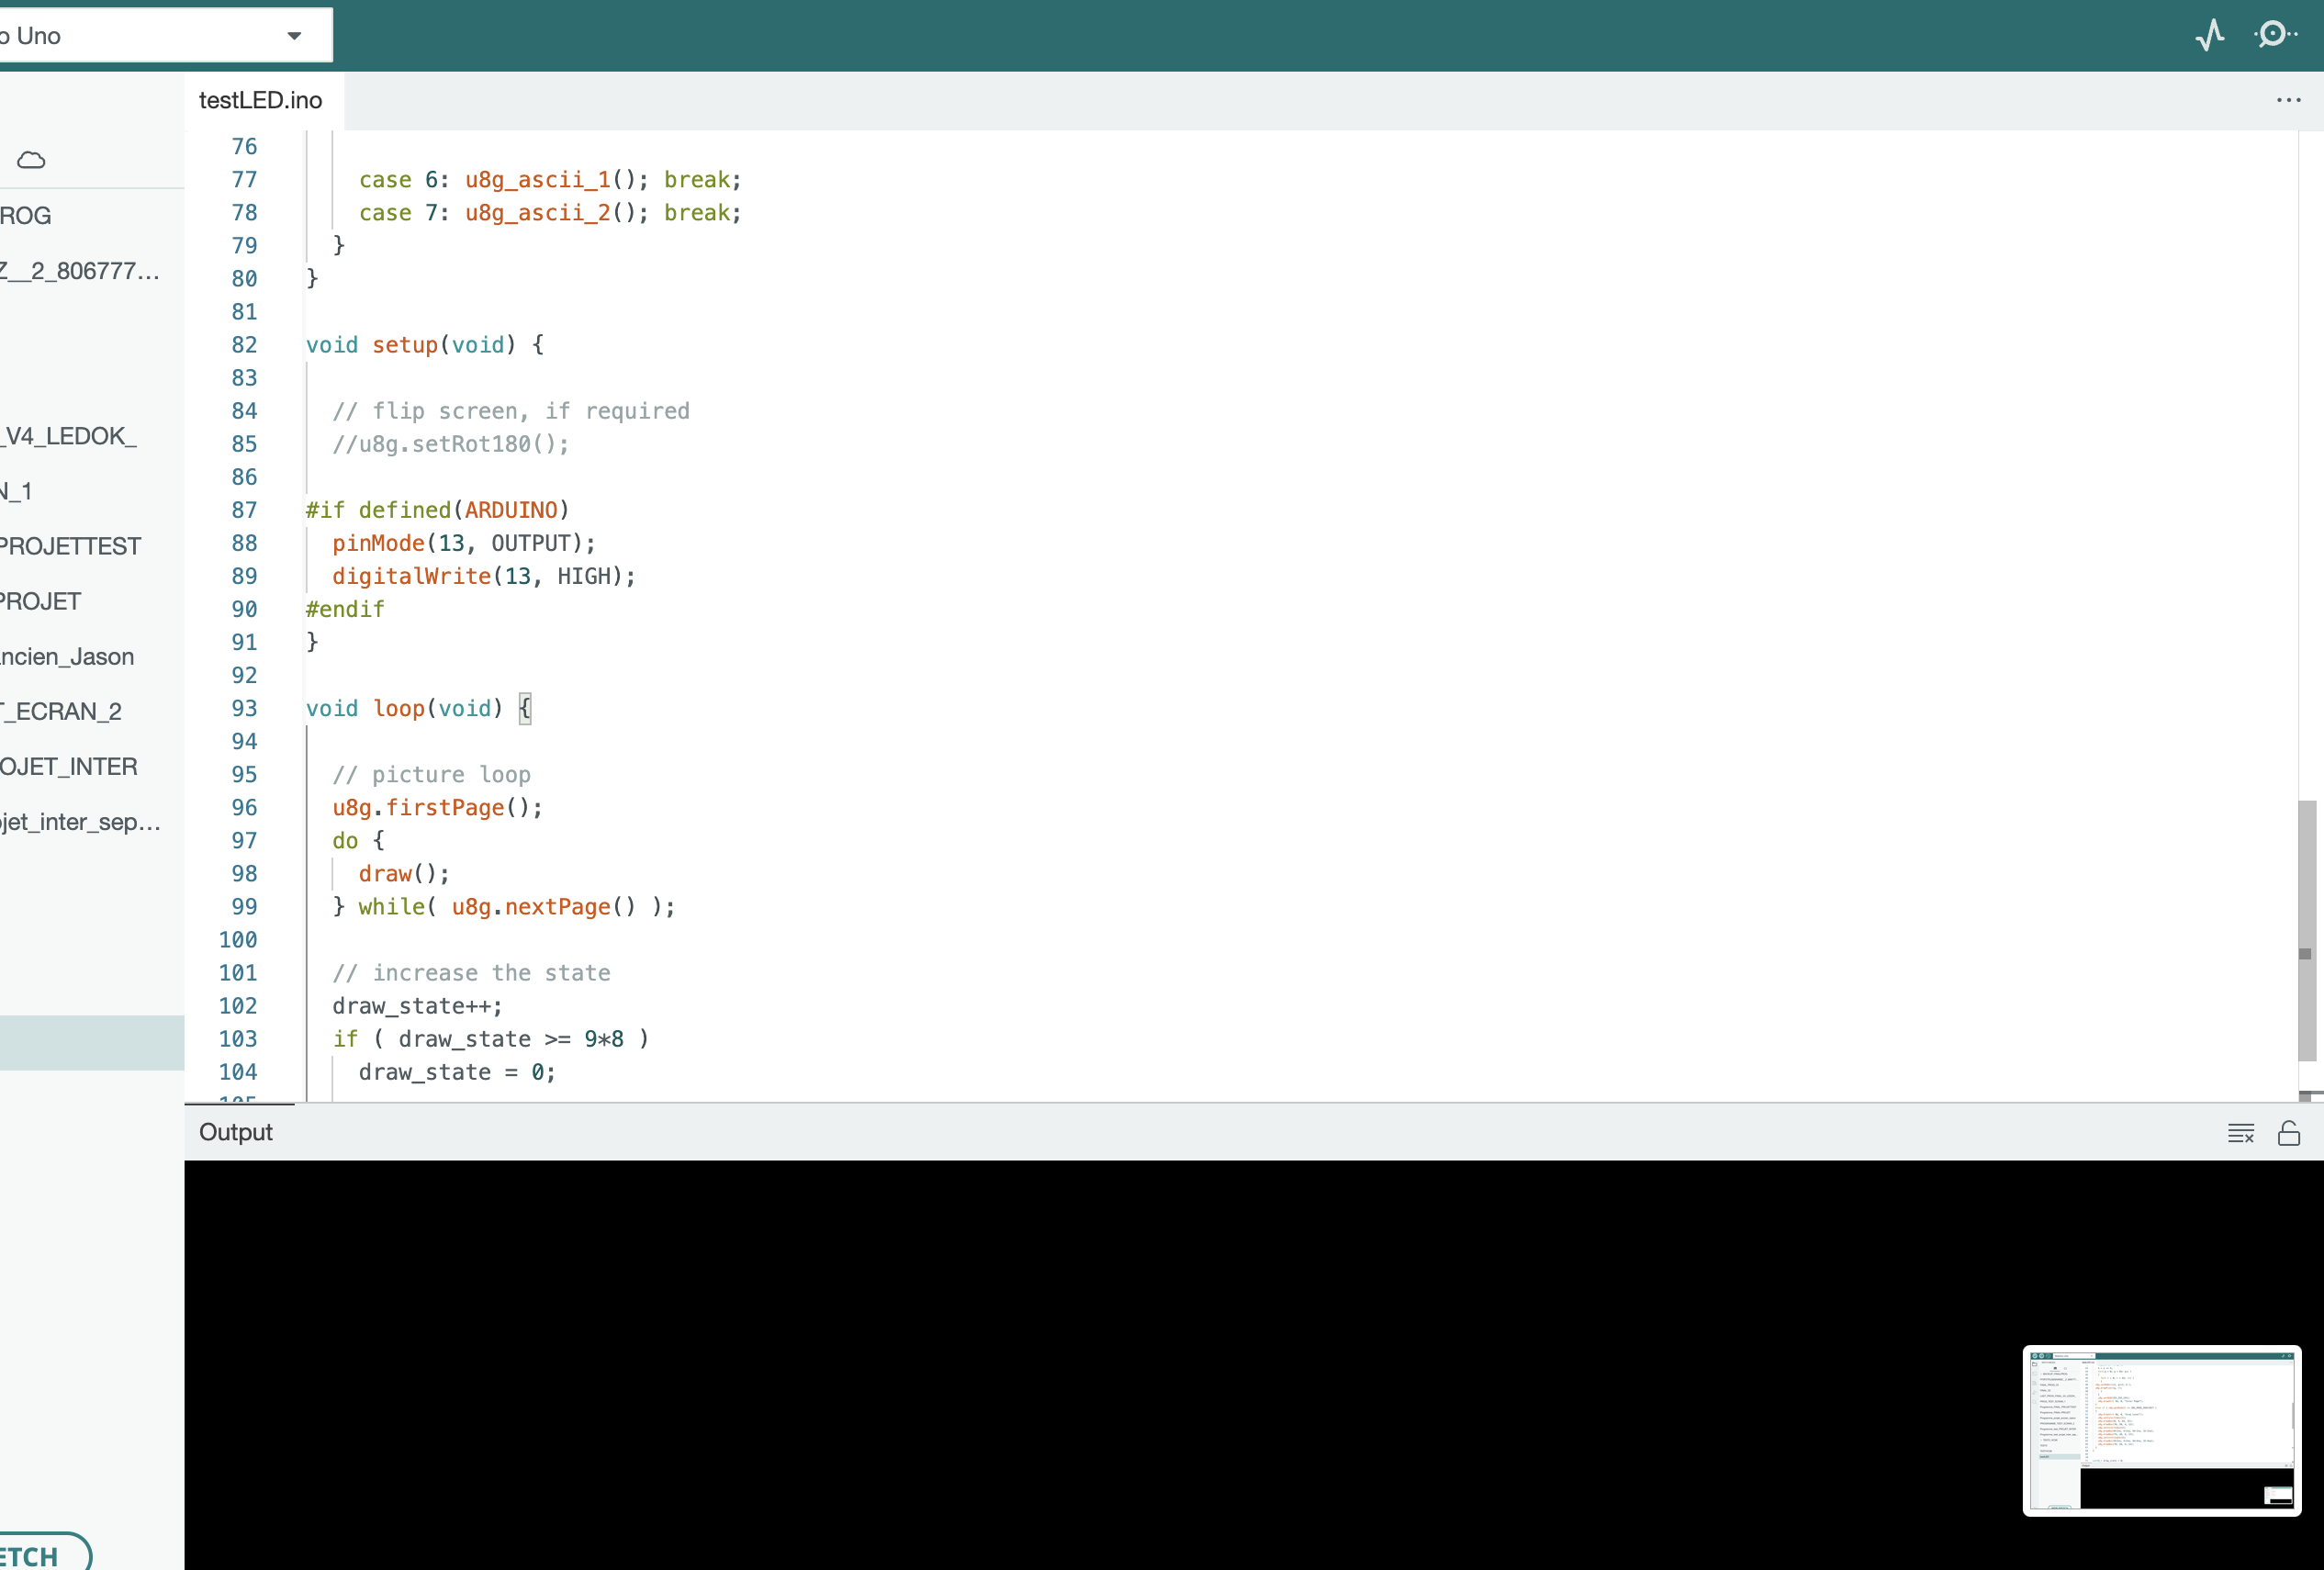
About the code : (the screen→ didn’t work→ in the main code)

Slide 17
What we learned
Improved in the programming of the code

