Slide 1
Lil’ Buddy 2N3904/2N3906 Power Amplifier
John Guy

Slide 2
INTRODUCTION
I had seen recent efforts to use parallel 2N3904 and 2N3906 transistors to make a power amplifier. This is my take on this exercise.

Slide 3
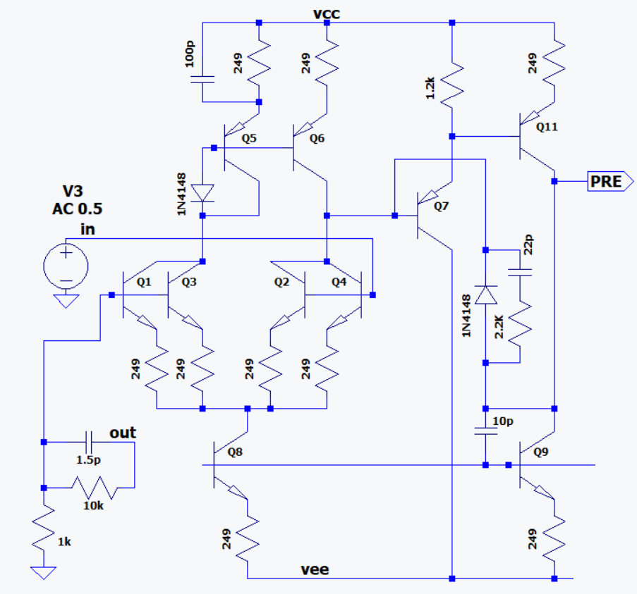
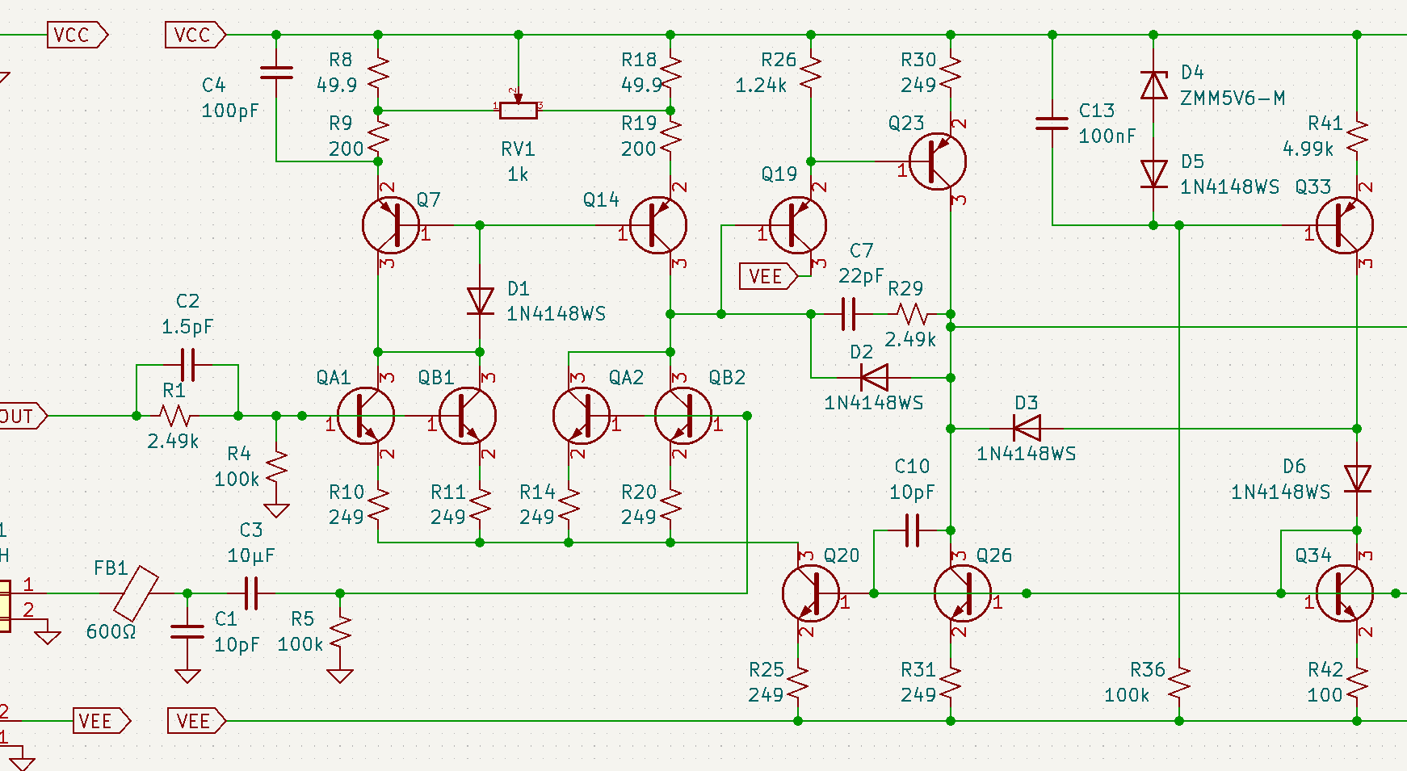
PREAMPLIFIER
Modeled after NJM2068, but with NPN inputs
Q8 and Q9 run at 500µA
Q1-Q4 are a cross coupled quad for lower noise and resistance to thermal gradient
Recent addition is a second Baker clamp to improve clipping performance

Slide 4
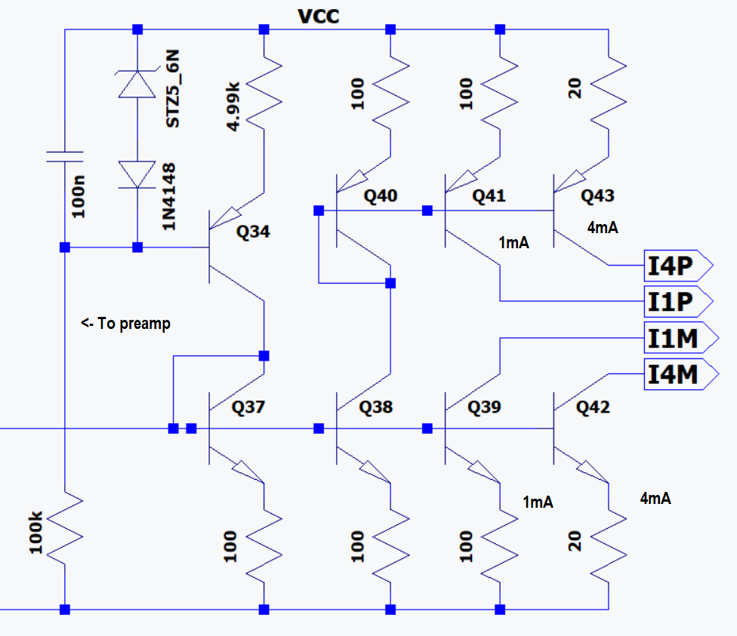
BIAS
A 5.6V Zener with a nominal 0mV/°C tempco has a diode in series to give it -2mV/°C tempco
This matches the tempco of VBE of Q34, thus stable bias over temperature
Q37 runs at 1mA
The preamp section runs at 500µA per leg
The output section has ±1mA and ±4mA bias inputs.

Slide 5
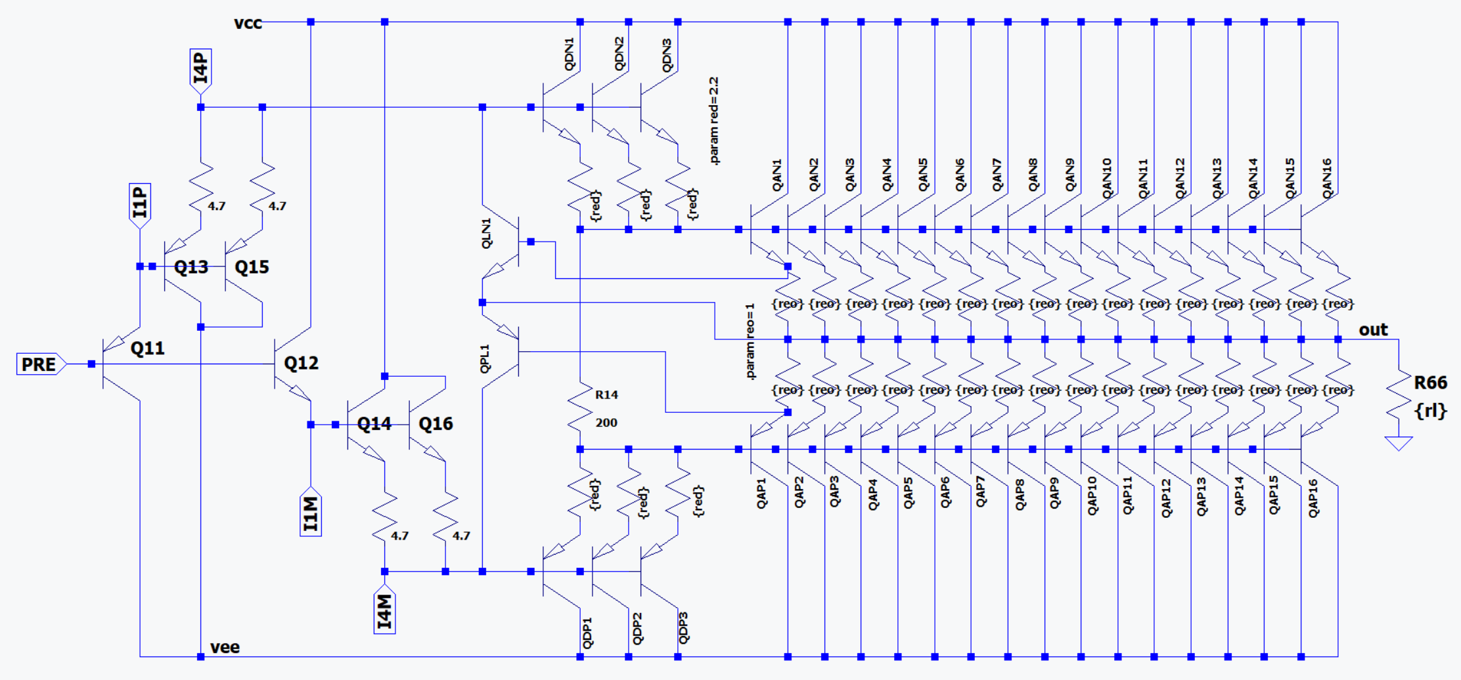
OUTPUT
A complementary Darlington emitter follower input stage is followed by a complementary emitter follower output stage.
R15, 200Ω as shown, will be hand trimmed from 150Ω to 250Ω to establish bias on the ±12V supplies at 35mA with no load and input grounded.
Output current limit is ±11A, or about 700mA per transistor
At 3.7W_{RMS} output power the peak power in each output transistor is 278mW, with an average power of 113mW

Slide 6
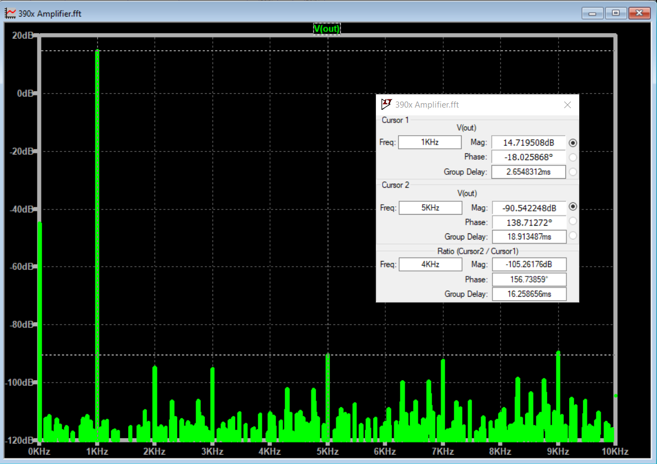
thd
Vin = 1.4V_{PP} at 1kHz
POUT = 3.7W_{RMS} into 4Ω

Slide 7
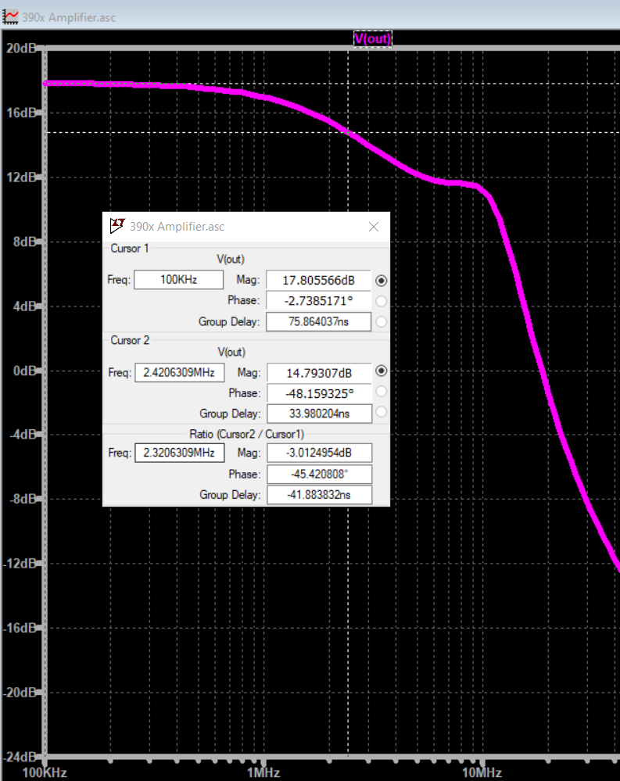
BANDWIDTH
Vin = 0.707RMS
POUT = 3.7W_{RMS} into 8Ω
BW = 2.3MHz

Slide 8
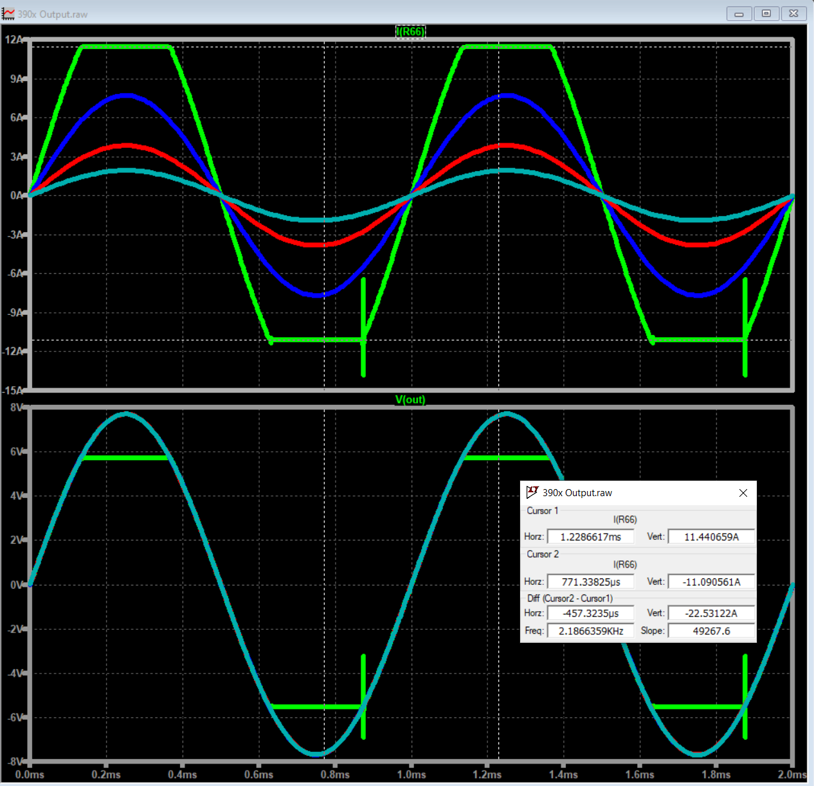
Current Limit
Current limit is about ±11A, suitable for 1Ω load at ±12V single ended, or 2Ω BTL.

Slide 9
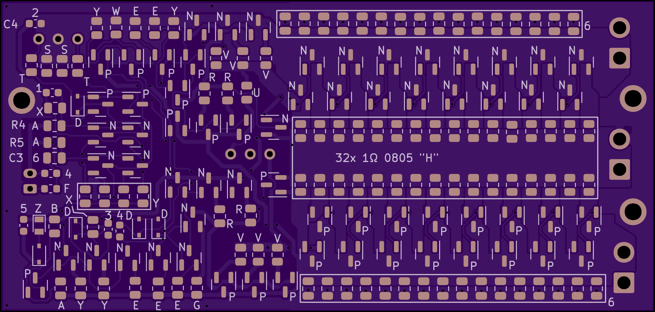
PCB TOP
85x40.5mm
3 mounting holes
This surface will be attached to heat sink via compliant thermal interface material
100% SMT components
All components have BOM designator, decoded on other sideof PCB

Slide 10
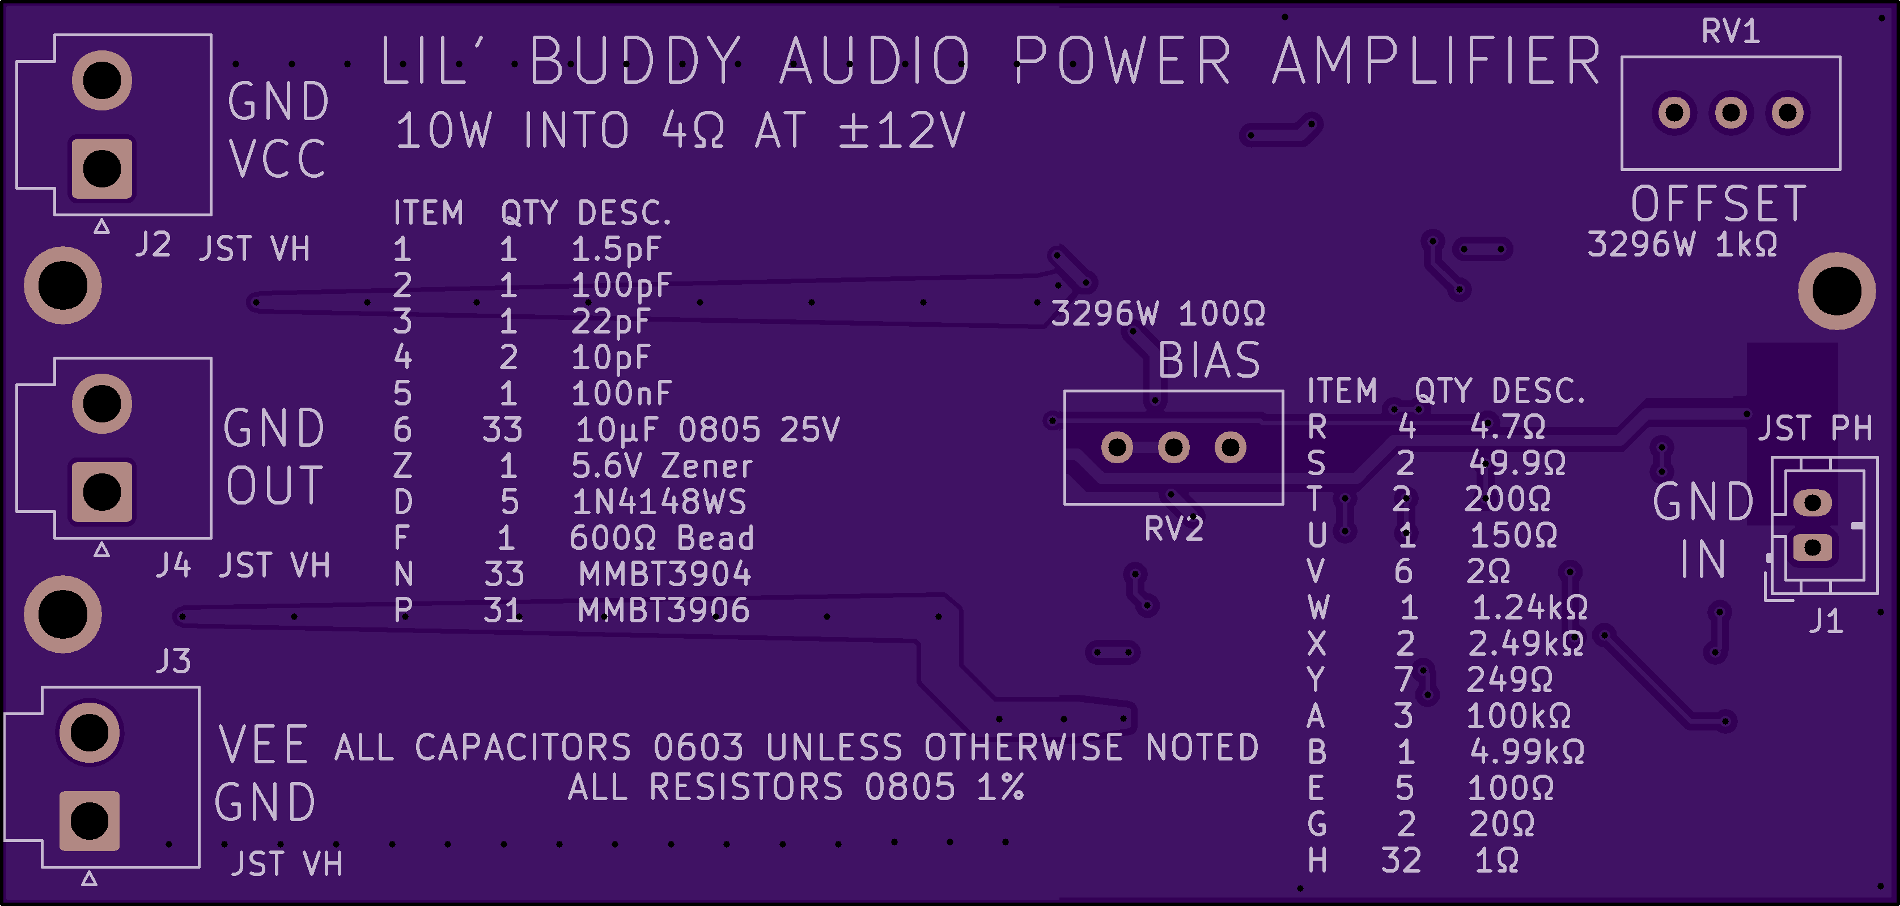
PCB BOTTOM
85x40.5mm
3 mounting holes
This surface will be face up when PCB is attached to heatsink
6 through hole components on this side
BIAS potentiometer is adjusted for 35mA supply current at no load
OFFSET potentiometer is adjusted for 0VDC offset with no load, no input.

Slide 11
THANK YOU

