Slide 1
Turing Machine Game Cards
CC BY-NC-SA Jeroen Brinkman

Slide 2
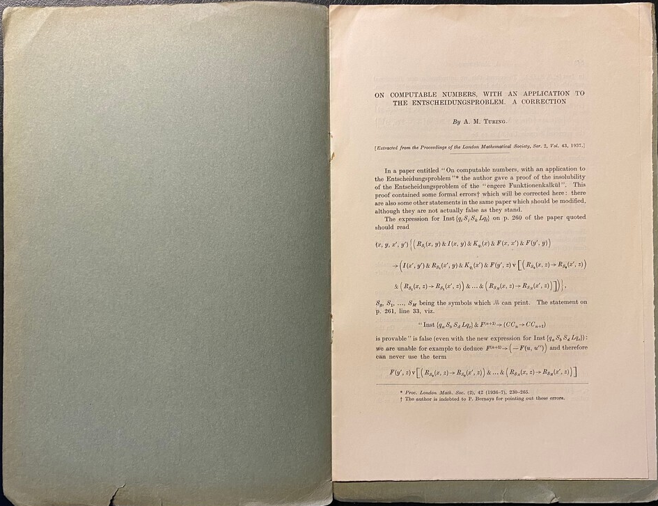
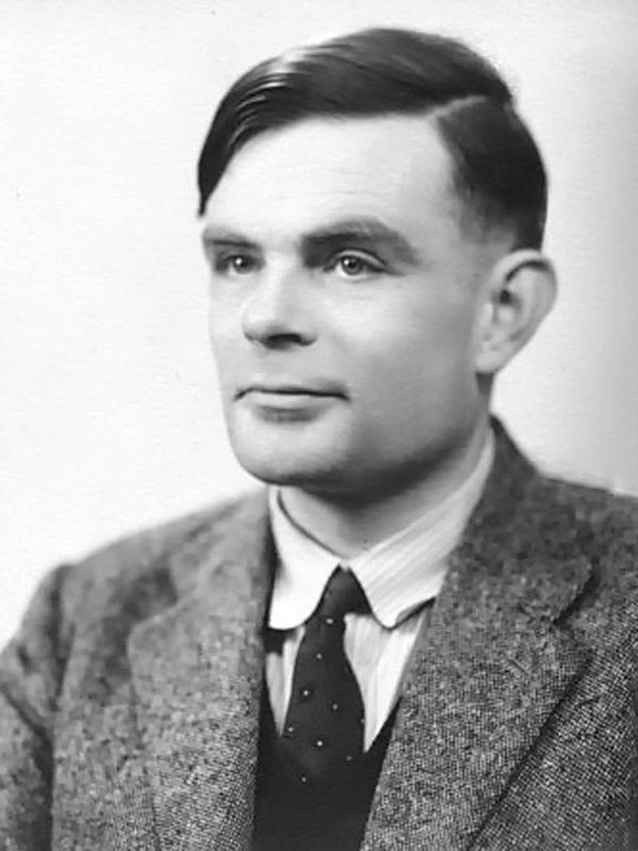
1936
Alan
Turing
In 1936 Alan Turing wrote the article On computable numbers, with an application to the Entscheidungsproblem.
In this article he introduced a theoretical device known as the "Turing machine." This wasn't a physical machine, but a mathematical model of computation.

Slide 3
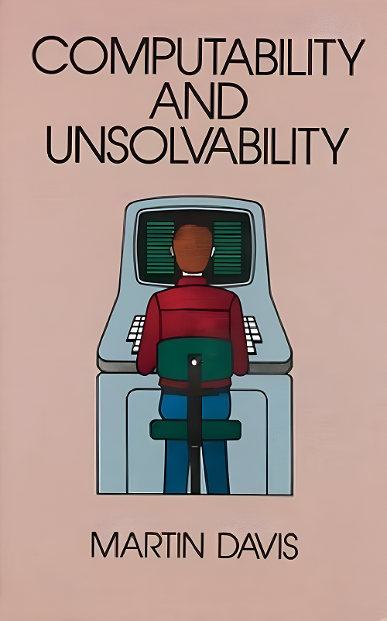
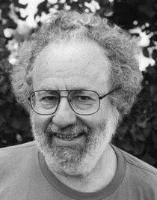
1958
Martin
Davis
In 1958 Martin Davis introduced the Halting Problem in its book Computability and Unsolvability. Martin Davis built directly on Turing's foundations by giving a precise formulation of what we now call the Halting Problem. Davis formalized it as a specific decision problem: "Given a Turing machine and an input, will the machine halt?".

Slide 4
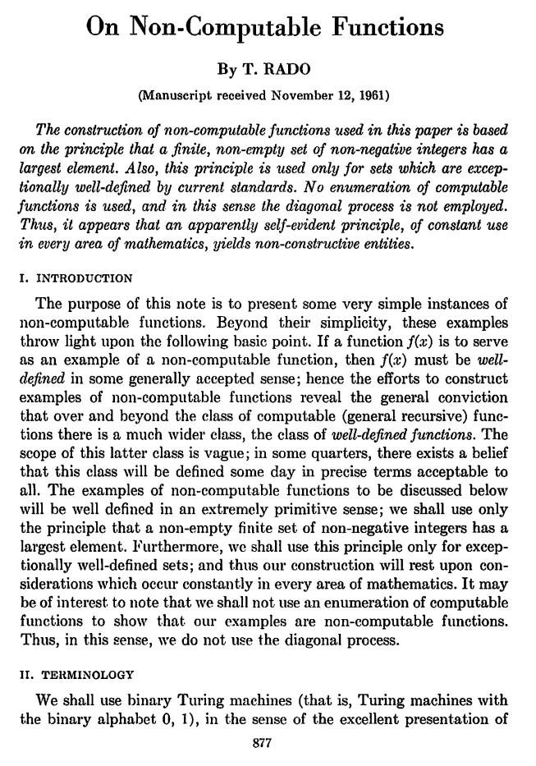
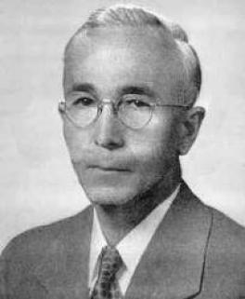
1961
Tibor
Radó
In 1961 Tibor Radó introduced the Busy Beaver (BB) problem in his article On Non-Computable Functions. Tibor Radó's introduction of the Busy Beaver problem created a fascinating connection to both earlier works. The Busy Beaver function BB(n) asks: "What is the maximum number of steps a halting n-state (n-cards) Turing machine can take, before halting?“.

Slide 5
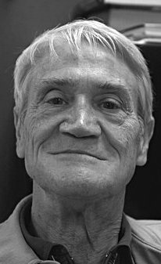
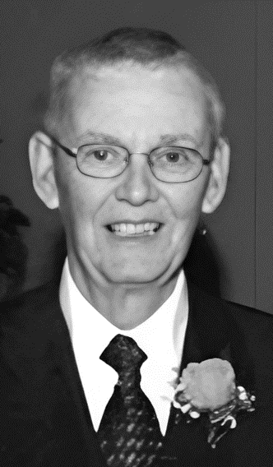
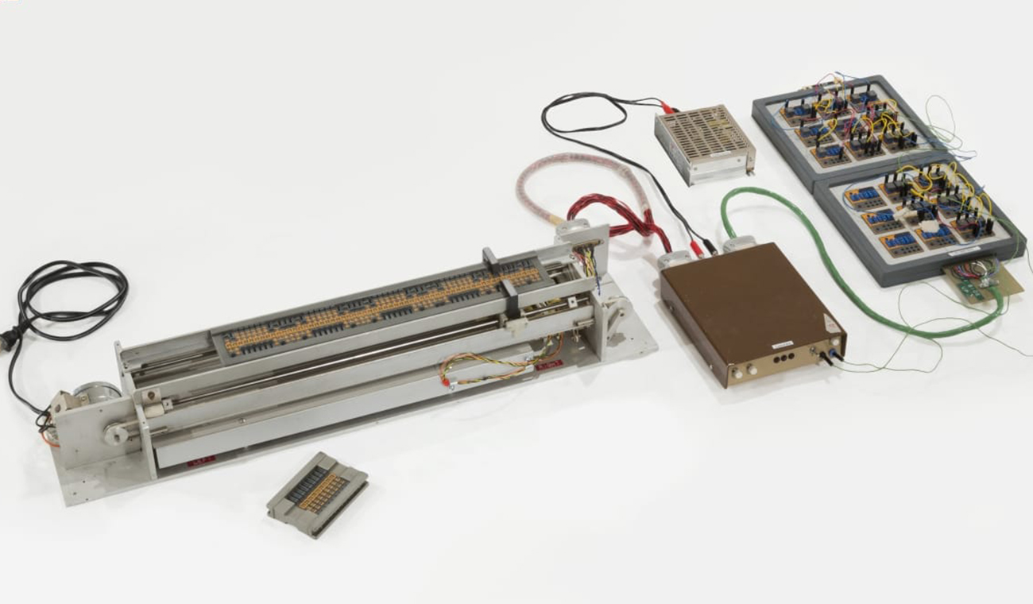
1972
Wesley Clark Bob Arnzen
In 1972 the first physical version
of Turing's conceptual machine
was made, the TOWTMTEWP:
The Only Working Turing Machine There Ever Was Probably.
of computation.

Slide 6
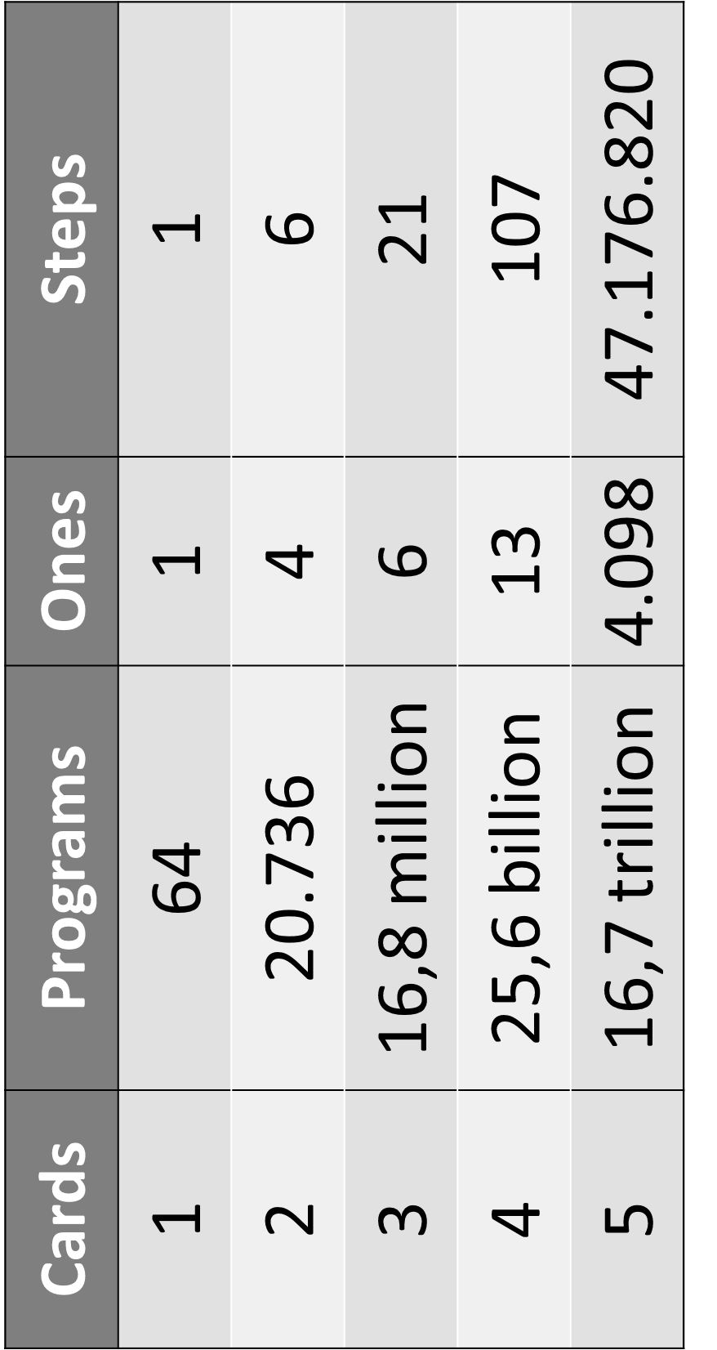
Busy beaver problem: Which Turing machine program runs the longest before stopping.

Slide 7
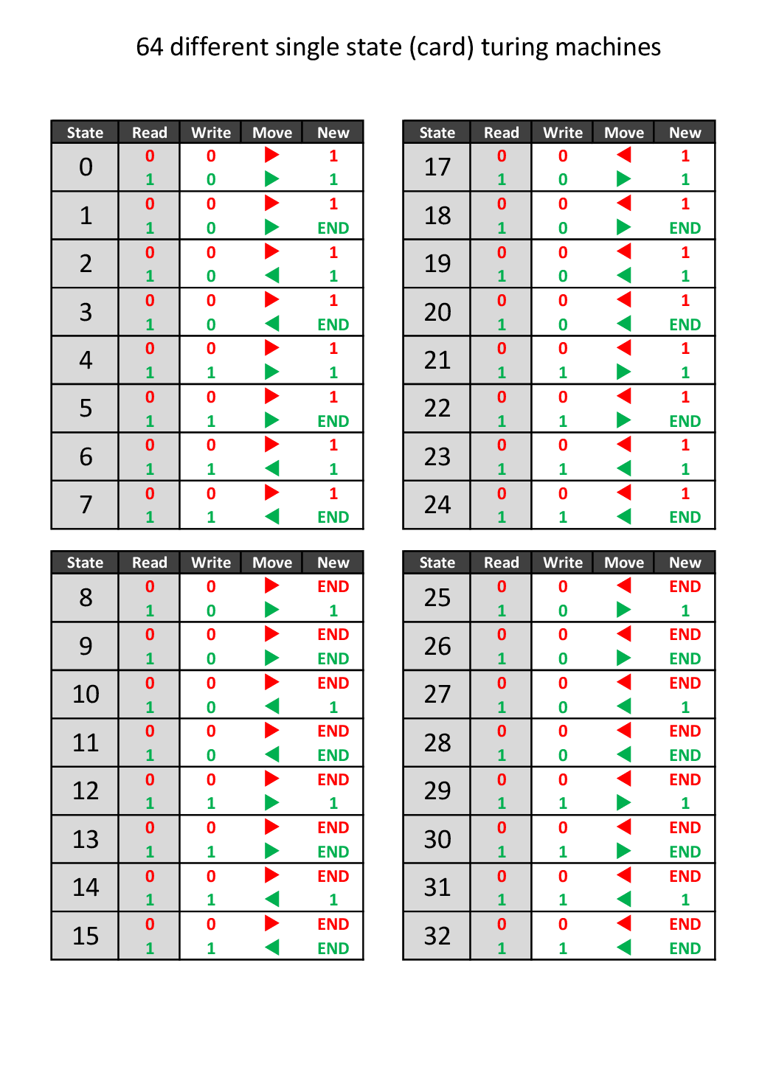
Busy beaver 1
All possibilities1/2

Slide 8
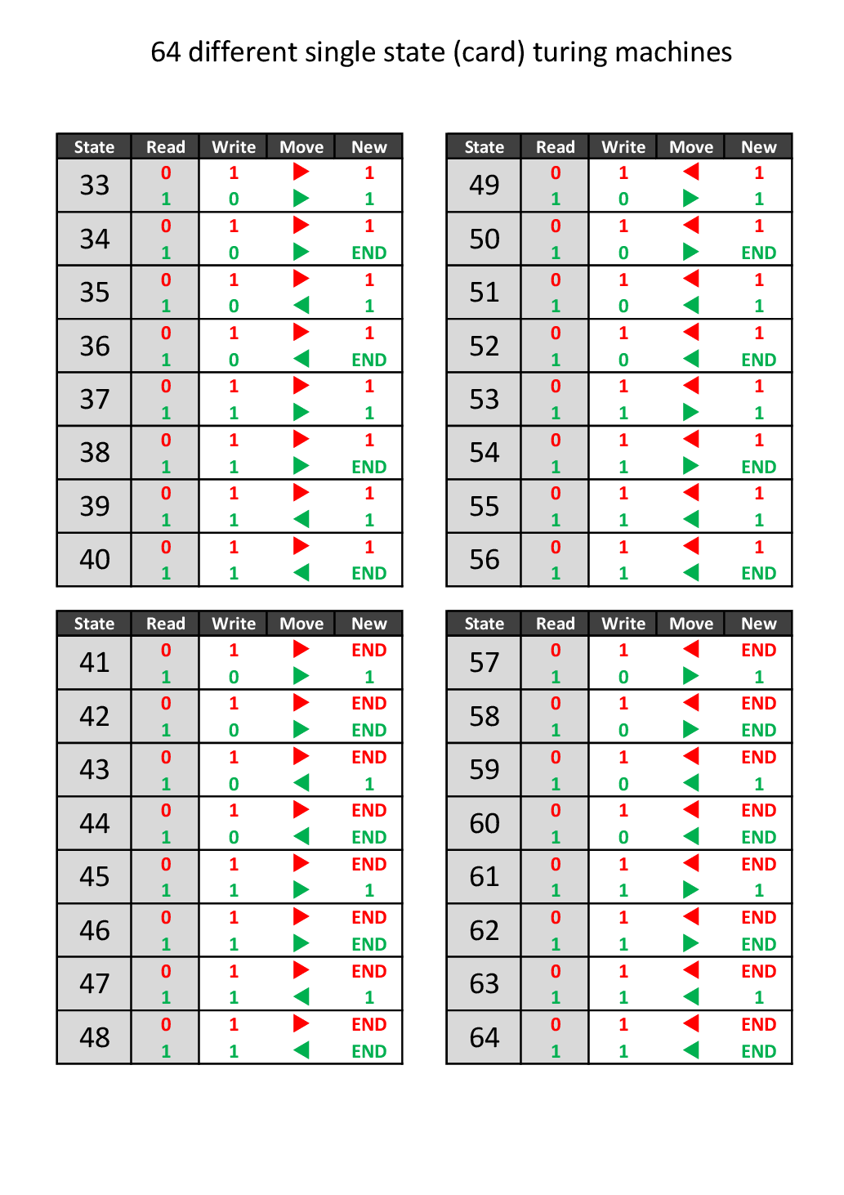
Busy beaver 1
All possibilities 2/2

Slide 9
Busy beaver 1
writes 1x 1 in one step
Card ⓪
0
EN
0
Take the 0 away and
place a 1 on the tape,
leave the arrow in place
and stop.
Place a 1 on the tape,
leave the arrow in place
and stop.
1
Leave the 1 in place,
leave the arrow in place
and stop.

Slide 10
Busy beaver 2
writes 4x 1 in 6 steps
Card ⓪
0
EN
0
Take the 0 away and
place a 1 on the tape,
move the arrow to the right
and take card ①.
Place a 1 on the tape,
move the arrow to the right
and take card ①.
1
Leave the 1 in place,
move the arrow to the left
and take card ①.

Slide 11
Busy beaver 2
writes 4x 1 in 6 steps
Card ①
EN
0
Take the 0 away and
place a 1 on the tape,
move the arrow to the left
and take card ⓪.
Place a 1 on the tape,
move the arrow to the left
and take card ⓪.
1
Leave the 1 in place,
leave the arrow in place
and stop.

Slide 12
Busy beaver 3
writes 6x 1 in 21 steps
Card ⓪
0
EN
0
Take the 0 away and
place a 1 on the tape,
move the arrow to the right
and take card ①.
Place a 1 on the tape,
move the arrow to the right
and take card ①.
1
Leave the 1 in place,
leave the arrow in place
and stop.

Slide 13
Busy beaver 3
writes 6x 1 in 21 steps
Card ①
EN
0
Leave the 0 in place,
move the arrow to the right
and take card ②.
Place a 0 on the tape,
move the arrow to the right
and take card ②.
1
Leave the 1 in place,
move the arrow to the right
and keep card ①.

Slide 14
Busy beaver 3
writes 6x 1 in 21 steps
Card ②
EN
0
Take the 0 away and
place a 1 on the tape,
move the arrow to the left
and keep card ②.
Place a 1 on the tape,
move the arrow to the left
and keep card ②.
1
Leave the 1 in place,
move the arrow to the left
and take card ⓪.

Slide 15
Busy beaver 4
writes 13x 1 in 107 steps
Card ⓪
0
EN
0
Take the 0 away and
place a 1 on the tape,
move the arrow to the right
and take card ①.
Place a 1 on the tape,
move the arrow to the right
and take card ①.
1
Leave the 1 in place,
move the arrow to the left
and take card ①.

Slide 16
Busy beaver 4
writes 13x 1 in 107 steps
Card ①
EN
0
Take the 0 away and
place a 1 on the tape,
move the arrow to the left
and take card ⓪.
Place a 1 on the tape,
move the arrow to the left
and take card ⓪.
1
Take the 1 away and
place a 0 on the tape,
move the arrow to the left
and take card ②.

Slide 17
Busy beaver 4
writes 13x 1 in 107 steps
Card ②
EN
0
Take the 0 away and
place a 1 on the tape,
leave the arrow in place
and stop.
Place a 1 on the tape,
leave the arrow in place
and stop.
1
Leave the 1 in place,
move the arrow to the left
and take card ③.

Slide 18
Busy beaver 4
writes 13x 1 in 107 steps
Card ③
EN
0
Take the 0 away and
place a 1 on the tape,
move the arrow to the right
and keep card ③.
Place a 1 on the tape,
move the arrow to the right
and keep card ③.
1
Take the 1 away and
place a 0 on the tape,
move the arrow to the right
and take card ⓪.

Slide 19
Binary counter
Card ⓪
0
EN
0
Take the 0 away and
place a 1 on the tape,
move the arrow to the right
and take card ①.
Place a 1 on the tape,
move the arrow to the right
and take card ①.
1
Take the 1 away and
place a 0 on the tape,
move the arrow to the left
and keep card ⓪.

Slide 20
Binary counter
Card ①
EN
0
Leave the 0 in place,
move the arrow to the right
and keep card ①.
Move the arrow to the left
and take card ⓪.
1
Leave the 1 in place,
move the arrow to the right
and keep card ①.

Slide 21
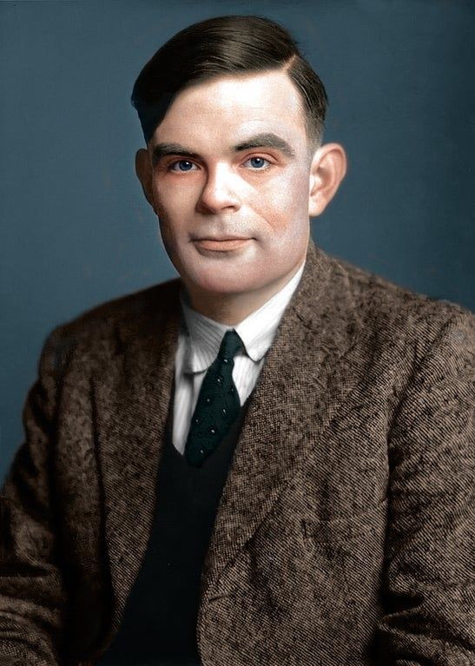

Back side

Slide 22
EN

Slide 23
EN

Slide 24
These cards can be ordered on: https://www.kwartetcadeau.nl
Please contact them first for international shipping rates.
Cards | Programs | Ones | Steps
1 | 64 | 1 | 1
2 | 20.736 | 4 | 6
3 | 16,8 million | 6 | 21
4 | 25,6 billion | 13 | 107
5 | 16,7 trillion | 4.098 | 47.176.820

