Slide 1
SAFERanger Thermal vision and Gas sensor based rover to detect abnormal Temperature and Gas Leaks
VARUN. S

Slide 2
PROBLEM
Many industrial applications involve checking for flaws in places where worker cannot act due to immense heat, toxic gases & limited space.
Hence it is essential to monitor such parameters in high value engineering sectors such as electrical substations and chemical sectors such as oil and gas power plant in order to protect human health and environment, and in certain cases preventing accidents.
Even though tools exists they at bulky, heavy and highly unyielding which consumes a lot of time and energy during an emergency.
Also, there is a lack of thermal camera in our country and the existing ones are a bit costly (1000$).
In case, a fire accident occurs it would be very difficult for the fire fighters to locate the injured people in the plant.

Slide 3
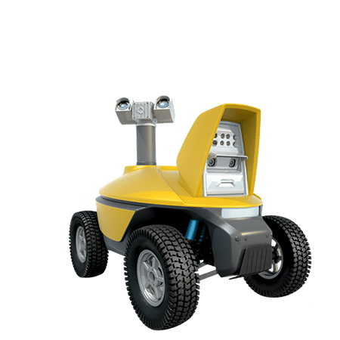
EXISTING TOOLS
1. DAQRI Smart Helmet
2. Electrical Substation Inspection Robot
Pros:
Augmented Reality based Thermal Vision
Provides guided work information
Wearable
Cons:
Expensive in comparison to other solutions
Difficult to reach critical areas
Pros:
360° pan-and-tilt positioner
Autonomous Vehicle Control System
Cons:
Detection of gas is not possible (Requires additional system )
Large size ( 54''x32''x62'' )

Slide 4
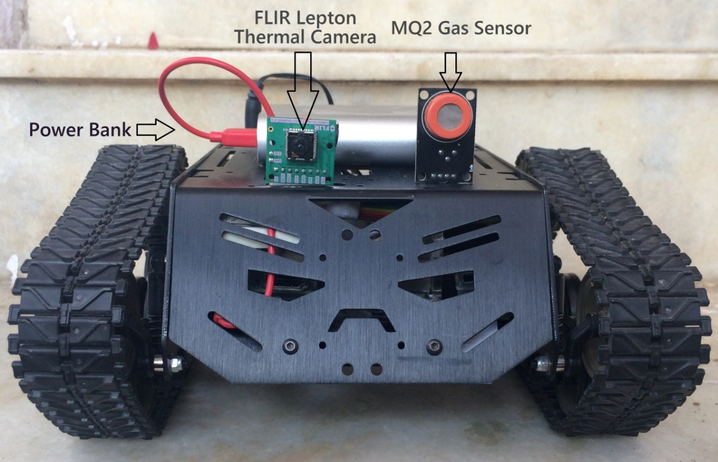
PROPOSED SOLUTION
A semi-autonomous miniature multispectral sensor equipped diagnostic tank based rover which can monitor heating of valves using a thermal camera and monitor gas leaks.
If an abnormal temperature is detected, the IR Image Processing system identifies an inappropriate heat which in turn alerts the operator via Wi-Fi, along with the thermal image.
It will also be helpful in navigation through the building incase of active fire & smoke. The thermal data can be remotely seen by the control center through VNC and look for survivors before taking the risky steps of locating the workers in the building.

Slide 5
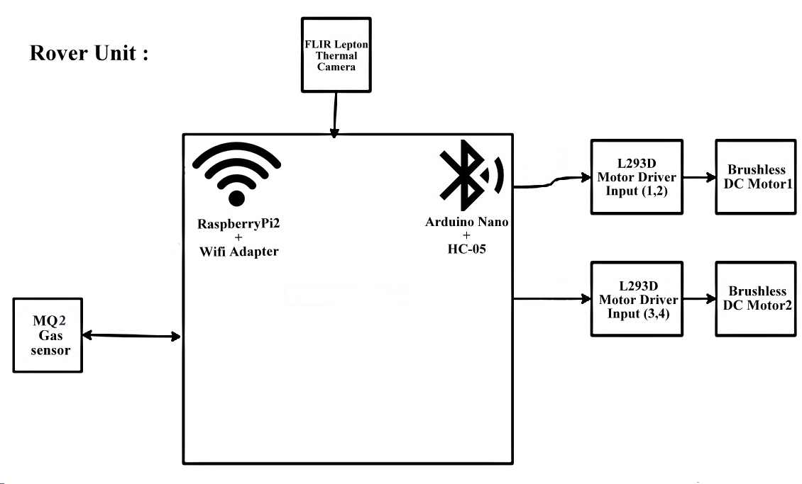
Block DIAGRAM :

Slide 6
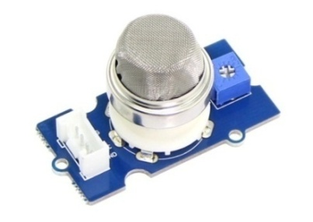
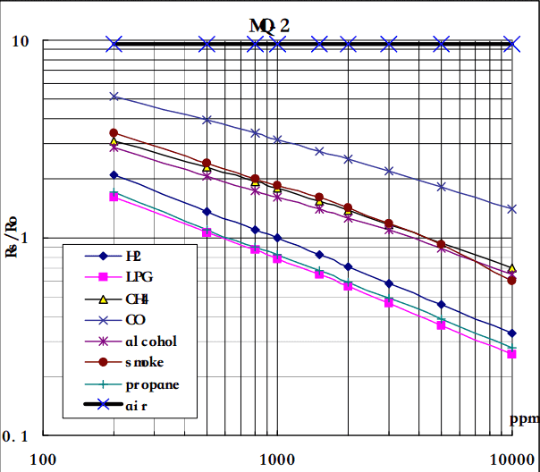
PRODUCT DIFFERENTIATION
MEMS based accurate yet low cost gas sensors (MQ2)
which we can use to monitor various dangerous compounds.
(H2, LPG, CH4, CO, Alcohol, Smoke or Propane)
Gas Detection – Sensitivity Characteristics

Slide 7
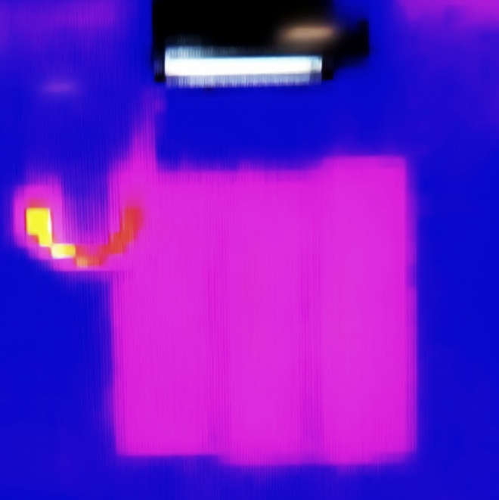
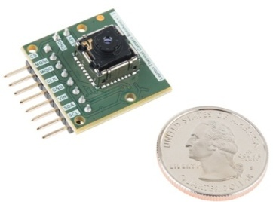
FLIR Lepton Thermal Camera
An FLIR Lepton Thermal Camera is incorporated with the mini rover to visualize the thermal image of the site and share it with the operator.
The rover is controlled by Arduino Nano & HC05 over Bluetooth and the FLIR Lepton is interfaced with Raspberry Pi2
The rover assists the operator in identifying abnormal temperatures and also any leakages using its thermal vision.

Slide 8
Prototype development

Slide 9
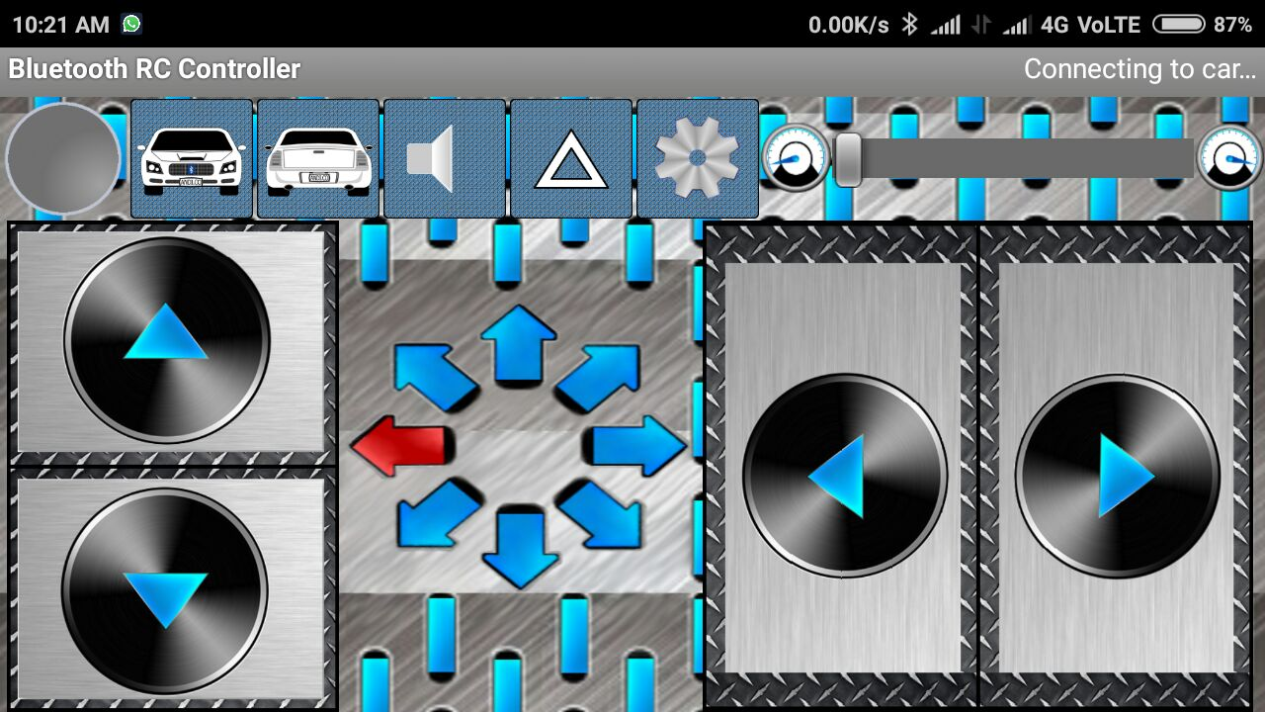
Rover motion control over bluetooth

Slide 10
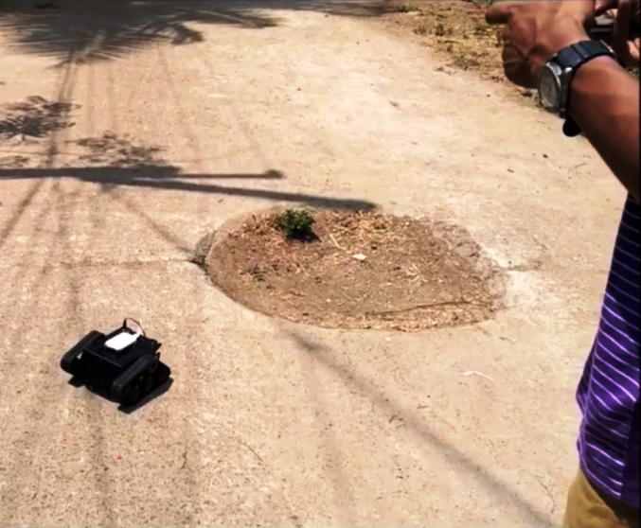
PROTOTYPE TESTING
A drive test was conducted on streets , by controlling the rover over Bluetooth using the Bluetooth RC Controller android application.

Slide 11
Flir thermal imaging
The FLIR thermal camera is interfaced with Raspberry Pi2 Model B

Slide 12
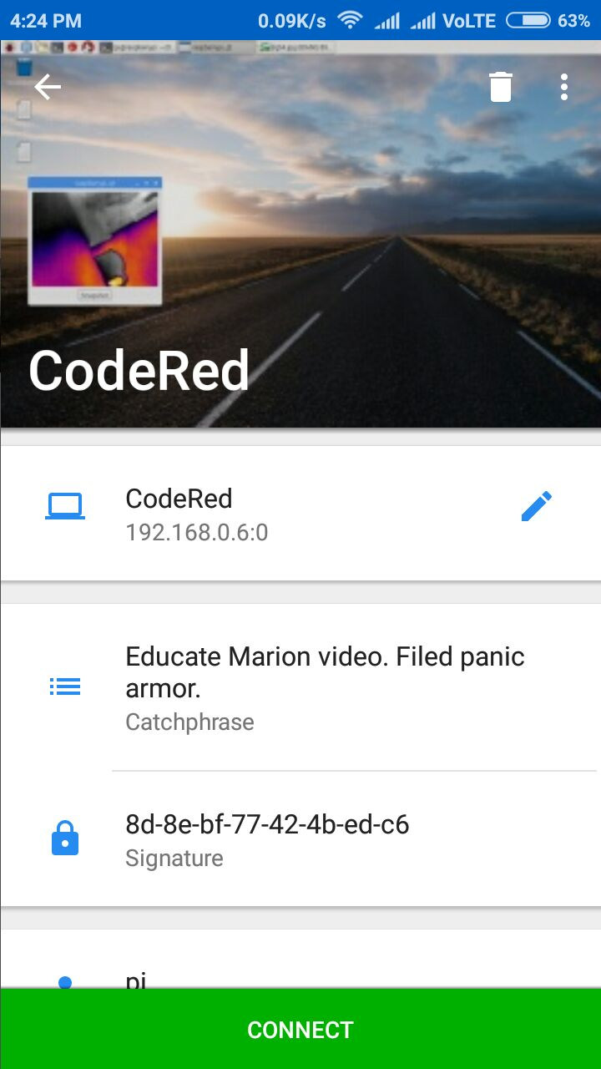
VIDEO STREAMING THROUGH VNC
The video is streamed through the VNC application. The thermal image of the site is continuously , externally monitored.

Slide 13
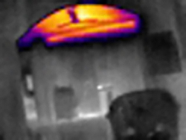
Output through vnc APPLICATION
The thermal image corresponding to the site is thus monitored continuously from the output obtained through the VNC
Application.

Slide 14
THERMAL IMAGE SHOWING TEMPERATURE VARIATION

Slide 15
Analysis of the thermal image
Thermal cameras do not actually detect color as the infrared range they operate in is way beyond the range of the visible light, instead they record thermal information and that thermal information is then displayed in a way that we can visually interpret it in the form of an image. To make it easier for people to easily analyze a thermal image visually it is represented using a false colors representing the difference in temperature and the most commonly used color palette where white is for the coldest areas, then blue and purple for slightly hotter areas, hottest is usually red, orange and yellow and then going to white for the coldest parts. In thermal images using false colors to represent the difference in temperature there is no specific temperature representing specific color from the color palette used, the colors are just there to make it easy to distinguish the coldest from the hottest parts.

Slide 16
MARKET ANALYSIS
Government Firefighter groups
Government will form the backbone of distribution for these helmets. By working and implementing in real threat situation, we can create large impact and thereby reducing loss of lives and property.
Retail
Process Control Industries involving gases and fuels involves leakage during testing and servicing. It also requires highly experienced employers for handling such work. With our solution, even a rookie employer can handle the situation easily.
Companies
Construction company employees who actively wears the worker helmet would be in a position to give a wide reach for the device as there involves lots of fatalities and injuries due to fall from the site.

Slide 17
PRIMARY USERS
First Responders
First responders may now use safer and more effective methods of controlling the active fire and also guide his teammates resulting in better cooperation.
Control Report
The Control Centre can directly monitor upon the firefighters and can guide them about the situation if it goes hostile. They can also alert the nearby firefighter if one of his teammates is in danger and requires backup.

Slide 18
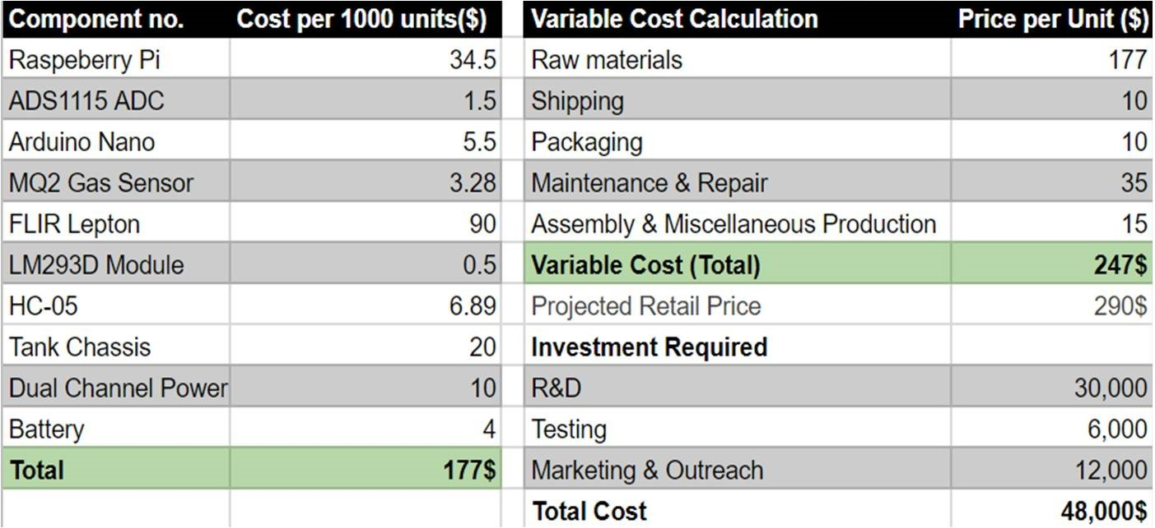

Slide 19
THANK YOU

